Slide 1
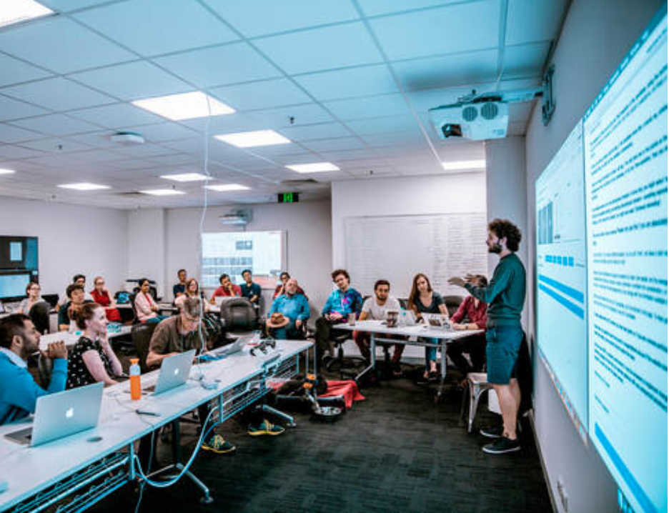
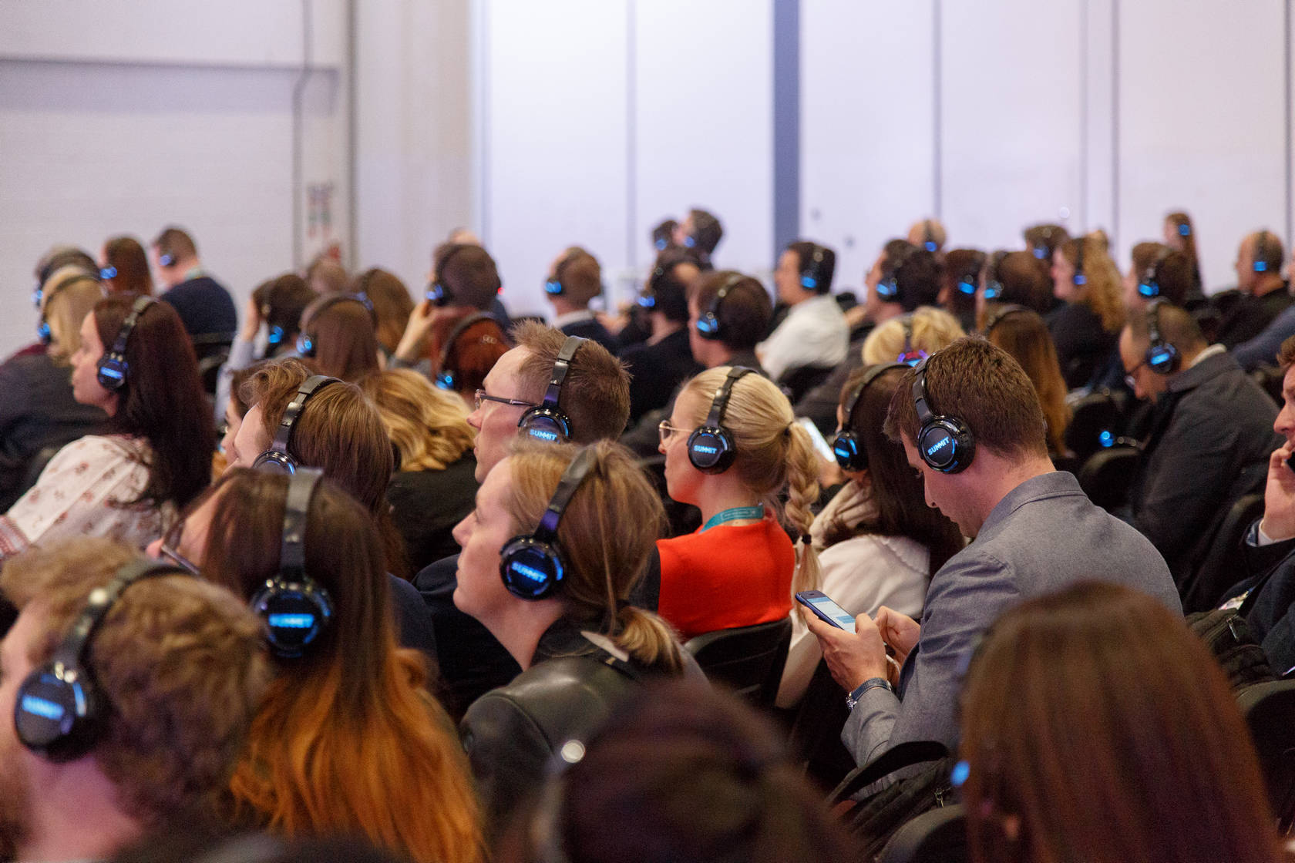
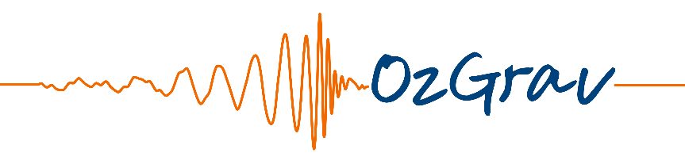



Access to plots, charts, and graphics using sonification
Jeff Cooke, Garry Foran (Swinburne University)
Jeff Hannam (RMIT University)
ARC Centre of Excellence for
Gravitational Wave Discovery
ARC Centre of Excellence for
All-Sky Astrophysics in 3D

Slide 2
Data sonification – Converting data into sound
For science
- Can be powerful for data analysis
- Faster analysis, crucial verification, enhances discovery
- Adds multi-parameter analysis capability
- Additional capabilities, e.g., low signal-to-noise ratio detection
For the blind, visually-impaired, print disability community
Enhances everyday life with access to data
Can help to understand plots, graphics, and images in real time
- Webpages, print articles, bank statements, purchases, etc.
- Health and medical information, work or public talks, etc.
- Education materials, scientific data, promotes STEM careers, etc.

Slide 3
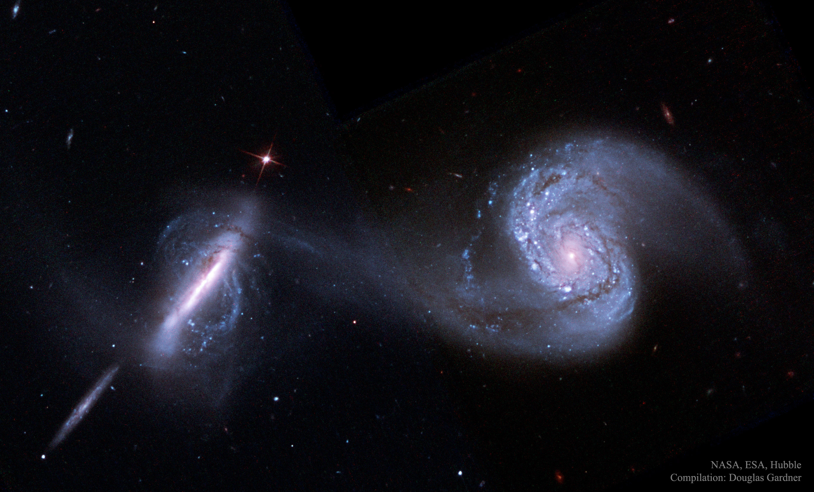
What we do
Galaxies
Distant galaxies in the early Universe –
study their properties and how they evolved to the present day
Cosmic Reionisation – study galaxies that were responsible for ionising the Universe

Slide 4
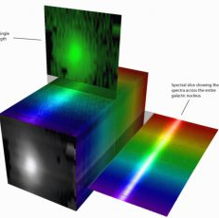
What we do
Galaxies
Distant galaxies in the early Universe –
study their properties and how they evolved to the present day
Cosmic Reionisation – study galaxies that were responsible for ionising the Universe
Sonification
1D spectra, 2D plots, 3D data cubes
Enables many parameters to be analysed in a single tone
- higher-order harmonics expands analysis to 10+ parameters
Verification of low signal-to-noise spectra

Slide 5
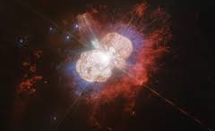
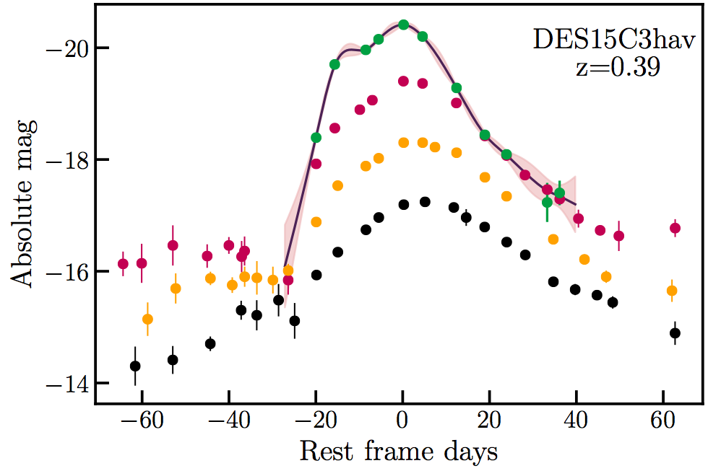
What we do
Explosions
Supernovae – detect the first stars that formed after the Big Bang
Gravitational waves – study associated explosions from the
mergers of neutron stars or black holes and neutron stars
The fastest bursts in the Universe – detect and follow up
millisecond-to-hours duration events at all wavelengths
Sonification
1D light curves, 2D images/plots, very fast analysis
Enables multi-parameter analysis in a single tone
Verification of low signal-to-noise events
Enhances virtual and augmented reality analyses

Slide 6
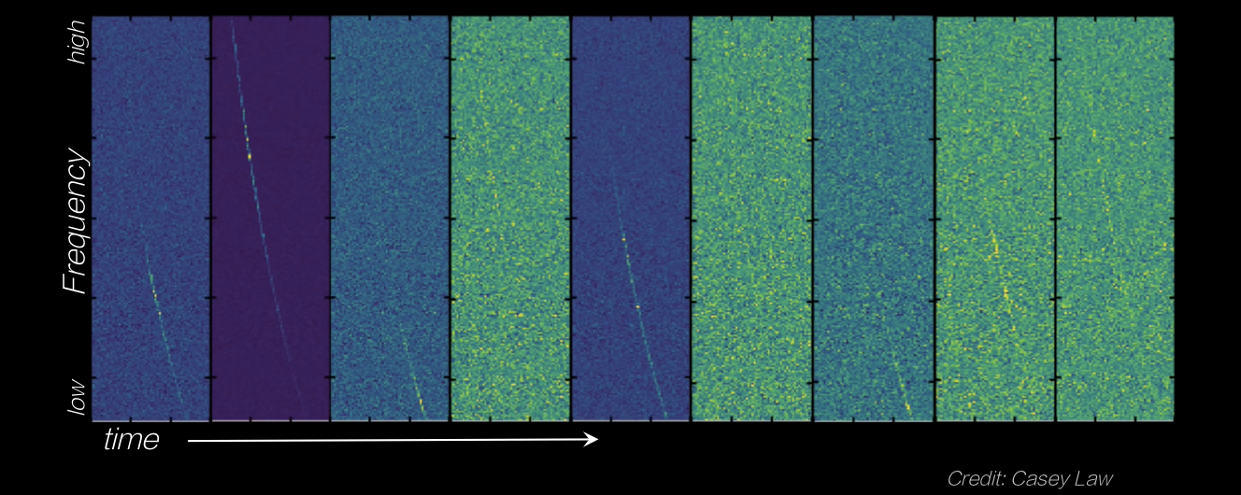
Data sonification – Low signal-to-noise detection

Slide 7

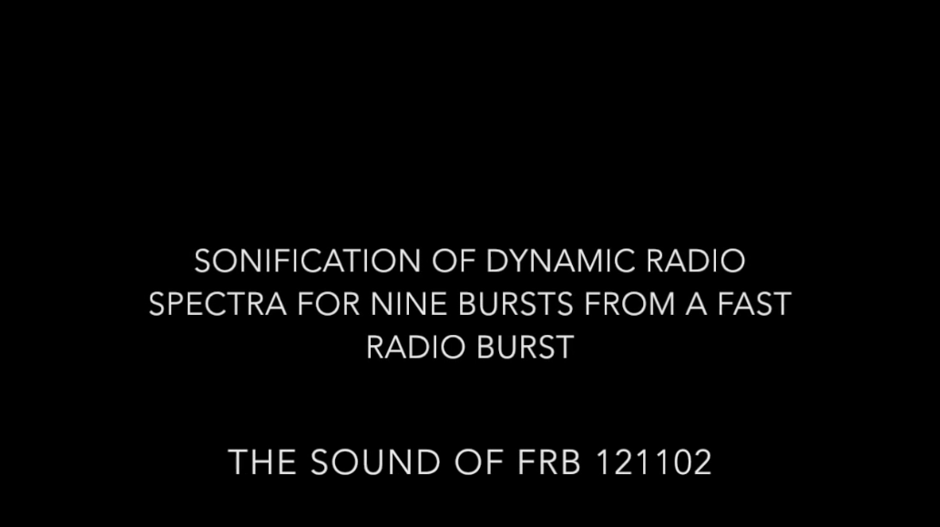

Slide 8
Telescopes on all continents and in space

Slide 9
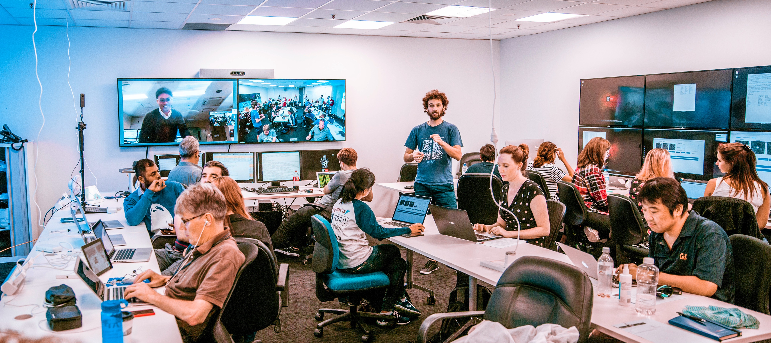
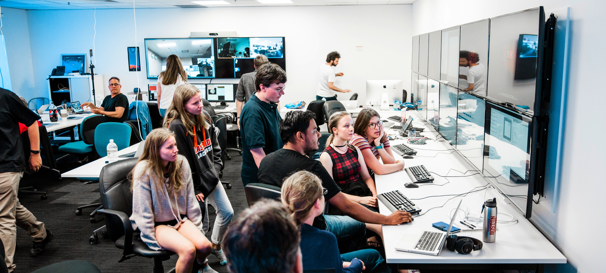
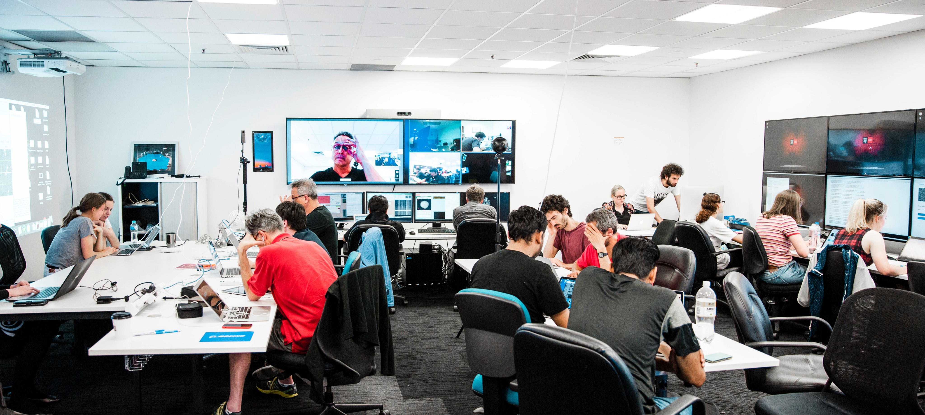
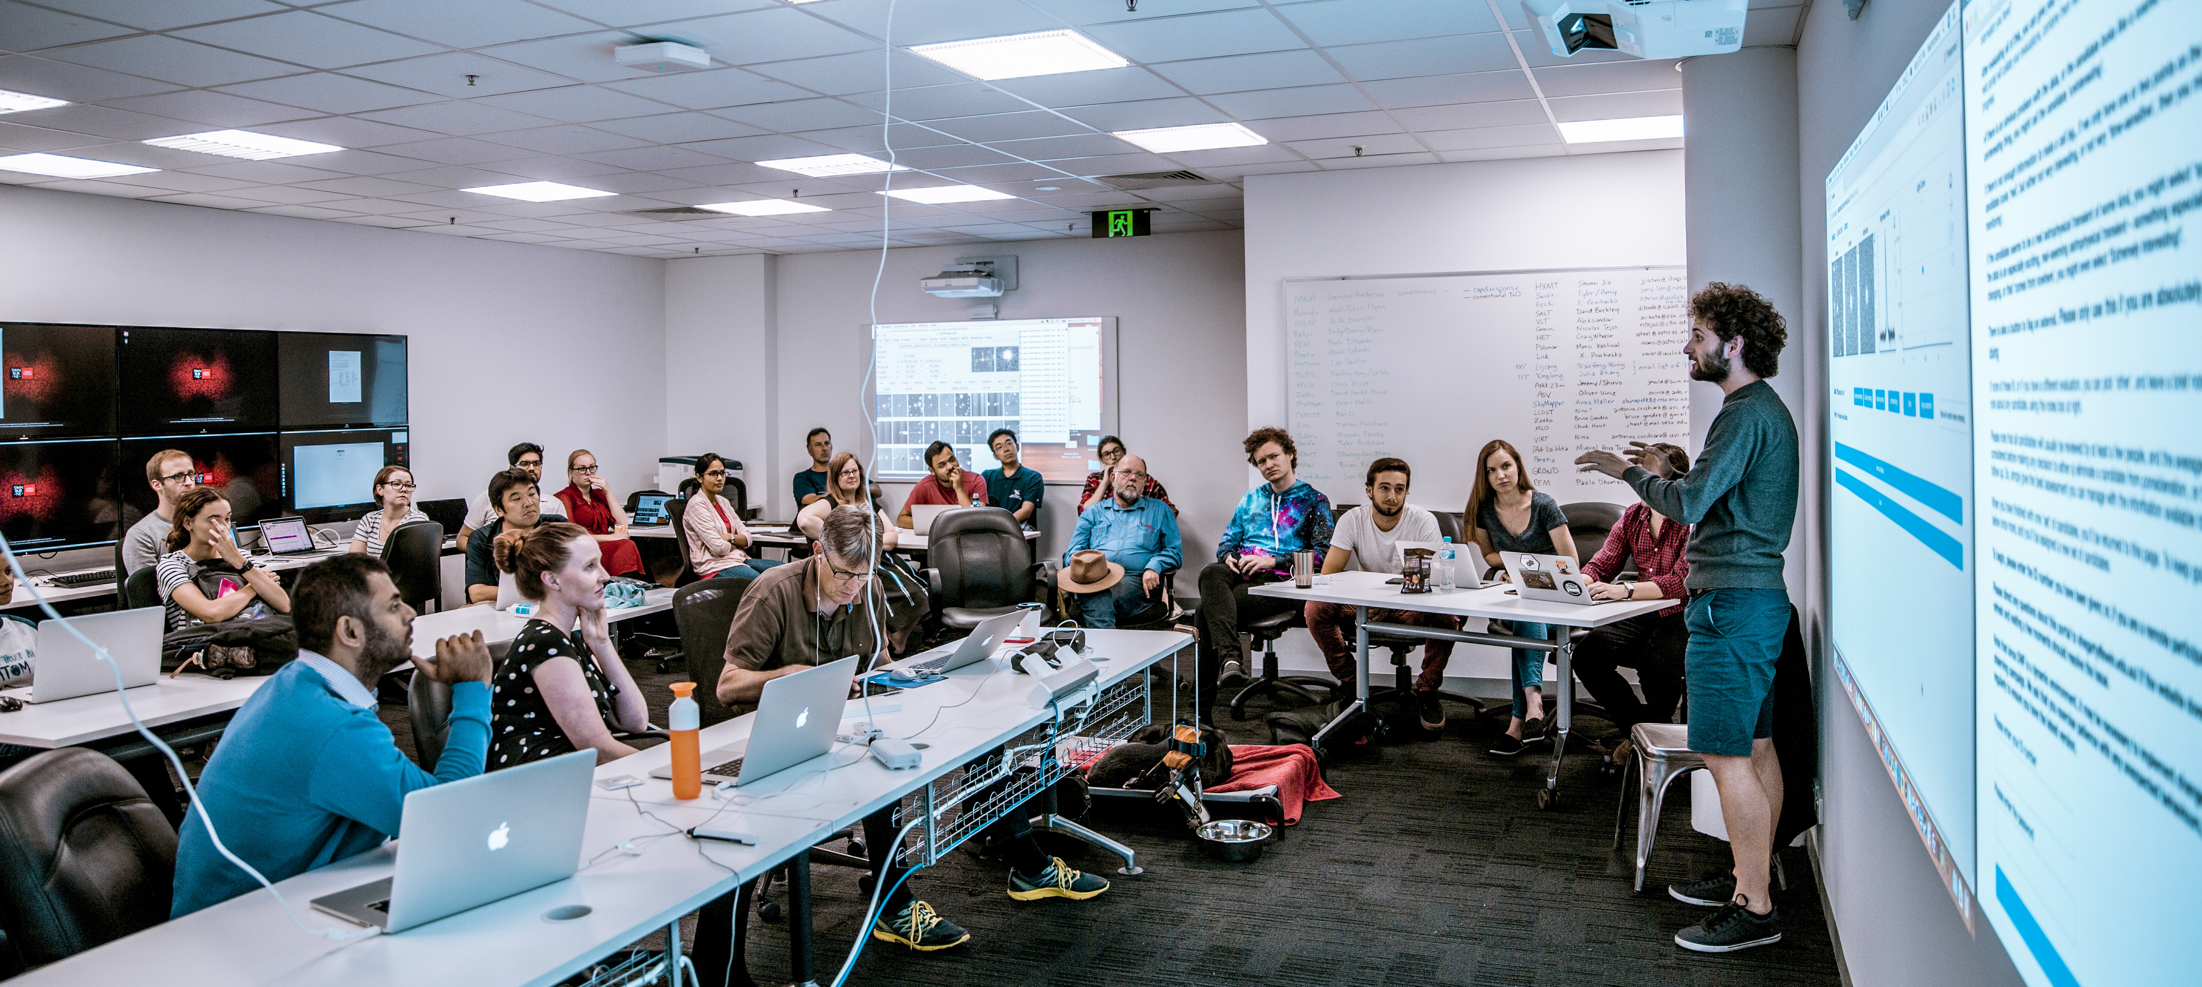
DWF Mission Control Room

Slide 10
Sonification tools
StarSound
– demonstration –

Slide 11
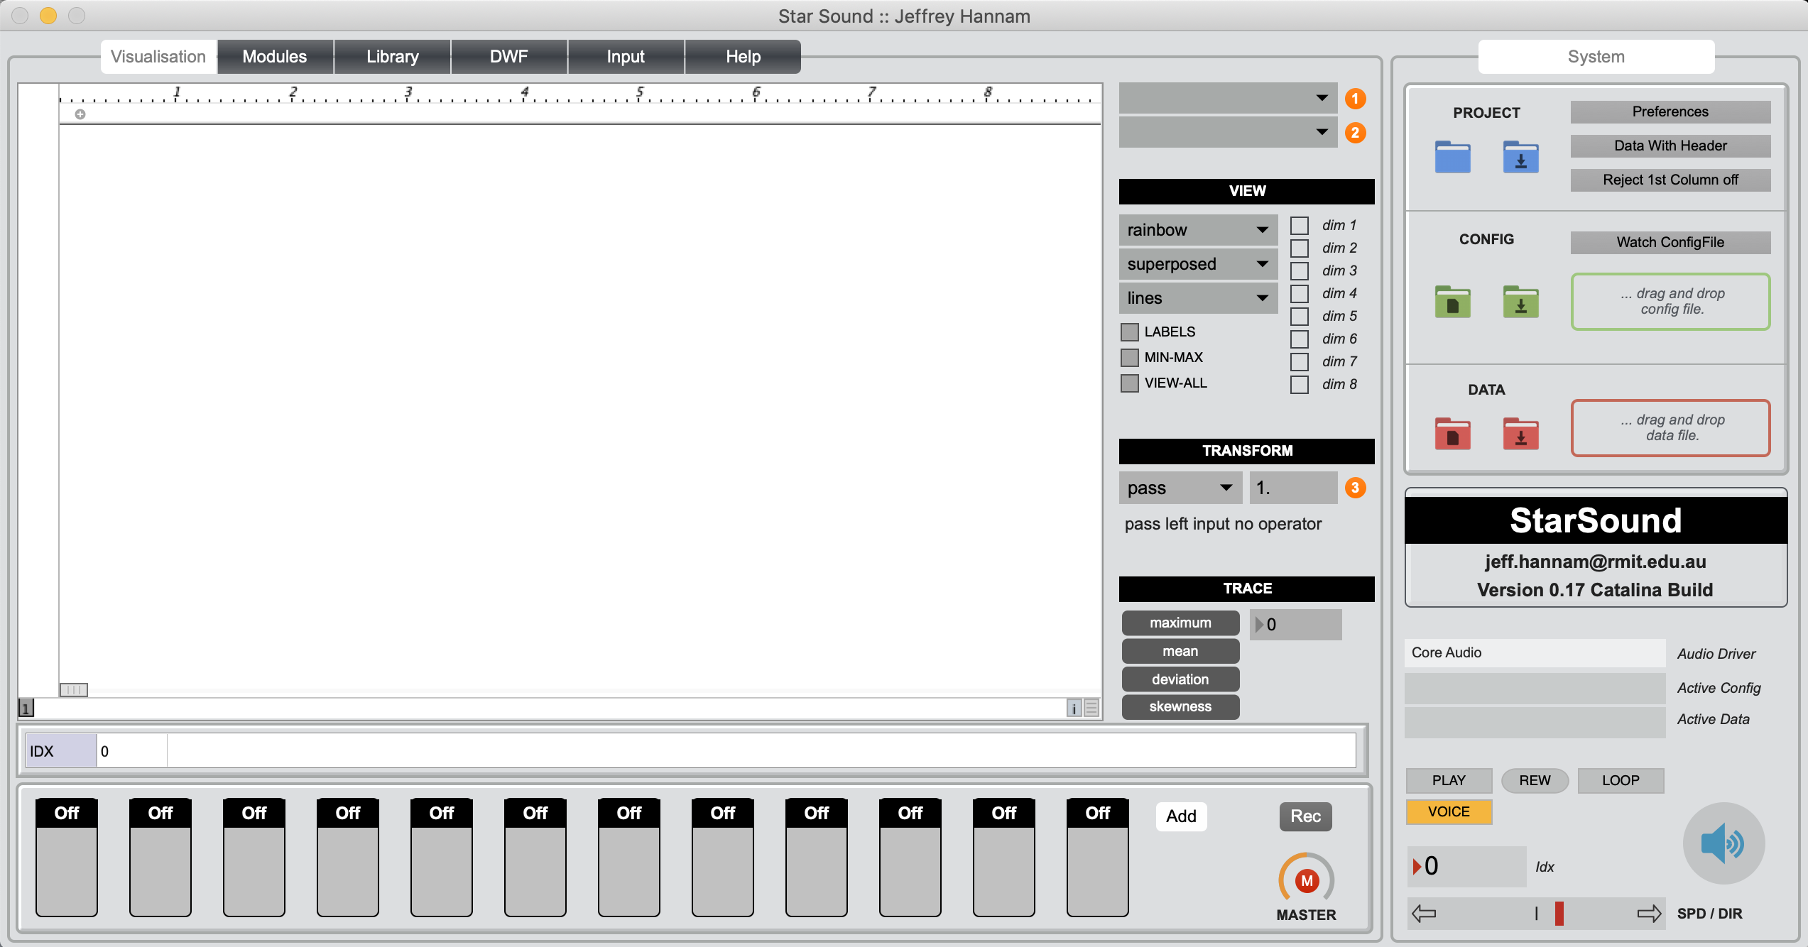
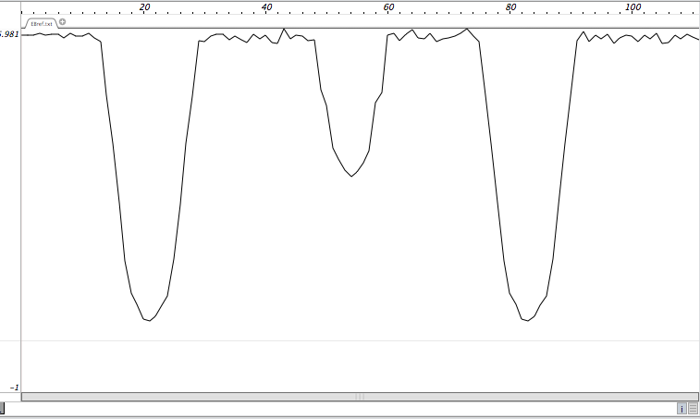
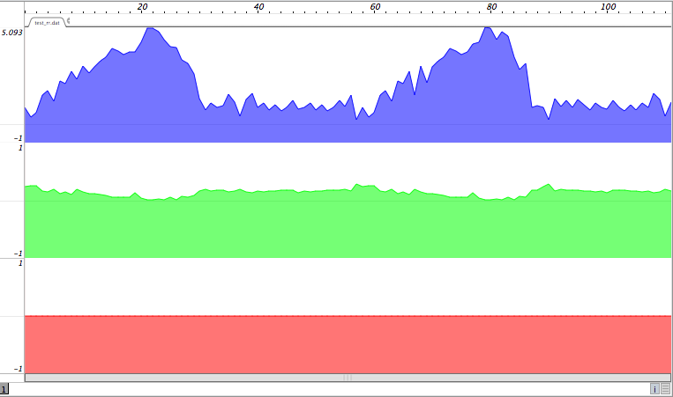
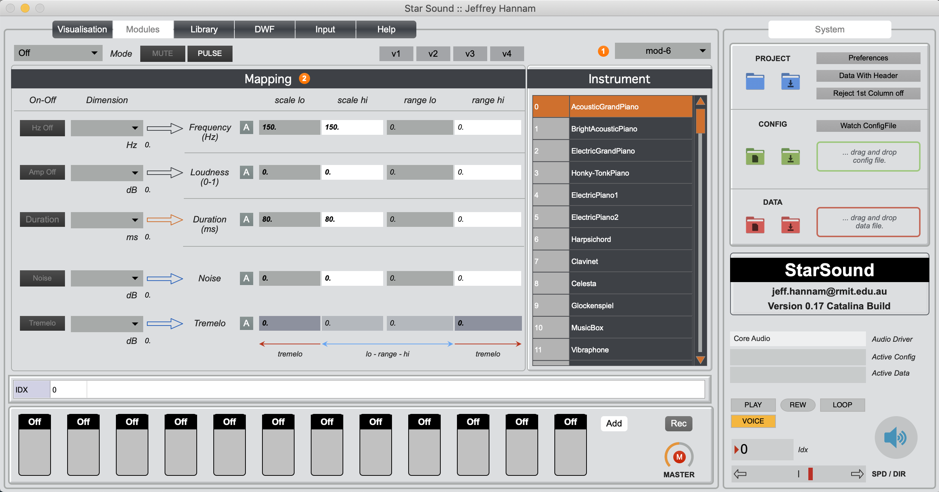
Sonification tools – StarSound

Slide 12
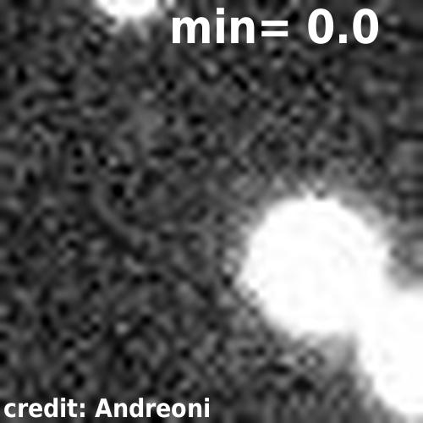
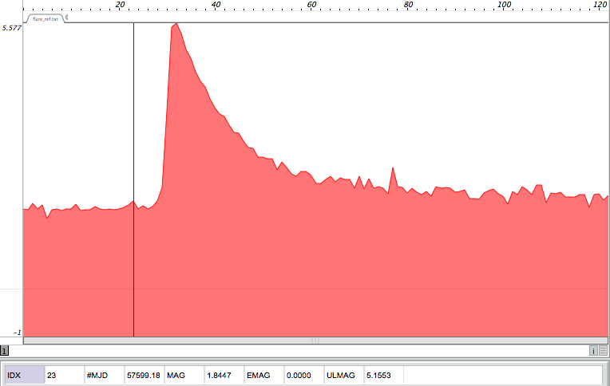
Sonification tools – StarSound – Flare star

Slide 13
Sonification tools
VoxMagellan
– demonstration –

Slide 14
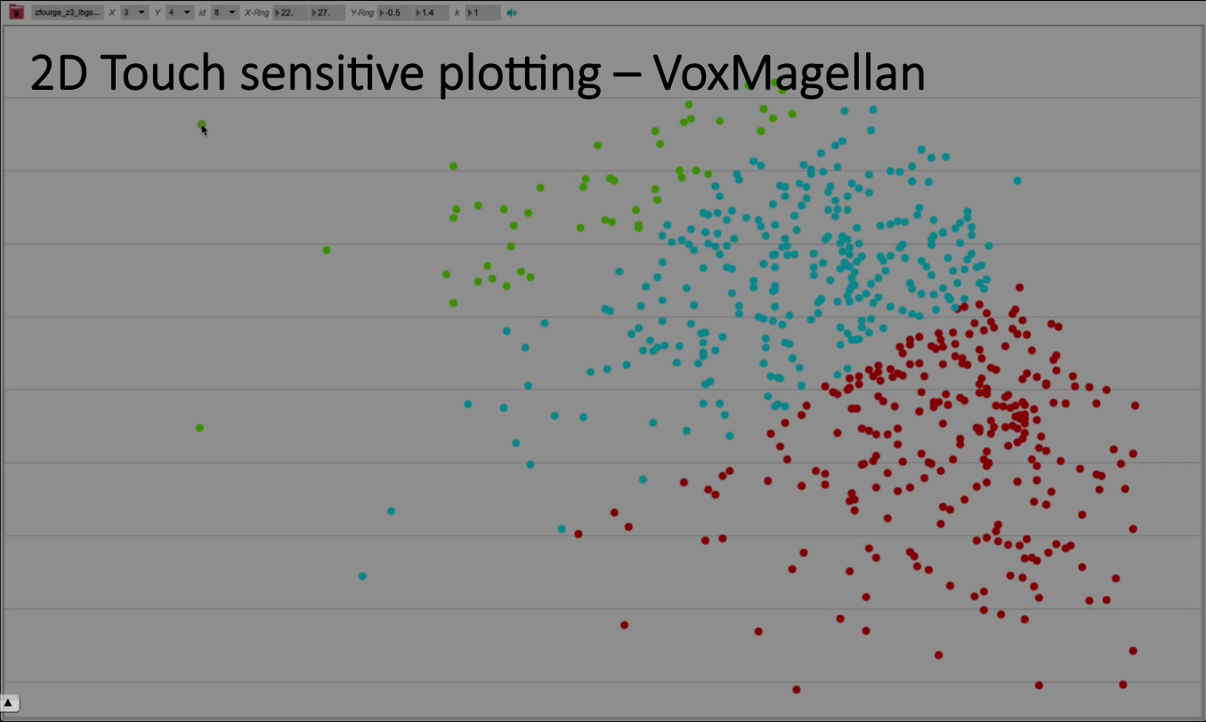
Sonification tools – VoxMagellan – scatter plot

Slide 15
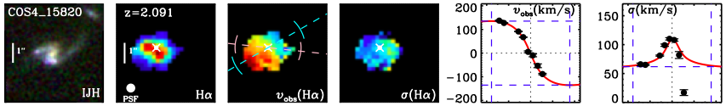
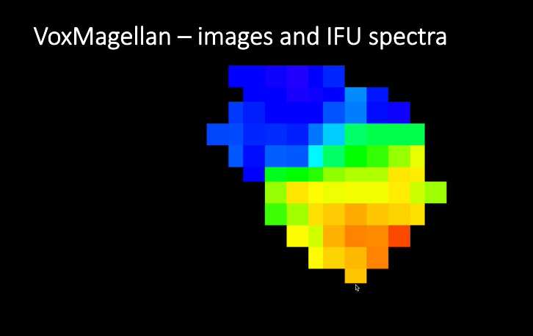
Sonification tools – VoxMagellan – low-res image

Slide 16

Application for conference/meeting/lecture talks

Slide 17
Application for conference/meeting/lecture talks
Real-time plot digitisation – no added work for speaker
Audience can hear the plots using their laptop
Can probe the data in more detail

Slide 18
Summary
For science
- Can be powerful for data analysis
- Faster analysis, crucial verification, enhances discovery
- Adds multi-parameter analysis capability
- Additional capabilities, e.g., low signal-to-noise ratio detection
For the blind, visually-impaired, print disability community
Enhances everyday life with access to data
Can help to understand plots, graphics, and images in real time
- Webpages, print articles, bank statements, purchases, etc.
- Health and medical information, work or public talks, etc.
- Education materials, scientific data, promotes STEM careers, etc.

