Slide 1

Inclusive Technology Design to Support Students with Print Disabilities
Troy Waller
Accessibility Lead, Education

Slide 2
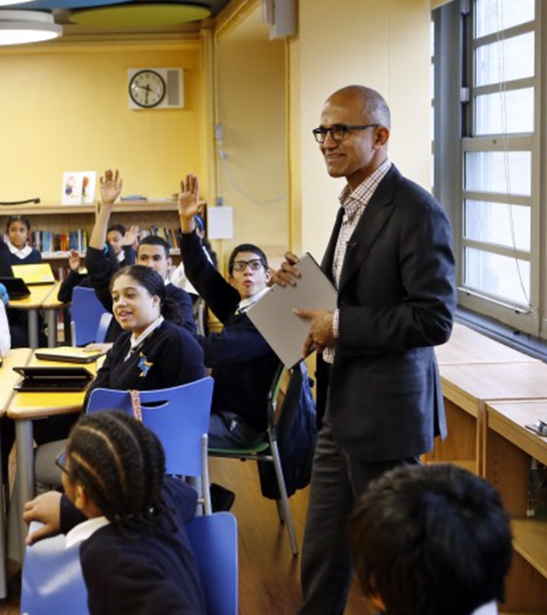
"Our mission is to empower every person and every organisation on the planet to achieve more."

Slide 3
Building a foundation for success
Inclusive education tools give more students personalised access to their curriculum, optimise educator time, and improve learning outcomes.
Students increase
independence and experience a reduction of stigma
Educators are more
empowered to engage
every learner
Institutions build reputations
as positive places that promote
equity and inclusion

Slide 4
Promoting independent learning
Accessible technologies help students with disabilities unlock their full potential by addressing a diversity of needs:
Learning
Visual
Hearing
Mobility
Neurodiversity
Mental Health
Dyslexia
Dysgraphia
Dyscalculia
Low vision
Blind
Colorblind
Deaf
Hard of Hearing
Cerebral Palsy
Muscle Dystrophy
Amputation
Autism
ADD/ADHA
Seizure
Anxiety
Depression
OCD
See Microsoft Accessibility features for every classroom

Slide 5
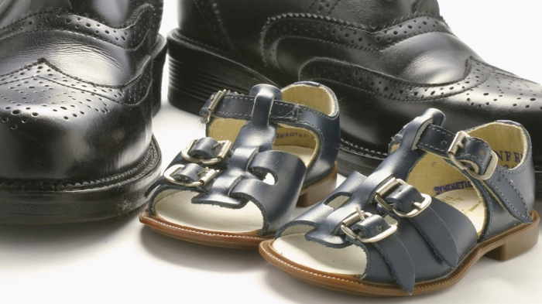
Average Shoe size

Slide 6
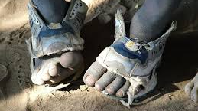
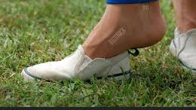
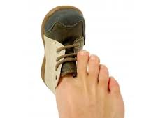

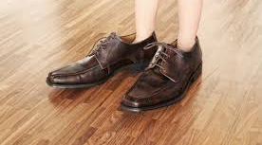
Missing what most people need

Slide 7

The Myth of the Average

Slide 8

We need various sizes and styles

Slide 9

Differentiation

Slide 10

Who has time to differentiate

Slide 11
Personalisation

Slide 12
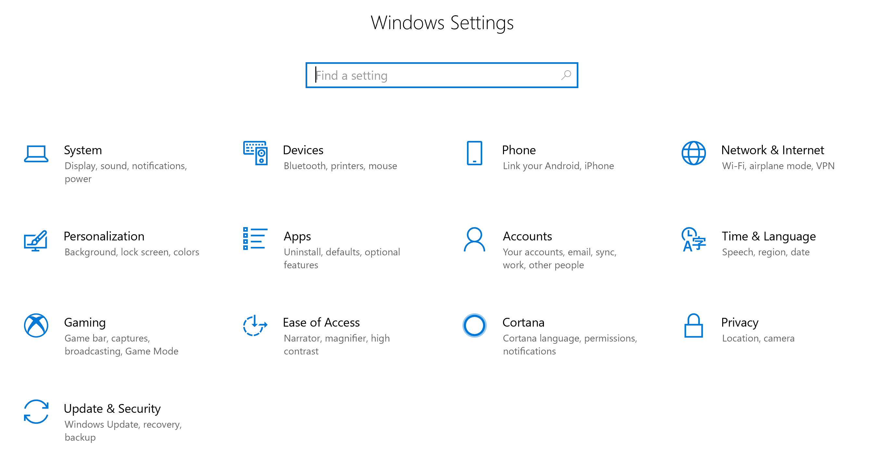
Make your PC easier to use - Windows 10 Ease of Access

Slide 13
Demo

Slide 14


The Inclusive Classroom
Reading Support

Slide 15

Word online

Slide 16
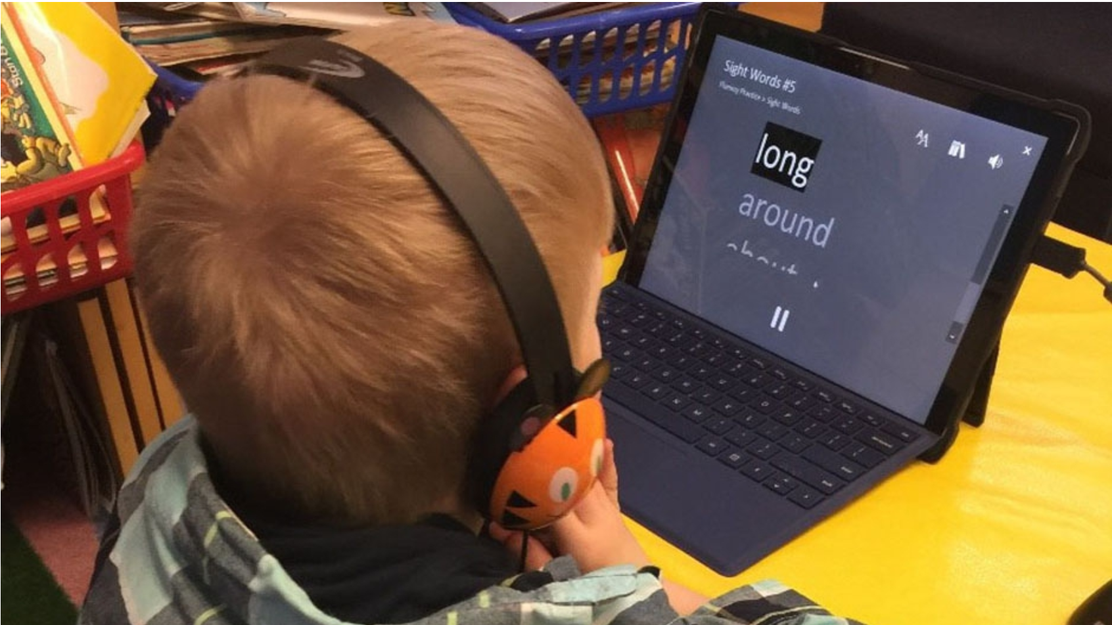

Listening posts and independent reading stations

Slide 17

Empowering
“It is an empowering tool. It evens the playing field for kids who are struggling readers. It allows them to feel more like independent learners, not depending on the teacher, not depending on peers.”
– 4th grade teacher

Slide 18

High interest, low ability
“Nearly all of the study teachers mentioned how it enabled their readers, regardless of skill level, to access content aimed at a higher reading level. In this case, “access” means comprehension of content that had previously been unavailable.”

Slide 19
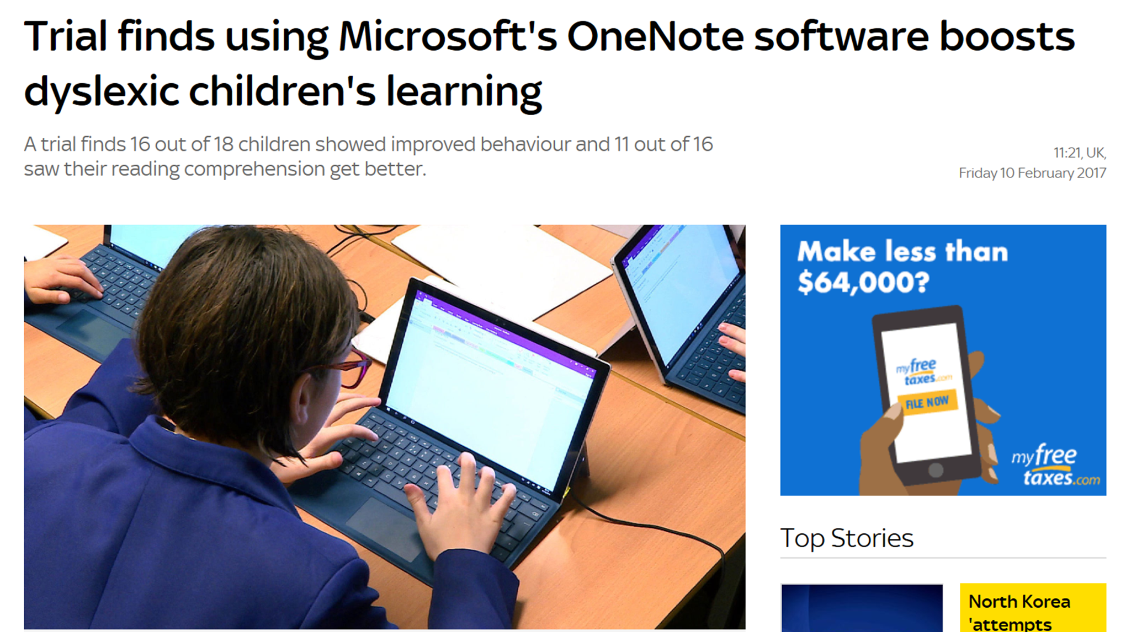
Study by the British Dyslexia Association and Knowl Hill

Slide 20
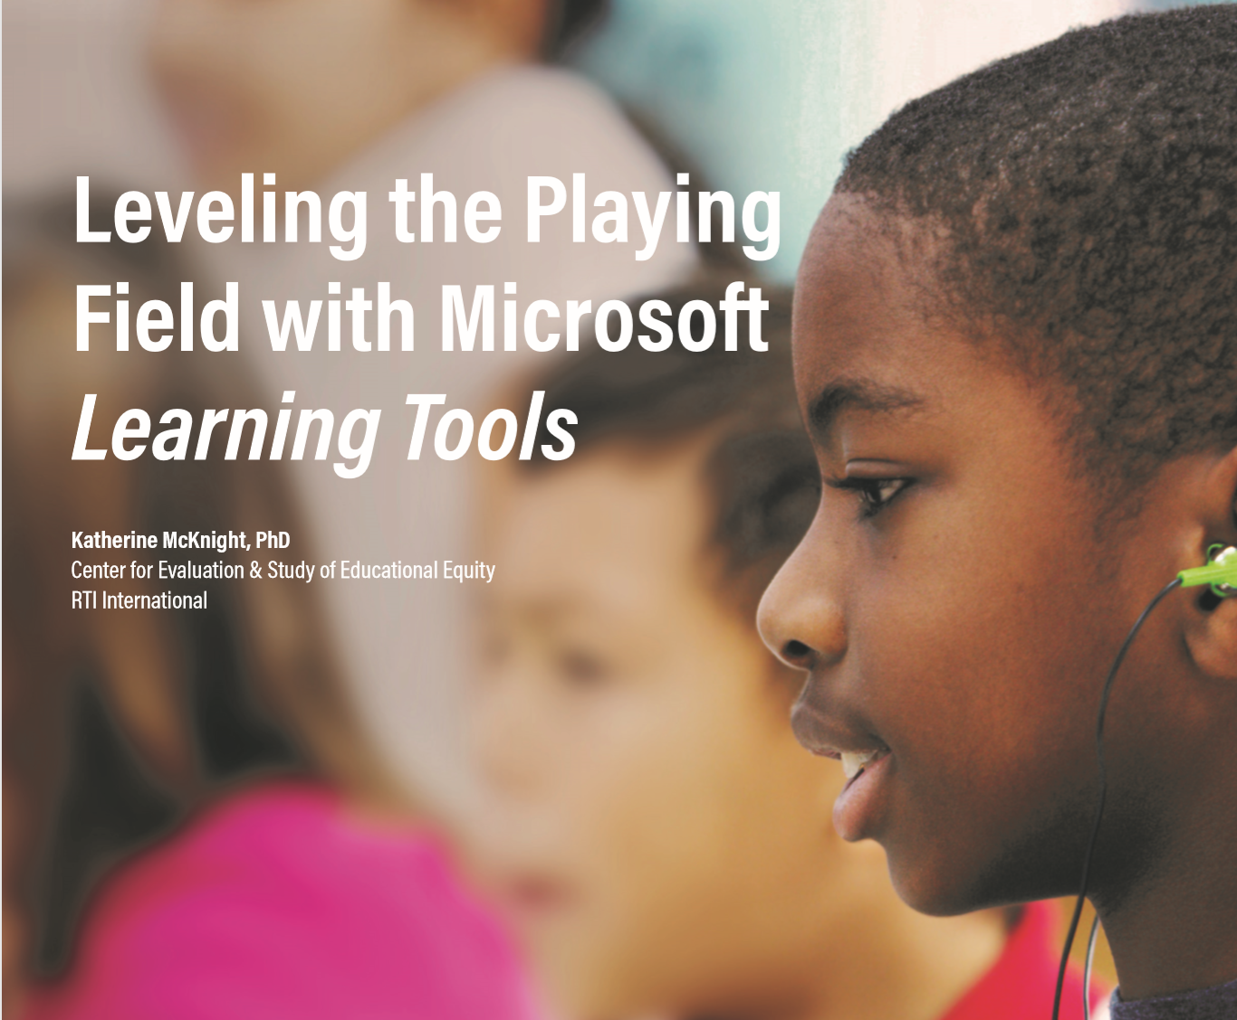
Learning Tools 3rd party research study – RTI
4th grade, 6th-8th, and 10-12th grade students
Reading Comprehension scores improved
Writing improved
Non-cognitive processes improved
Equal access of materials
Full Report: http://aka.ms/LearningToolsStudy

Slide 21

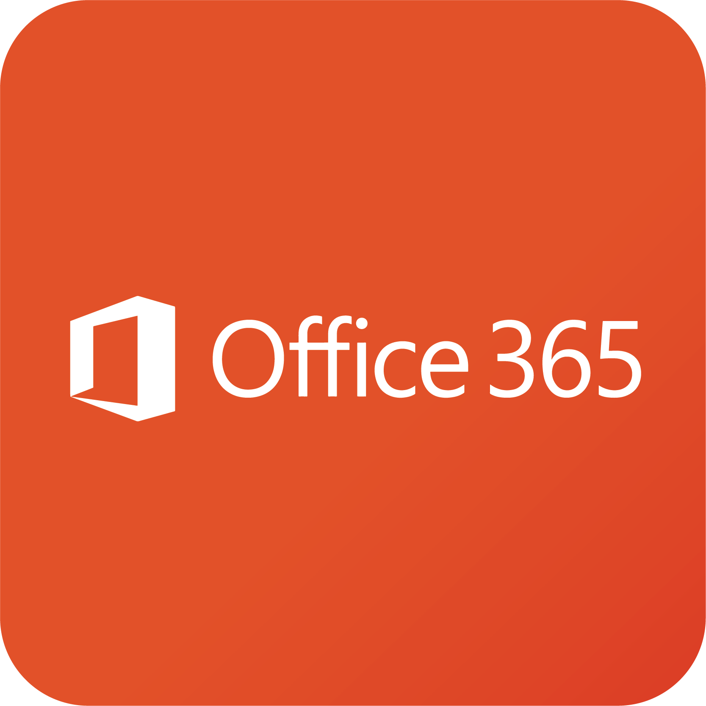
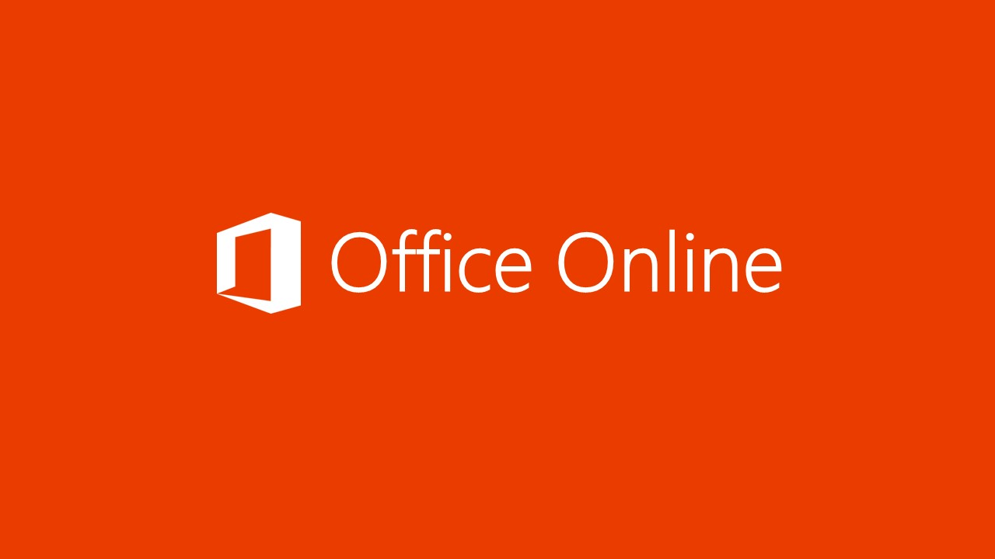
Immersive Reader is available in
Office 365, Office Online & Teams

Slide 22

OneNote

Slide 23
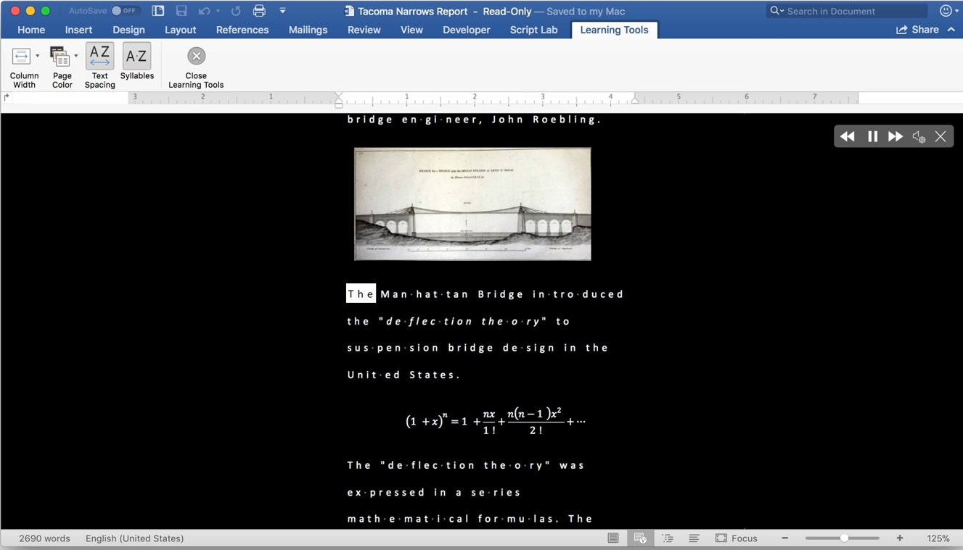
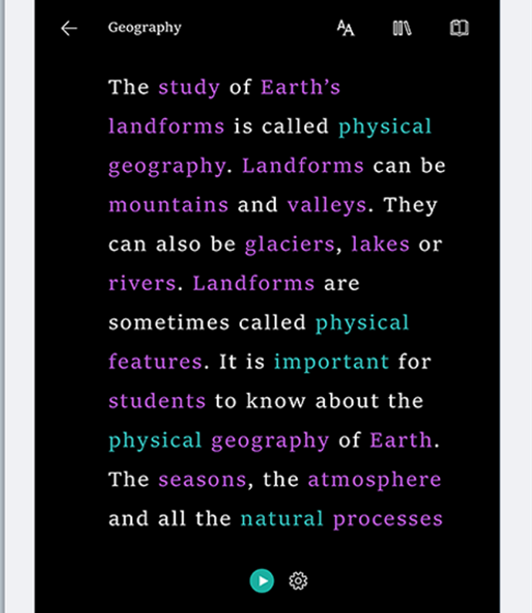
OneNote for iPad & OneNote for Mac

Slide 24

Edge Browser

Slide 25

Forms

Slide 26

Outlook

Slide 27

Minecraft

Slide 28
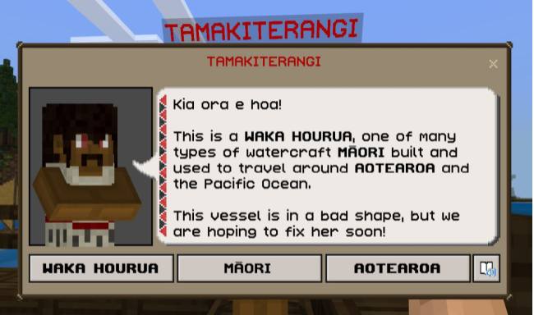
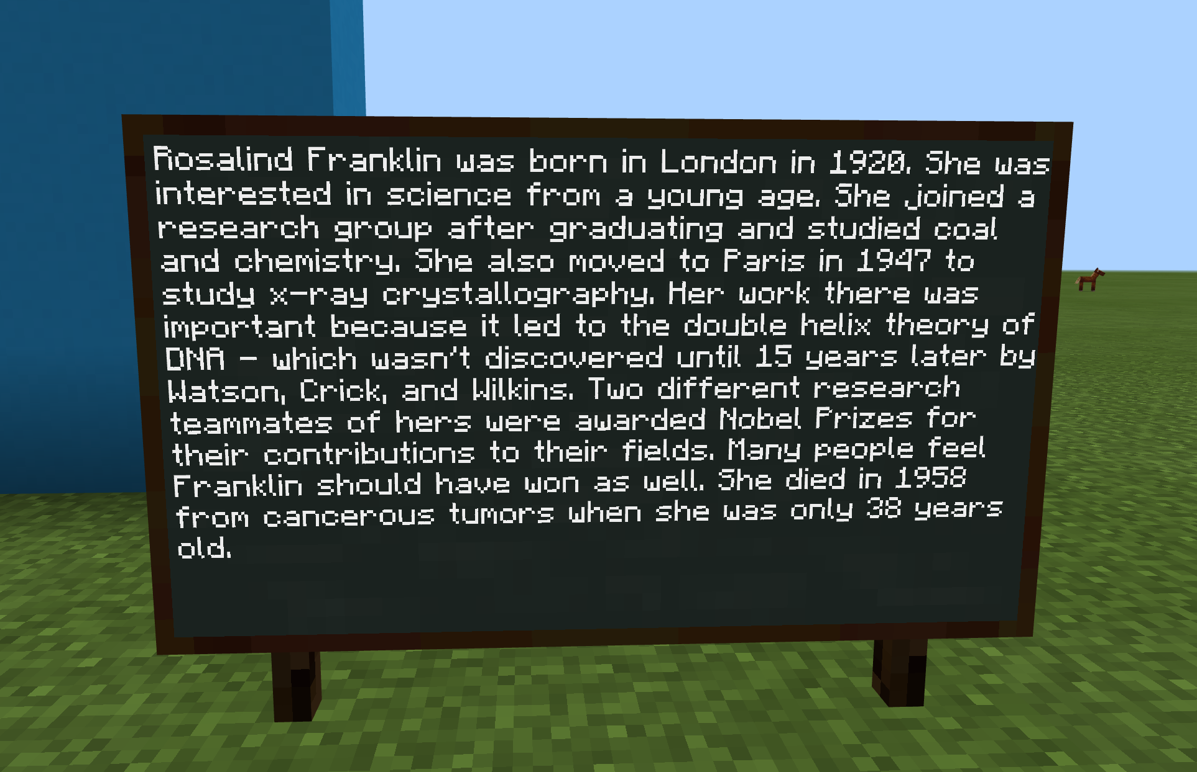

Minecraft: Education Edition

Slide 29
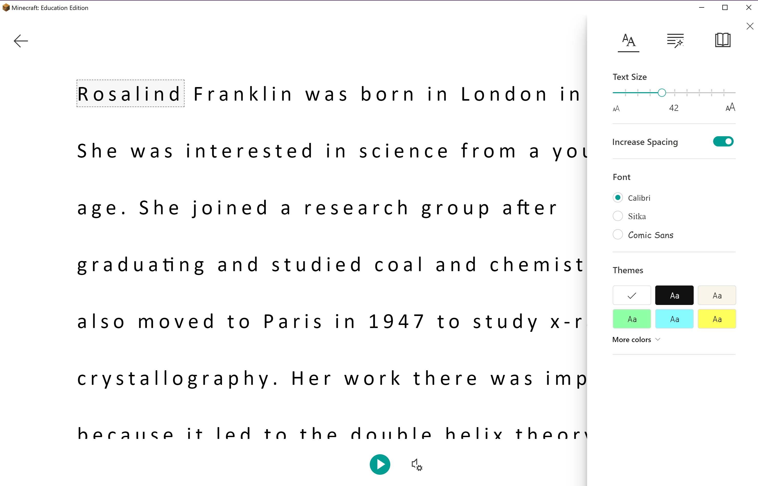
Immersive Reader in Minecraft

Slide 30
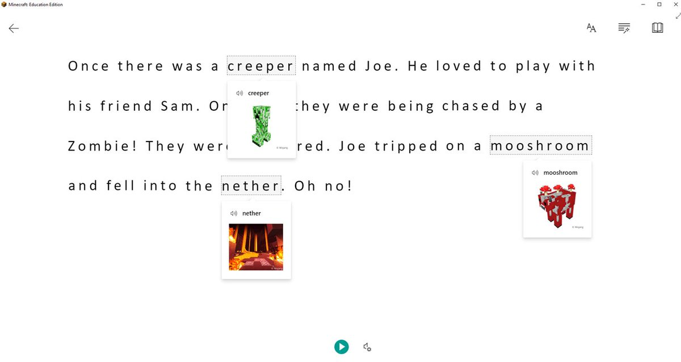
Minecraft: Education Edition

Slide 31

PowerPoint

Slide 32

Microsoft Teams

Slide 33


Everything in teams

Slide 34


In 2018, Microsoft was the first company to sign the Made By Dyslexia pledge.

Slide 35


Microsoft and Code Read Dyslexia Network

Slide 36
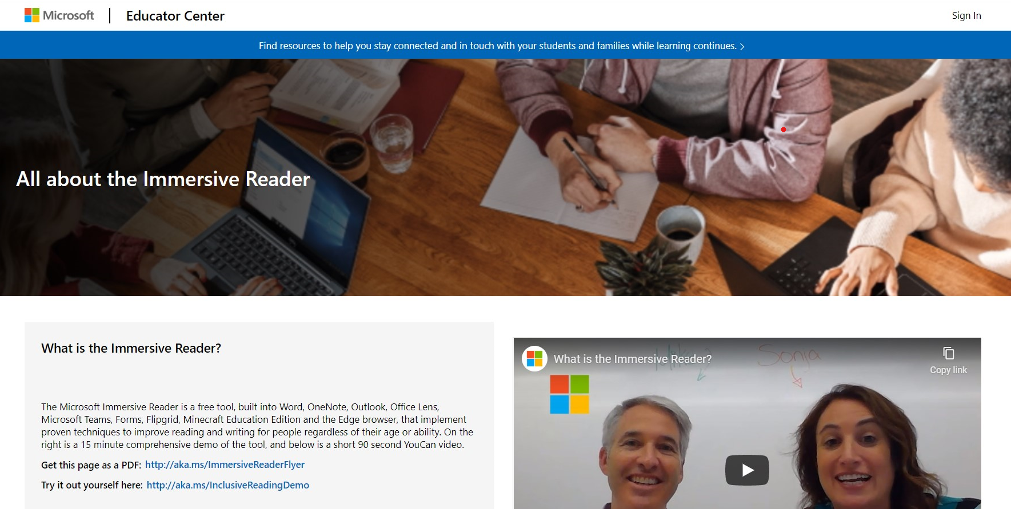
https://education.microsoft.com/en-us/resource/9b010288

Slide 37
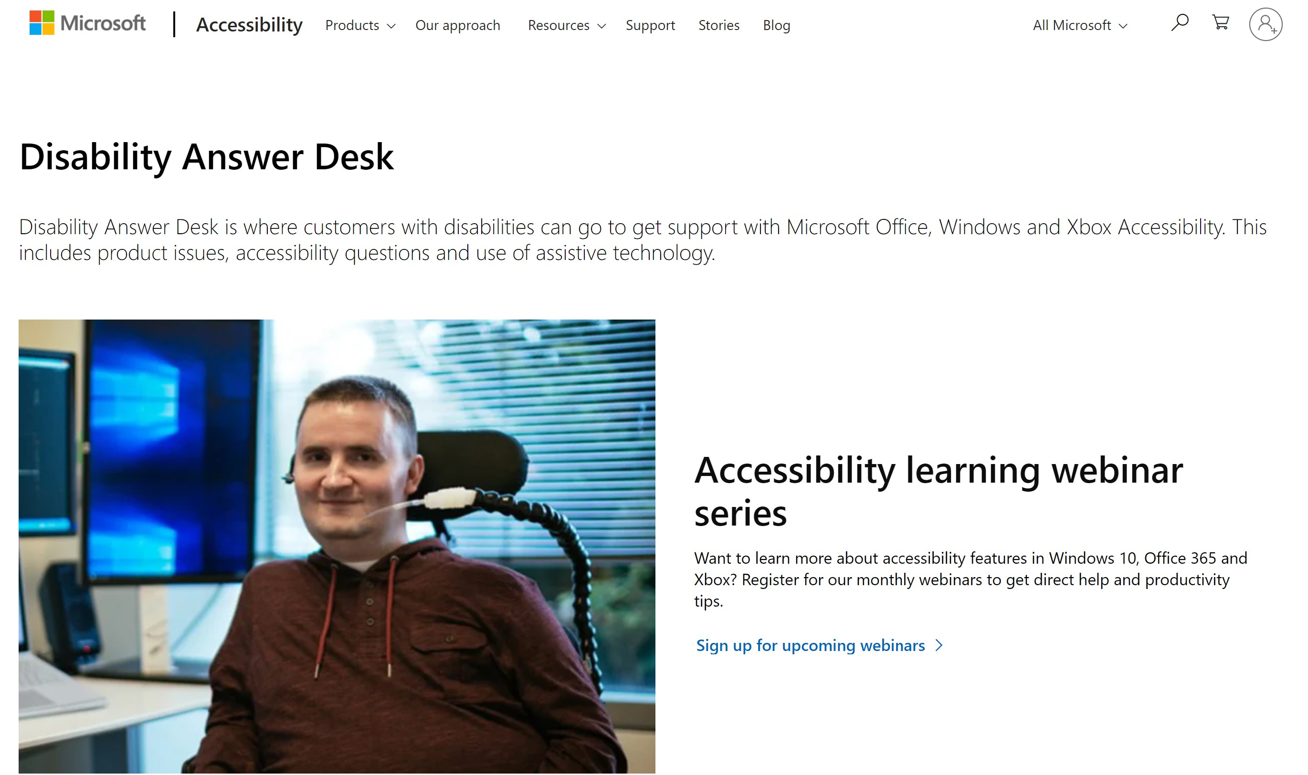
aka.ms/AccessibilitySupport

Slide 38

CodeJumper.com

Slide 39

Get the videos: aka.ms/TroyYT
© Copyright Microsoft Corporation. All rights reserved.

Slide 40
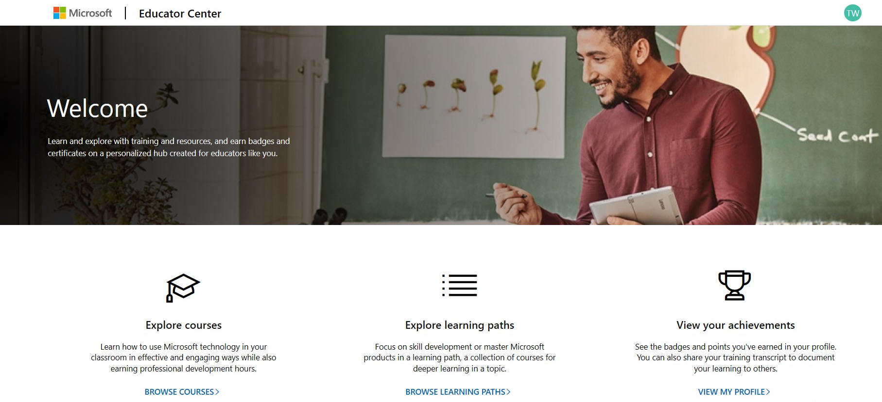
education.microsoft.com
Microsoft Educator Centre

Slide 41
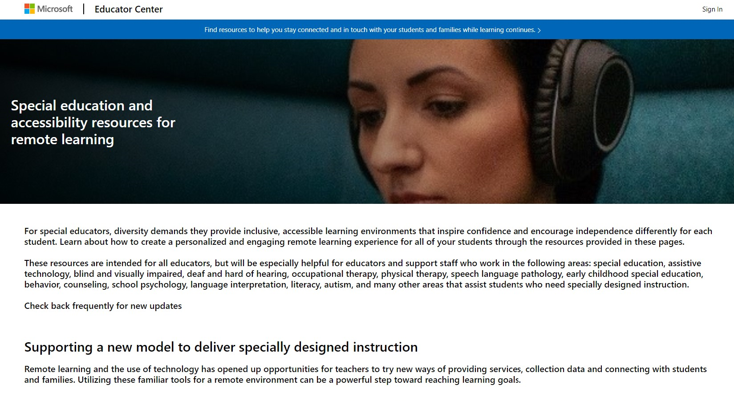
aka.ms/MECAccessibility

Slide 42
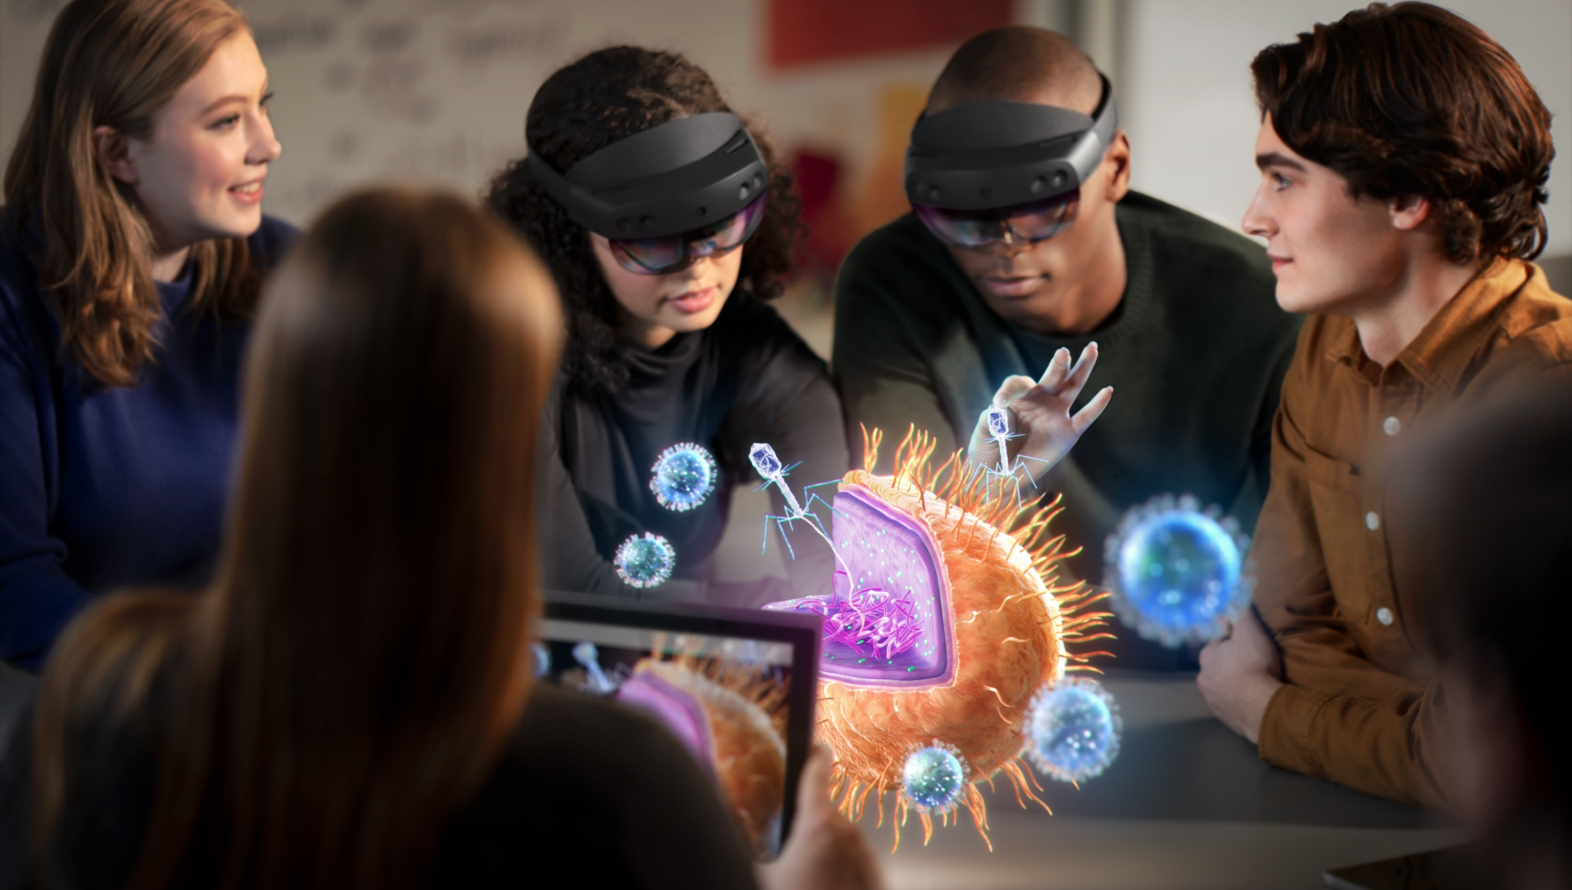




Stay connected…
@hojusaram
Troy Waller
Troy Waller Microsoft
© Copyright Microsoft Corporation. All rights reserved.

