Slide 1
The Place for Easy English for full information access
VisAbility’s continuing journey into Easy English
Presenter: Leone Carroll, 17th May 2021

Slide 2
Introduction
Easy English ensures the full range of alternative formats are available to the full range of abilities.
Equivalent to a Triple A standard (Victorian Government)
“Print disability” includes literacy, as well as learning, physical and vision impairments.
www.visability.com.au

Slide 3
The VisAbility journey
Provided conversions to Easy English
Series of workshops – ILC grant.
Most participants had heard of Easy English.
www.visability.com.au

Slide 4
Why we need to consider literacy levels
44% of Australians do not have functional literacy skills.
Learning disability (e.g., dyslexia) – difficulty decoding written words.
Intellectual disability – difficulty understanding written text.
Culturally and Linguistically Diverse backgrounds.
www.visability.com.au

Slide 5
Australian literacy levels
56% of Australians can understand written material at a Year 9 level or above.
44% cannot.
- 14% have a low to very low level of literacy.
www.visability.com.au

Slide 6
Making Documents more understandable
Plain Language
Easy Read
Easy English
Differ in the literacy level required to understand them.
www.visability.com.au

Slide 7
1. Plain Language
Year 9 level reader
Sentences around 25 words long
“need to know” + “nice to know”
56% of the population
www.visability.com.au

Slide 8
2. Easy Read
Readers not at a Year 9 level
Sentences around 15 - 25 words long
Mostly “need to know”
Images, usually photos and symbols
86% of the population
www.visability.com.au

Slide 9
3. Easy English
Readers not at a Year 9 level
Sentences in 5-10 word chunks
Consistency in layout
Just “need to know”
Images – drawings/illustrations
100% of the population
www.visability.com.au

Slide 10
An example: Plain Language
The Print Disability Services Program (PDSP) supports organisations to produce print material in alternative formats for people with print disability who are unable to read standard print with ease due to vision impairment, a physical disability or a learning disability.
www.visability.com.au

Slide 11
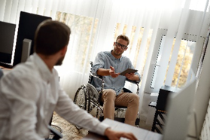
An example: Easy Read
The Print Disability Services Program (PDSP) supports organisations to make their information in alternative formats. This is for people with print disability.
www.visability.com.au

Slide 12
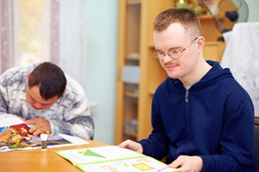
An example: Easy Read
They may not be able to read things that are written because they have:
a vision impairment
a physical disability or
a learning disability.
www.visability.com.au

Slide 13
An example: Easy English
We get money from the Print Disability
Services Program.
We say PDSP.
Print disability means you can not read information
that is written.
www.visability.com.au

Slide 14
Easy English p2
Like you
can not see it
can not hold a book
can not follow words on a page.
www.visability.com.au

Slide 15
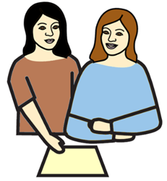
Easy English p3
We help services make sure you can
get the information
and
understand the information.
www.visability.com.au

Slide 16
Easy English p3
We help services make sure you can
get the information
and
understand the information.
www.visability.com.au

Slide 17
Images
Purpose: draw attention, assist understanding.
Drawings / Illustrations
Photos
Symbols / Icons
www.visability.com.au

Slide 18
Using Easy English
Printable hard copy, shared reading.
44% have difficulty understanding written text
76% over 55 years old have auditory processing deficits
1 in 5 households do not have a computer
Reading online is harder than reading print
www.visability.com.au

Slide 19
Contact Details
Leone Carroll
Braille Production Officer,
Easy English Specialist
Phone: 08 9311 8202
Email: access@visability.com.au
www.visability.com.au
Notes:
Feel free to contact me fro further information about our Easy English (and other Accessible Information) Services, or about details about this paper.

Slide 20
VisAbility
Every support at any stage.
VisAbility website: www.visability.com.au

