Slide 1
How COVID-19 is Impacting Education in the U.S. and Canada: The Challenges, Successes and Unanswered Questions
Dr. L. Penny Rosenblum
Director of Research American Foundation for the Blind prosenblum@afb.org
Notes:
Penny

Slide 2
It’s So True!
Everybody has had to adapt to crazy things that are not very normal. People are getting tired of this [COVID-19] stuff but we have to move forward with the education of our young people with all the organizations and programs and services offered.
Family member of a child with low vision 2.5 to 3 years old, and a preschool child who is blind with additional disabilities
3
Notes:
Penny

Slide 3
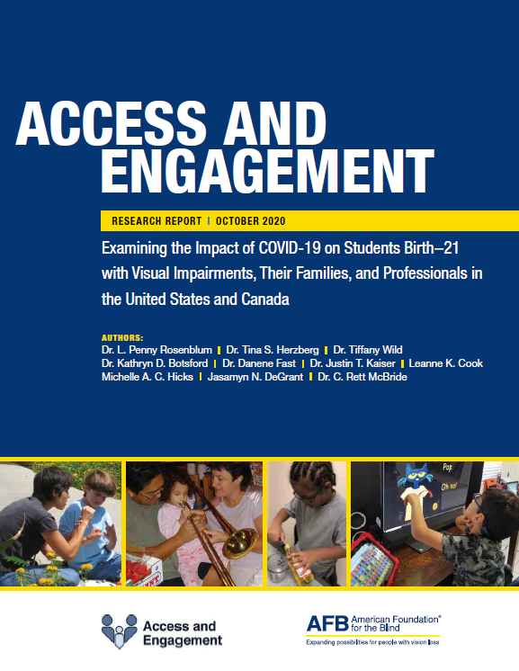
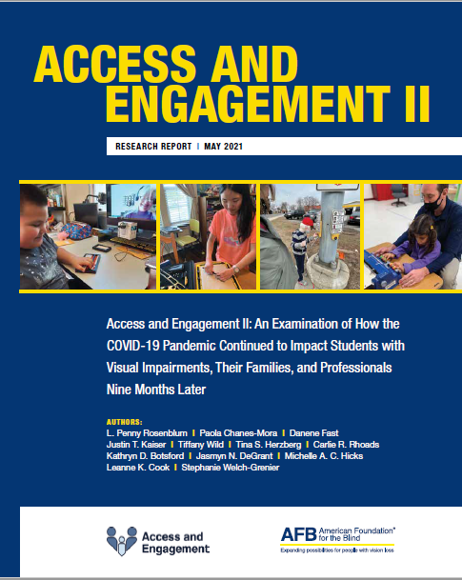
Two Studies: One Research Question
How has the COVID-19 pandemic impacted the education of students with visual impairments, their families, TVIs, and O&M specialists in the United States and Canada?
https://www.afb.org/research-and-initiatives/education/access-engagement-study
Notes:
Penny

Slide 4
A Couple of Things to Keep in Mind
Both studies required participants to use the Internet to take a survey.
Both surveys were long.
Both study samples were primarily female and White.
Both studies were advertised by schools, organizations, and companies in the blindness field.
Notes:
Penny

Slide 5
Dates and Demographics
A&E I
A&E II
April 22-May 13, 2020
1432 participants
79% White
87% female
Oct. 28-Nov. 30, 2020
662 participants
85% White
81% female
Data were collected through an online, accessible survey.
Notes:
Penny

Slide 6
The Children
A&E I (n=455)
A&E II (n=206)
62 receiving early intervention
60 receiving preschool services
333 school age
16 receiving early intervention
22 receiving preschool services
168 school age
56% of children in the first study and 57% in the second student had additional disabilities.
Notes:
Penny

Slide 7
Early Intervention Services in November 2020
n=16
56% of family members reported their child had a current IFSP.
Most families were receiving early intervention services online.
7 families were currently meeting in-person with early intervention providers.
Most family members felt overwhelmed.

Slide 8
For Some Families Online Education was Not Working
I think this is especially more of a challenging time for visually impaired students. For kids like mine, distance or online learning is just not the same or comparative to in-person learning. I don’t think there are enough resources for children with visual impairments.
Family member of a child with low vision and additional disabilities aged 2 to 2.5 years of age
3
Notes:
Penny

Slide 9
Preschool Services in November 2020
n=22
91% of preschoolers had a current IEP.
Children had difficulty adjusting to changes in delivery models (e.g., online to hybrid).
Some family members had concerns about regression.
Some family members felt their child was making more progress during the pandemic.
Opportunities to work on ECC skills and collaborate with professionals.

Slide 10
Child Progress
We have been able to dedicate more time to independent learning skills with the slower pace. She has become potty trained and she can help get water and ice from the fridge. Still working on putting clothes and shoes and braces on.
White female family member of a child who is blind, 3 years old
11

Slide 11
School Age Services in November 2020
n=168
92% of children had a current IEP.
30% of children were in general education classes.
22% of children were in a combination of general and special education classes.
15% of children were in a self-contained special education class.
19% of children were at a specialized school.
14% of children were in other placements (e.g., homeschool, center-based programs)

Slide 12
Dedicated Professionals
[The TVI] has been the most stable aspect. She has worked out lessons, weekly drops off materials, and has met with us regularly four days a week, twice each day. She is the glue holding my son’s education together.
Female family member of a child who is blind with additional disabilities, 5 to 7 years old
12

Slide 13
The Professionals
A&E I (n=1,028)
A&E II (n=481)
710 TVIs
138 O&M specialists
180 Dually certified professionals
301 TVIs
79 O&M specialists
87 Dually certified professionals
Most TVIs and O&M specialists were itinerant in both studies.
Notes:
Penny

Slide 14
Professionals Supporting Families
58% of professionals were able to reach 91%-100% of their families.
17% of professionals were only able to reach 25% to 49% of their families.
Reasons families were not reached included:
Not having current contact information
Families were struggling
Language barriers
Family members having multiple demands on their time
Families not having Internet and/or device access
Notes:
Kathryn

Slide 15
A&E II Participants: Supporting Families
Vision professionals spent considerable time and effort to advocate for their students to have accessible technology.
Some vision professionals and many family members needed training and ongoing support to use technology (e.g., video conferencing, Google Classroom, Zoom).
TVIs on average used 12 ways to support their students and families and O&M specialists used 9 ways (e.g., text, online meetings, delivering materials).
Notes:
Michelle
Here of some of the ways the participants helped support families that stood out to us. A lot of time was spent advocating for accessible technology. In the first study, at the beginning the shift to online instruction was so quick a lot of families and schools had no idea what was happening . Everybody needed training and support to navigate spaces like zoom and google classroom. We found that there were less complaints about technology by the second survey. And just like many of you, we had to connect to families through texts and even becoming a delivery service for educational materials.

Slide 16
Challenges of Online Education
For students with very complex needs, the virtual classroom is not beneficial to them. We have provided materials for home use, but it certainly does not replicate what they would have access to in the special education classroom at school. This is particularly true for our [multiply sensory disabled] high school students who would have work placements and community activities in a typical school year. White female TVI
16

Slide 17
Educating Students with Additional Disabilities
Vision professionals recognized that families had competing demands.
Online education enabled some family members to better understand how to support their child’s learning.
Many students were not able to “engage” with a screen, limiting their participation in their education.
In-person instruction required careful planning to maintain safety yet provide individualized hands-on instruction.
Notes:
Michelle
I think prior to the pandemic, we as professionals often forgot our students didn’t live in a bubble. But we got a much closer view as to all the demands families have going on. We got a better perspective, but families were better able to learn ways to support their child in the home. The need for face to face interaction is really required to have engaged students.

Slide 18
Recommendations from Access & Engagement II
The importance of teamwork
Full access to digital learning
Providing students access to the curriculum
Meeting the needs of students with additional disabilities
Changes to IFSPs and IEPs as a result of the pandemic
Provision of orientation and mobility instruction
Continuing to build on successes that have resulted from the COVID-19 pandemic
Supporting the mental health and safety of students, families, and professionals
Notes:
Justin

Slide 19
The Importance of Teamwork
Communication between students, family members, vision professionals, other educators, and administrators must be ongoing, clear, and individualized to the needs of the student and family members.
Provide interpreters for non-English speakers.
Ensure funding and resources are available to allow all children to receive services.
Ensure assessments continue to occur for children.
Help connect families to resources to obtain reduced/free meals and/or childcare.
Notes:
Is this slide in the right place?

Slide 20
Full Access to Digital Learning
Mechanisms are needed to provide students, family members, and vision professionals instruction and ongoing support with technology including replacing and/or repairing technology in a timely manner.
Over the 9 months of the pandemic both vision professionals and students gained skills in using digital learning tools and video conferencing platforms.
Students need the same AT when online as they have in school.
One size does not fit all!

Slide 21
Advocating for Students’ Technology Needs
All students in the school district that I work in were given Chromebooks as their point of school access this year. The battle is to convince and prove to the district [administration] that this is not the appropriate option for JAWS [users]. Braille Notetakers, really any accessible technology...has been very tough [to acquire for students].
White female TVI
21

Slide 22
Digital Learning Tools
Attend online classes with the student to ensure access.
Work with administration to get needed equipment (e.g., an external monitor to pair with a Chromebook).
Request that a vision professional be on the selection committee for technology the school/district is considering for purchase.
Notify companies with specific information about accessibility and usability issues with their product.
Notes:
Michelle
I know I found it very helpful when I could be added to the virtual classroom even just to go an observe to judge how my student was able to participate. We made sure to spend time learning what worked. Liked external moitors and keyboards. Also, giving specific ideas that are causing problems for our students. One of mine, his mom actually tweeted about a learning platform and the company reached out and asked could they get information and they were able to make the platform more accessible .

Slide 23
Continuing to Build on Successes
Vision professionals have built communities of practice and online support networks (e.g., TSBVI Coffee Hour).
Vision professionals and students have had to learn new technology skills that will benefit them in the future.
Many family members and vision professionals have been able to work more closely together when education is delivered online.
Some administrators have increased their understanding of the specific needs of our students.
Notes:
Justin

Slide 24
The Importance of Access & Engagement II
I am the parent of a blind child and certified as a TVI, but working as a Superintendent at a school for the blind. I feel like this has been a very difficult time for our students and that remote learning is inaccessible to many without 100% parental/family support. [Remote learning] is specifically challenging for young students and those with multiple disabilities. I think data like this survey is critical because gaps identified during the pandemic will be relevant in years to come. With an ever-increasing digital component to employment, the pandemic very much models many job opportunities for our students.
White female family member of a child who is blind with additional disabilities, 13-15 years old
Notes:
Penny

Slide 25
Access & Engagement II
The report will be available in early May
https://www.afb.org/ae2/
Blog post
It Takes a Village: Join the Access and Engagement Village and Advocate for the Education of Students with Visual Impairments
Share your ideas with us
access_report@afb.org
Notes:
Justin

Slide 26
Thank You
Dr. L. Penny Rosenblum
American Foundation for the Blind
prosenblum@afb.org
https://www.afb.org/research-and-initiatives/education/access-engagement-study
Notes:
Penny

