Slide 1
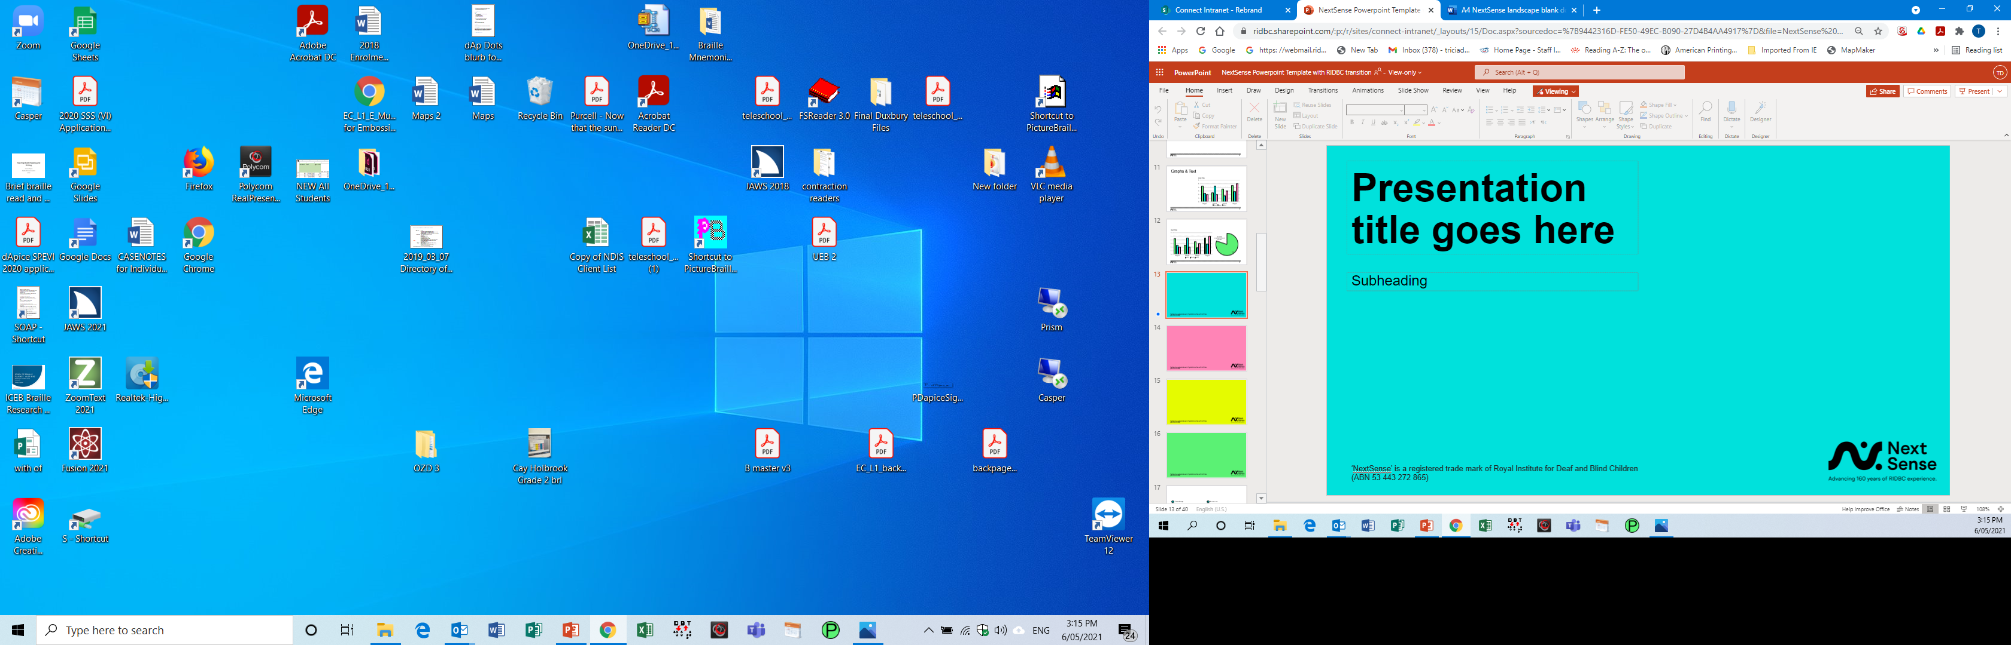
Resources created since Braille Fluency research.
Tricia d’Apice
Roundtable 2021

Slide 2
Research Results
Research results were as suspected:
of the 73 students who had their Oral reading fluency assessed, one student exceeded the sighted norms
The rest were behind the sighted norms
The gap widened as the student got older.

Slide 3
Fluency
It is generally thought that reading fluency is directly related to comprehension …
– HOWEVER, our students are doing well in school!!
– Is this statement the case with Braille reading?

Slide 4
What has happened since this research?
Anecdotal observations
The majority of reading accuracy errors were Braille reversals.
Parents invest a great deal of time and money in their sighted children’s literacy …
… however, they may not have the resources or knowledge to be able to do the same with their child who is blind.

Slide 5
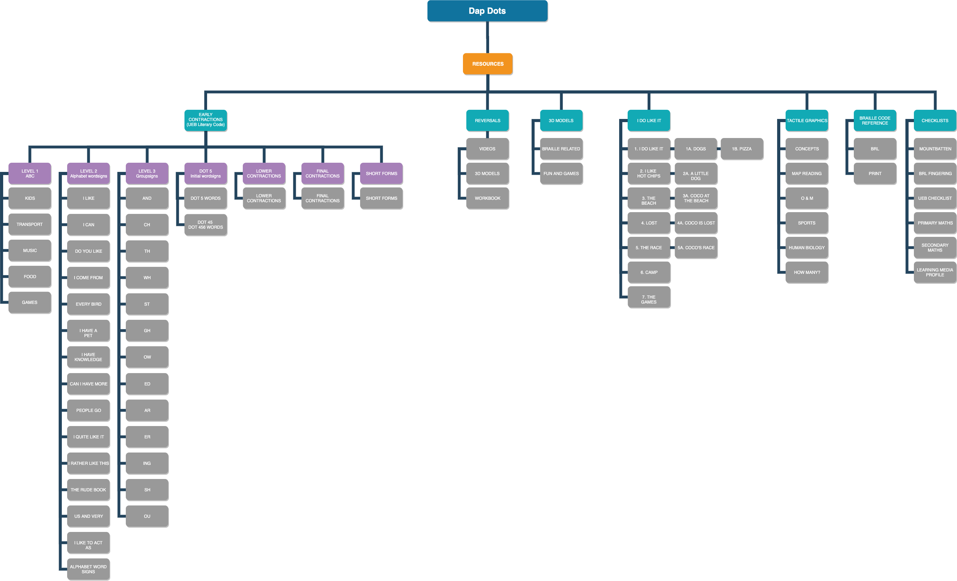
2. Resources made for parents since research.
95 items on website

Slide 6
dApDots
54 books, taking you step by step through the UEB literary code.

Slide 7
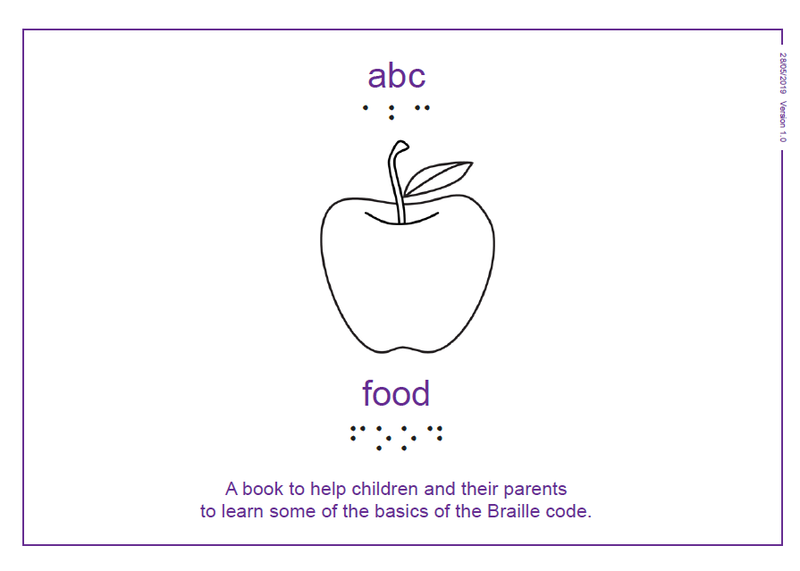
Alphabet books
ABC for Kids
ABC Transport
ABC Music
ABC Food
ABC Games

Slide 8
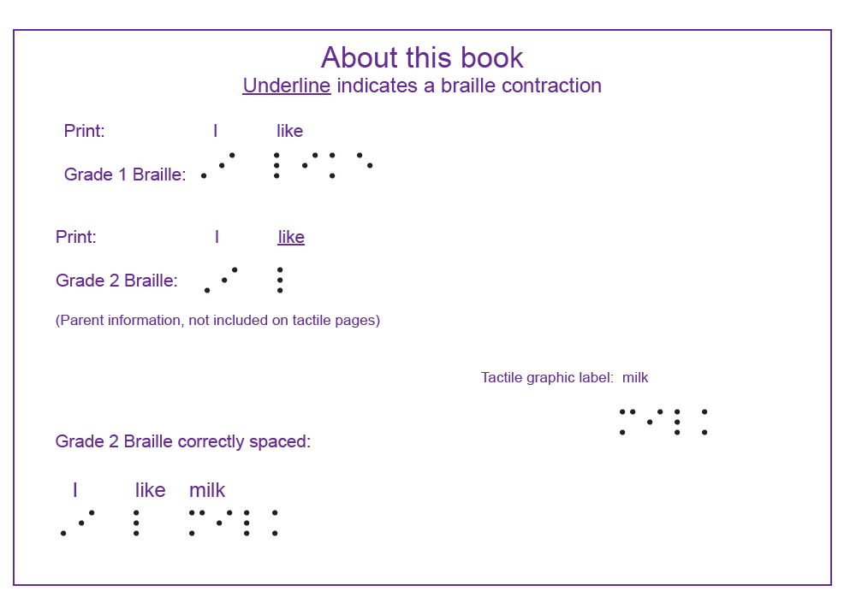
Standalone Wordsigns:

Slide 9
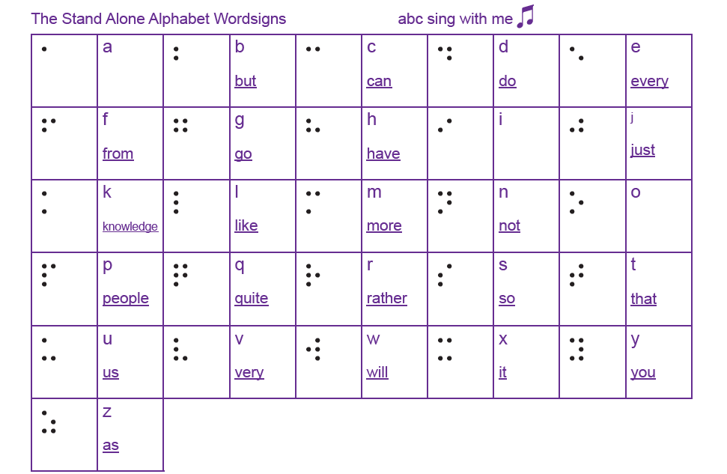
Last page of alphabet books

Slide 10
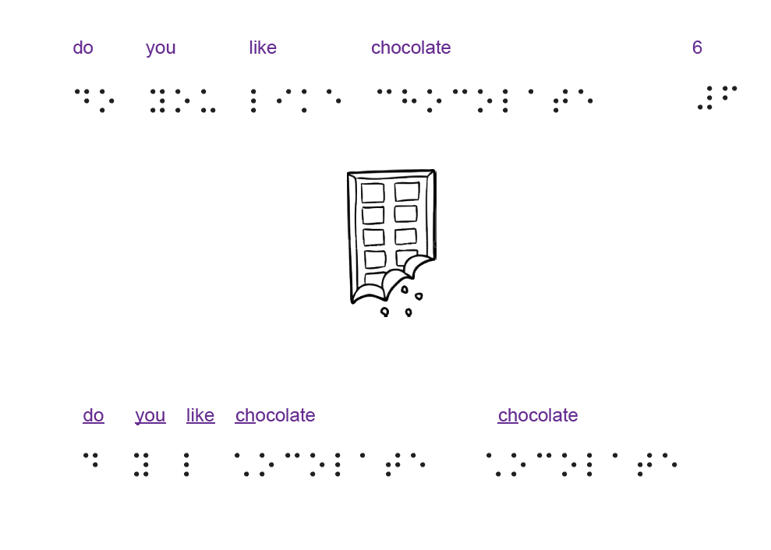
Stand alone alphabet wordsigns

Slide 11
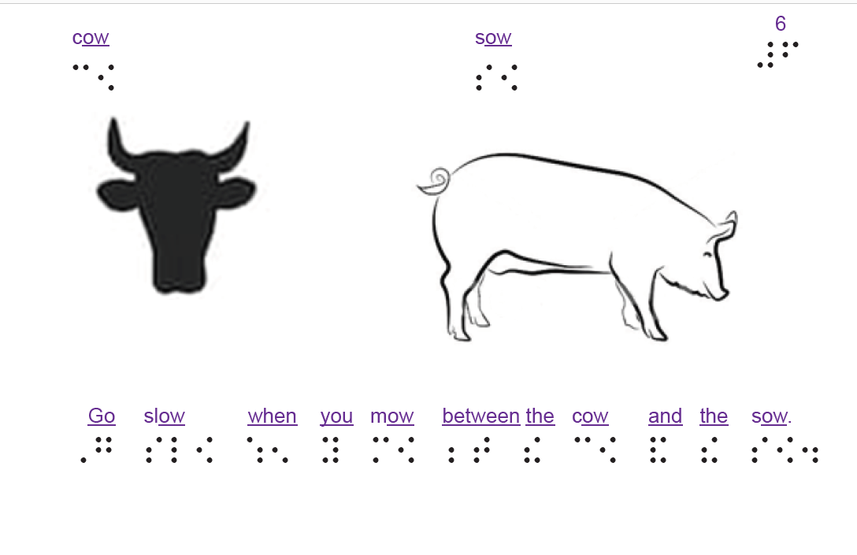
Group Signs

Slide 12
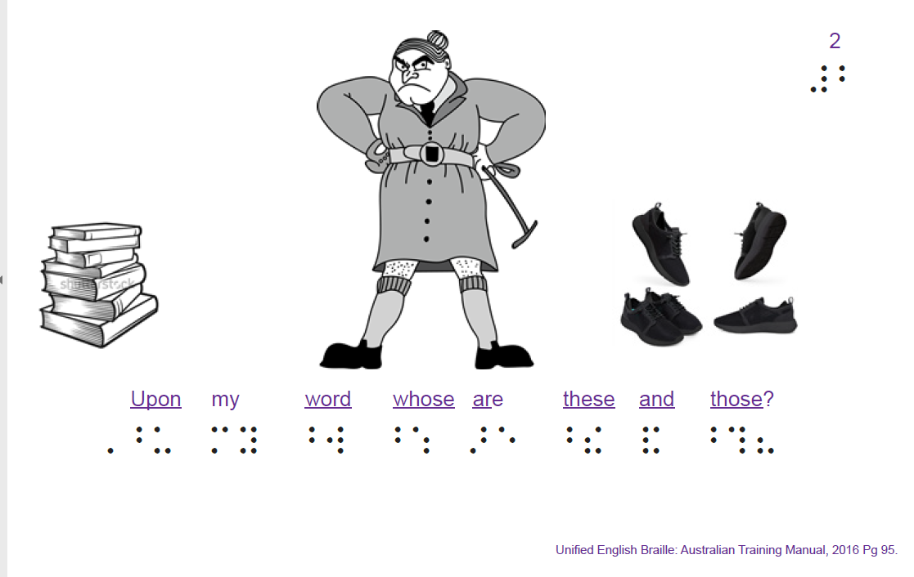
Initial wordsigns

Slide 13
All the UEB literary code
Lower Contractions
Final Contractions
Shortforms

Slide 14
Reversals:
3 reversal videos on YouTube
Reversals Workbook
3D Printing files x 3

Slide 15
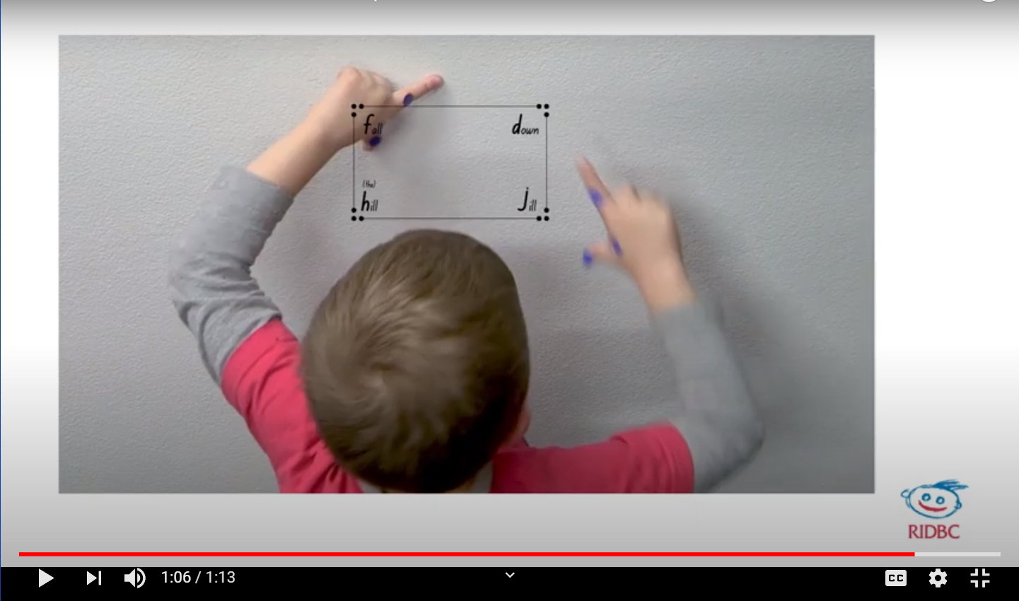
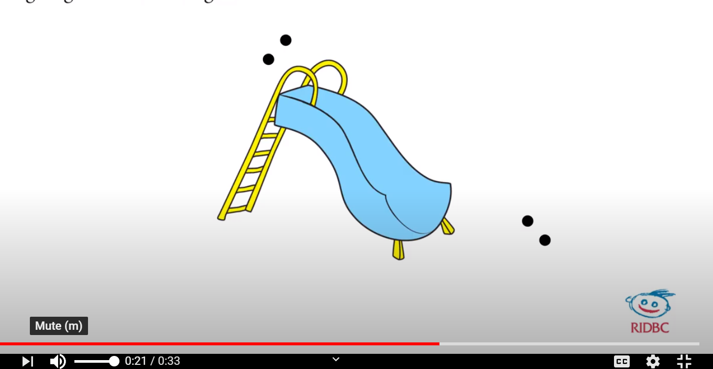
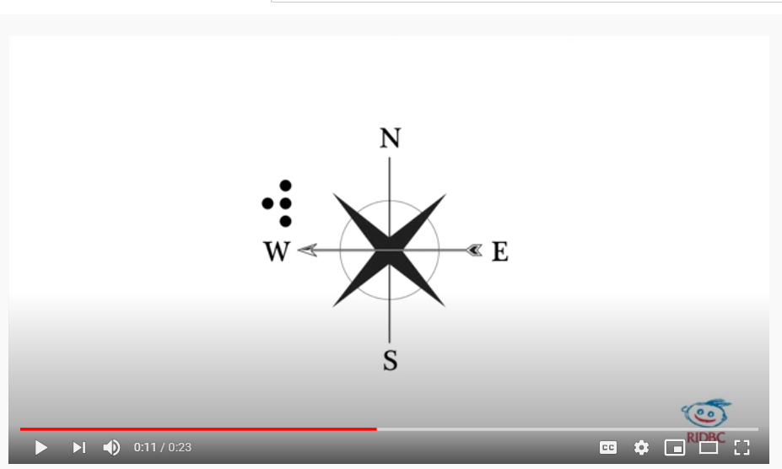
https://www.youtube.com/playlist?list=PL2OLz2SfD-DzGbKcjQ7Wh2TpZJLWnFiGo

Slide 16
1. Reversals, 3D printed
Magic Square (f,d,h,j)
Slippery dip (e, i)
Christmas Tree (st, ch)

Slide 17
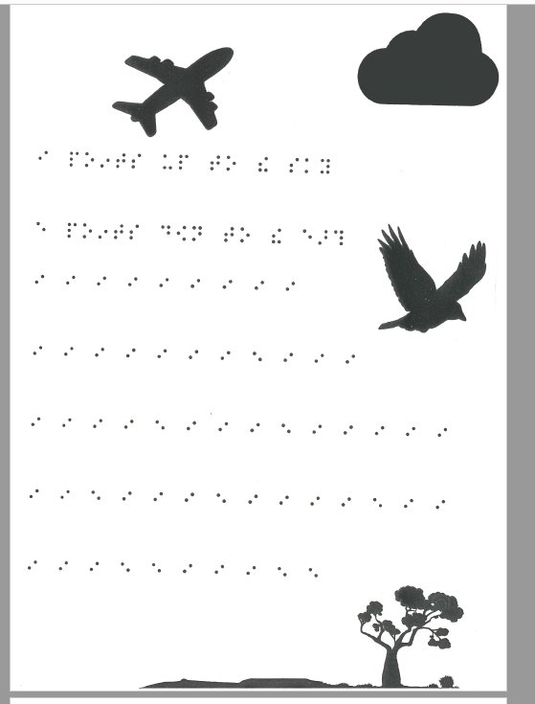
Reversal work book
Other pages
1. fdhj
2. and, y
3. n, ed
4. the, z
5. p, th
6. st, ch
7. m, sh
8. with, of

Slide 18
6 Tactile graphic kits
16 3D printing files
6 checklists

Slide 19
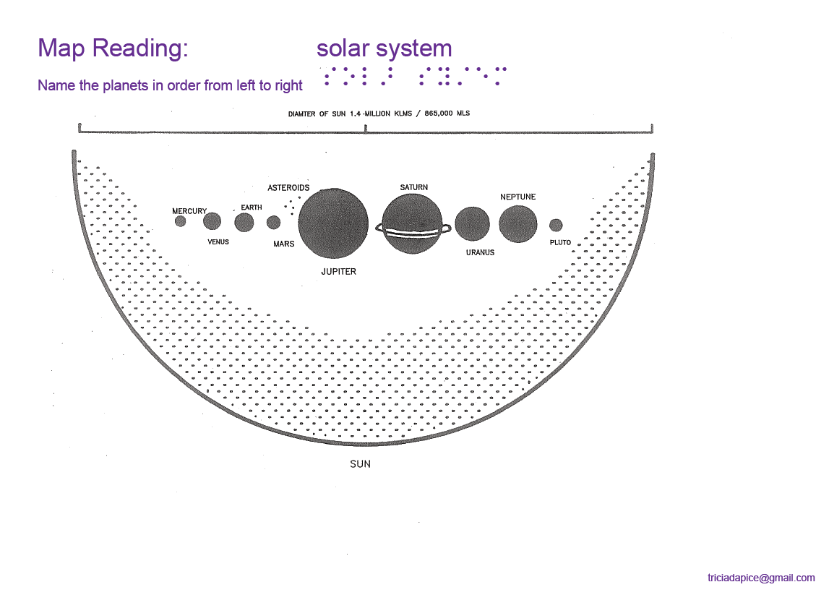
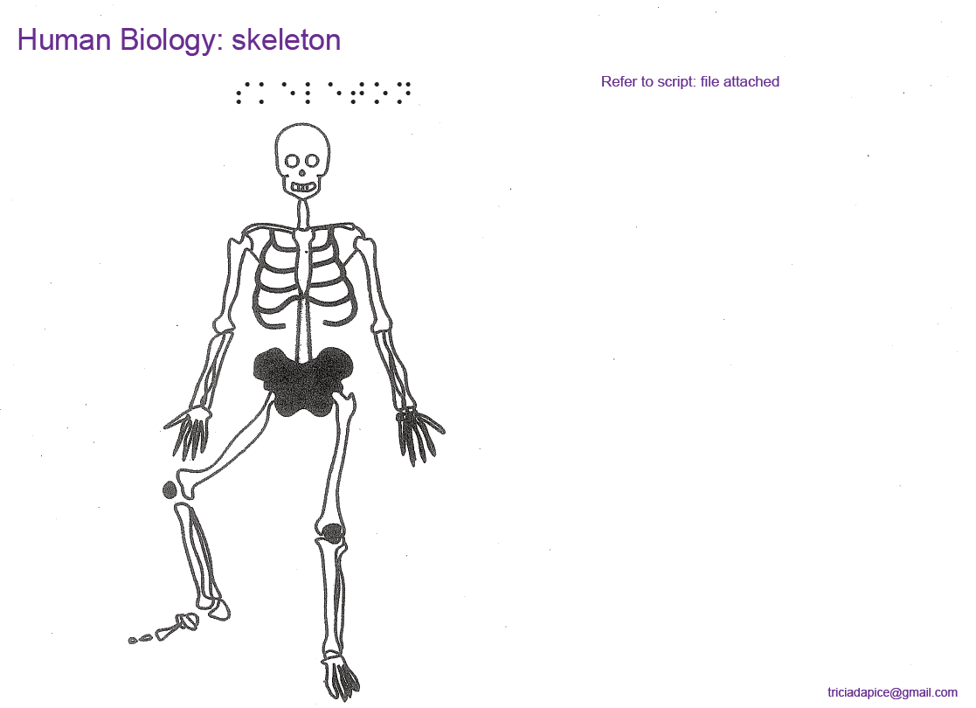
Tactile graphics kits
Map reading
Human Biology
Concept development
Sports
Orientation and Mobility
How Many?

Slide 20
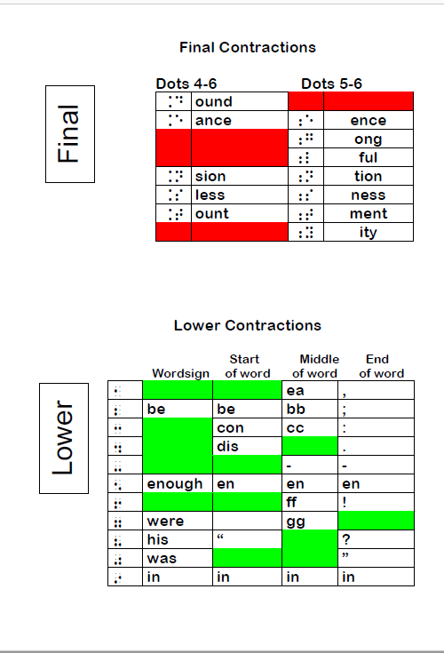
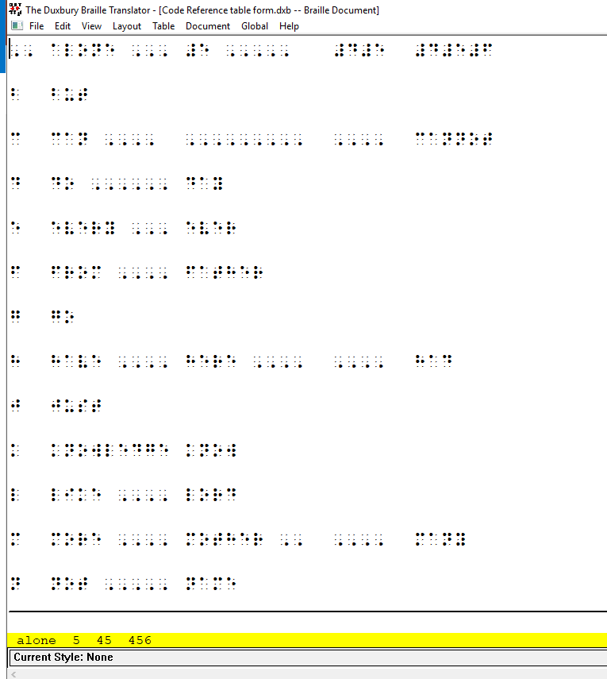
Braille Reference Books

Slide 21
Thank you
All files available for $10 Australian, for the entire bundle. (Make them yourself!)
dApdots.ridbc.org.au

Slide 22
