Slide 1
3D printing for accessible graphics: A progress report
Kim Marriott Inclusive Technologies, Human-Centred Computing, Monash University

Slide 2
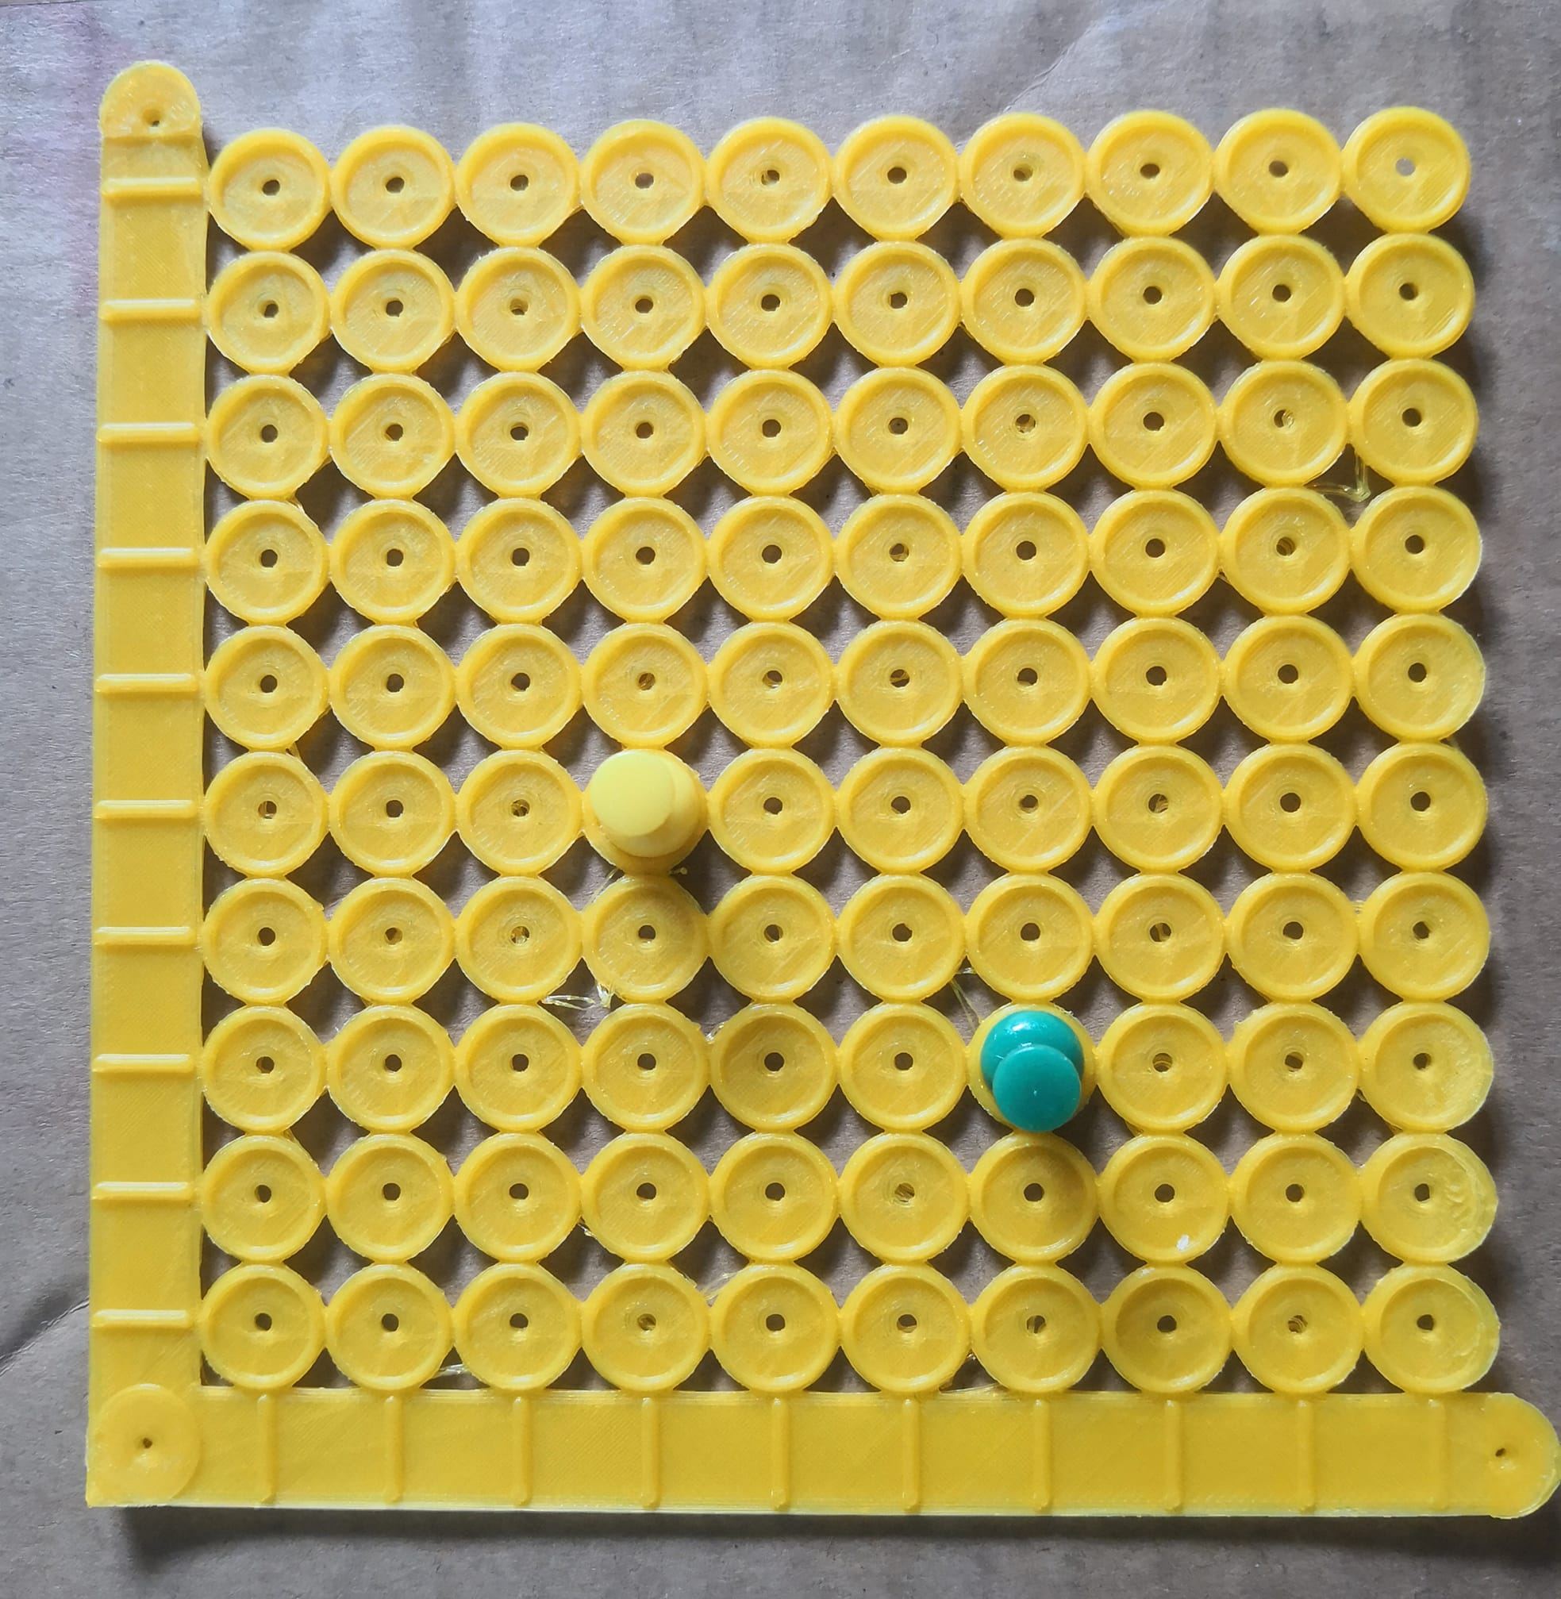
Outline
ARC project
Education
Mapping
Building Capacity
Next Steps

Slide 3
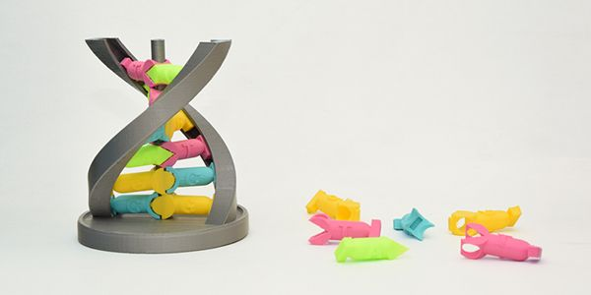
ARC Linkage

Slide 4
ARC Linkage Project
“Investigating the use of 3D printed models for access to graphics by people who are blind or have low vision”
Partners:
Round Table (with special support from SPEVI)
Department of Education, Victoria
NextSense
Guide Dogs Victoria
RSB
Project goals:
Clarify when 3D prints are best suited for touch readers
Build capacity within the national accessible format provision sector for the production and use of 3D prints

Slide 5
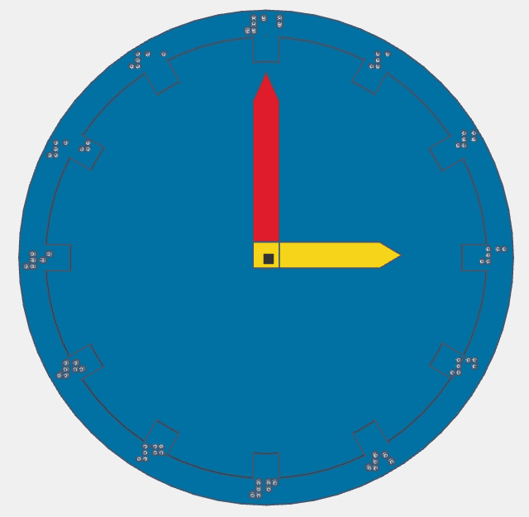
Project Timeline
October 2018 - Project launch
May 2020 - ANAGG 3D printing group formed
May 2021 - 2021 Round Table Conference
October 2021 - Original project end
March 2022 - Expected extended end date

Slide 6
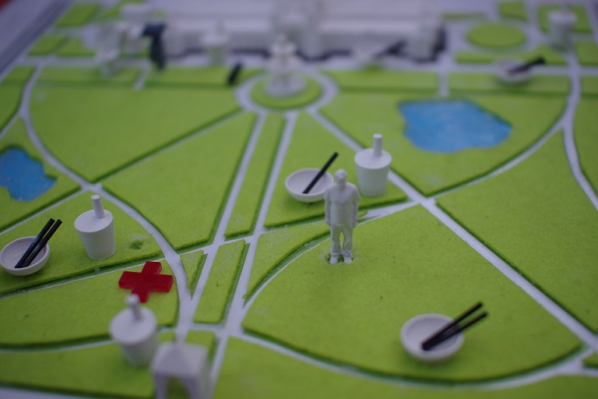
Evidence supporting the use of 3D printing for touch readers
3D printed models:
Can be understood more easily than tactile graphics
Are more engaging
Allows more time for teaching concepts
Are more inclusive
Can be used by blind and sighted together
Therefore seen as of more value for use/display in public places

Slide 7
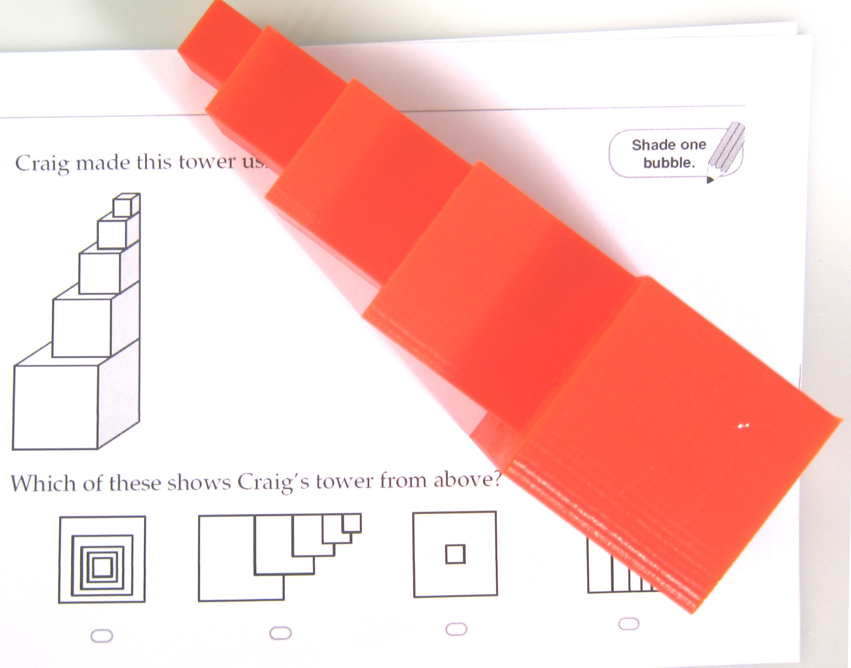
Education

Slide 8
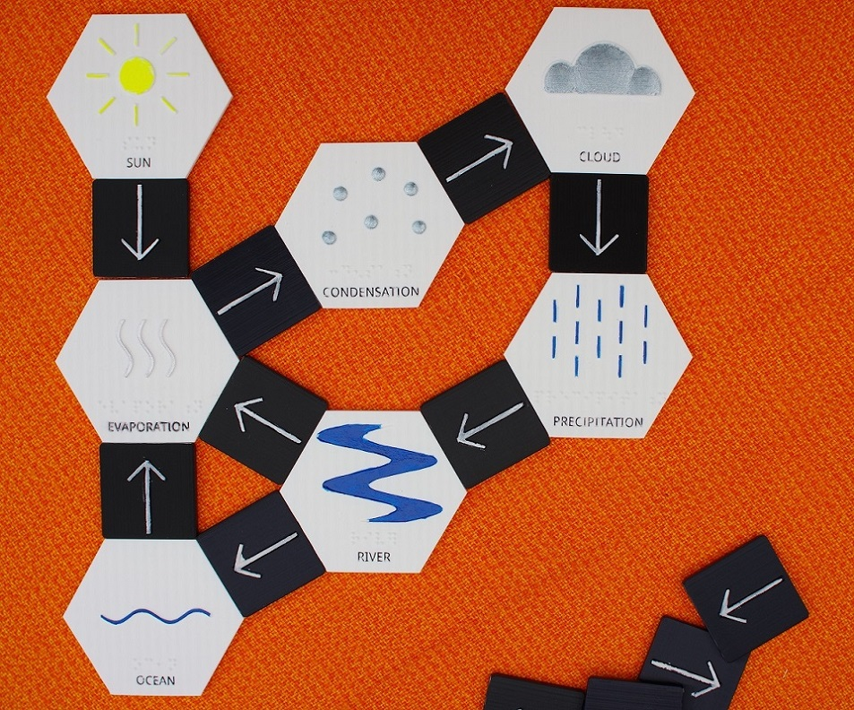
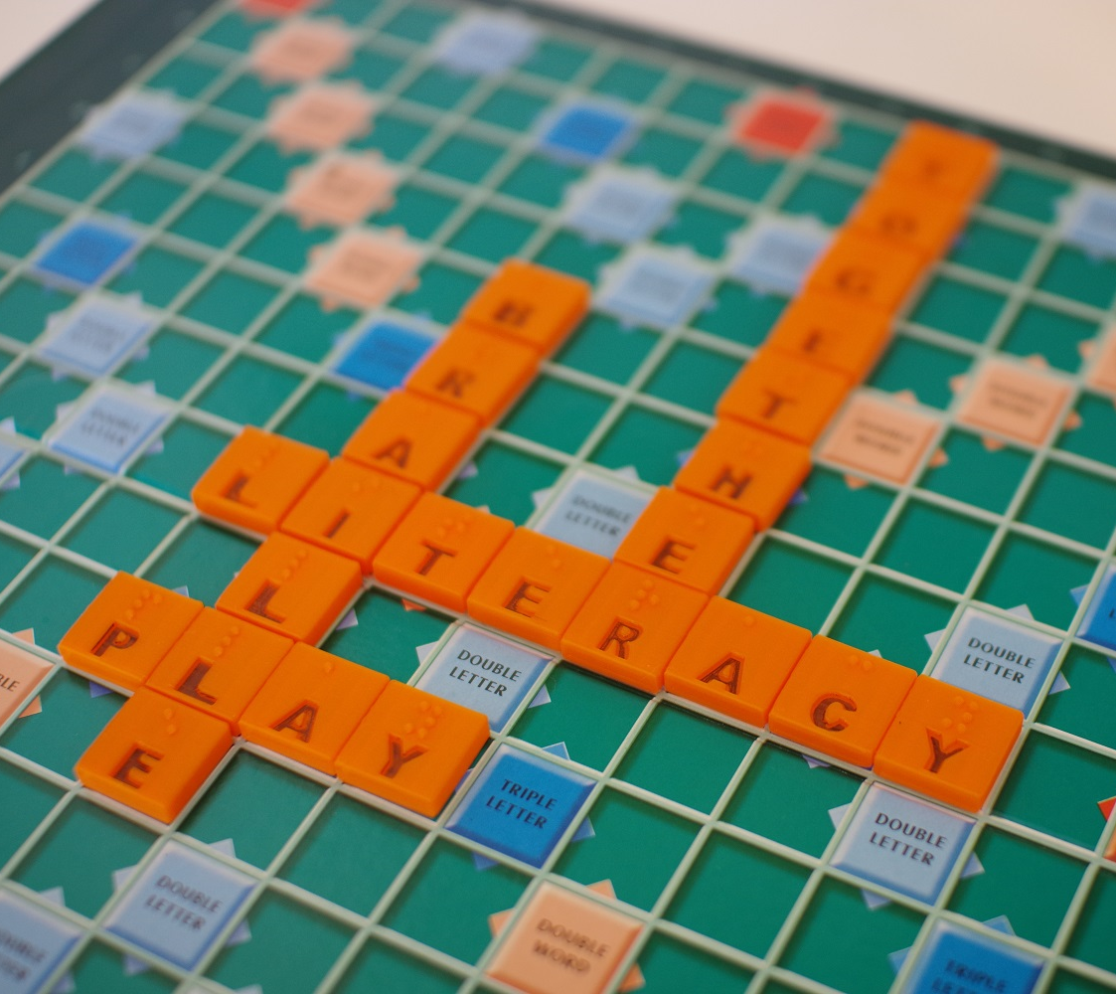
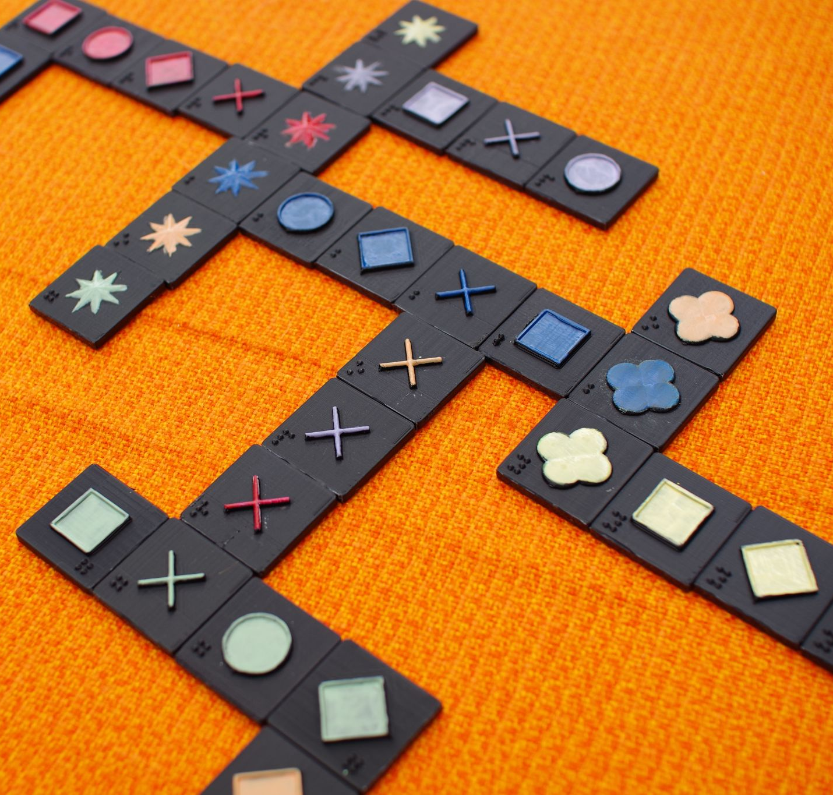
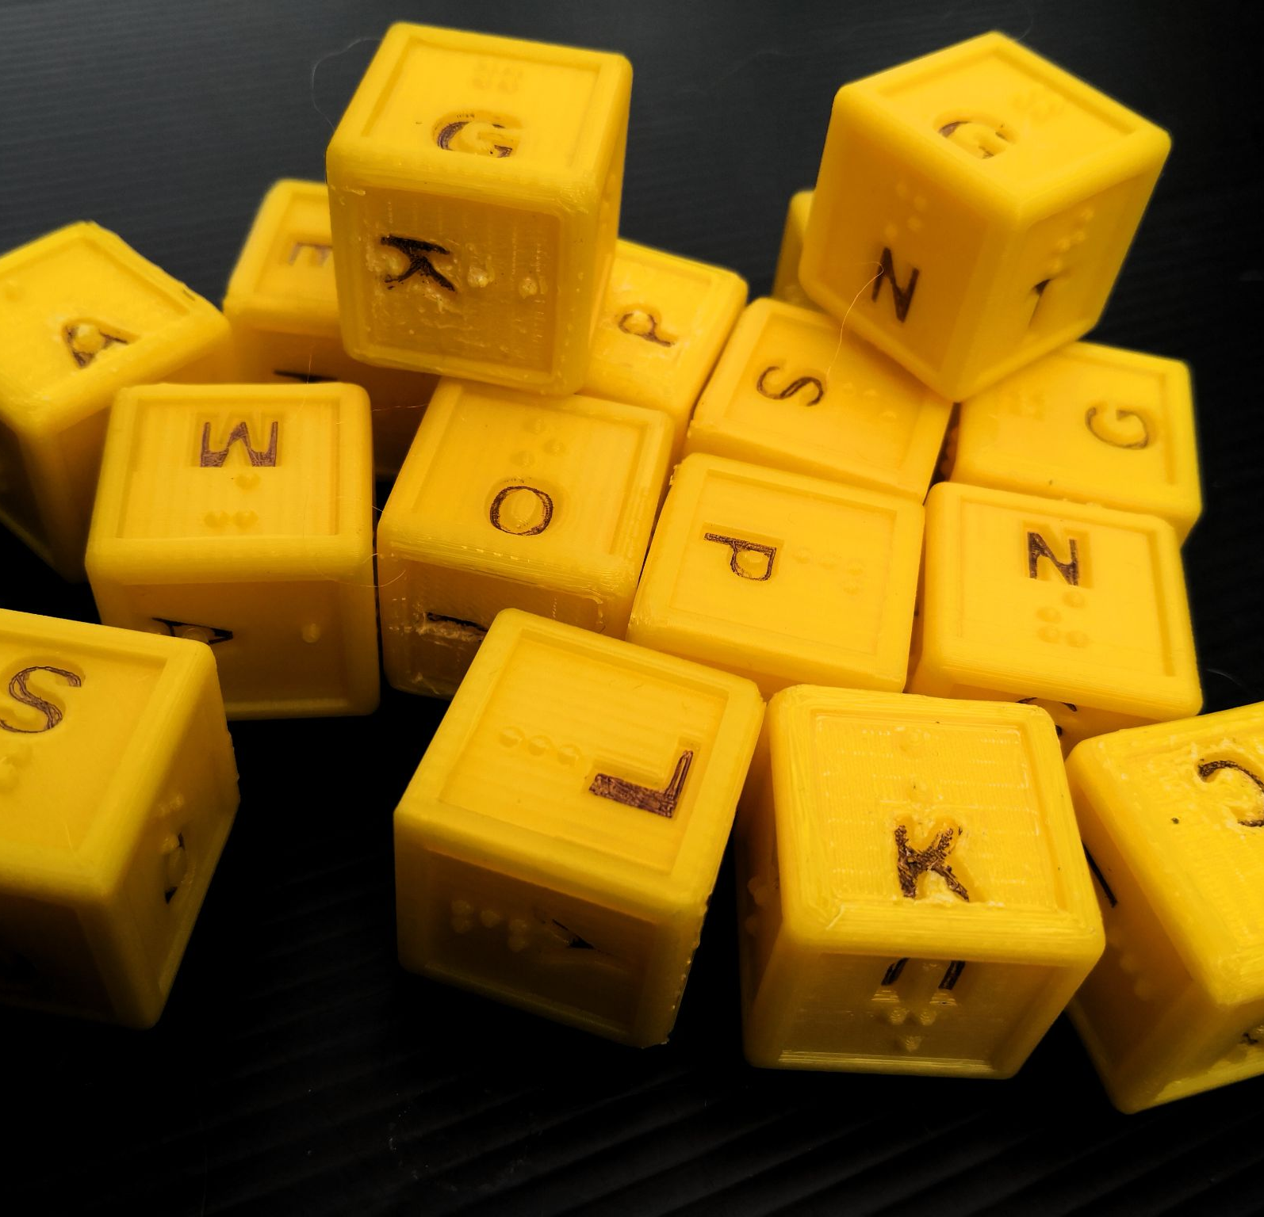
Education
We have examined:
What tools and materials are currently being used in the K-2 classroom, and where are the gaps?
What 3D printing models are available for BLV students?
What 3D printing models are most popular for BLV students?
> “Top Ten” 3D printable models
Next steps:
Feedback from classrooms

Slide 9
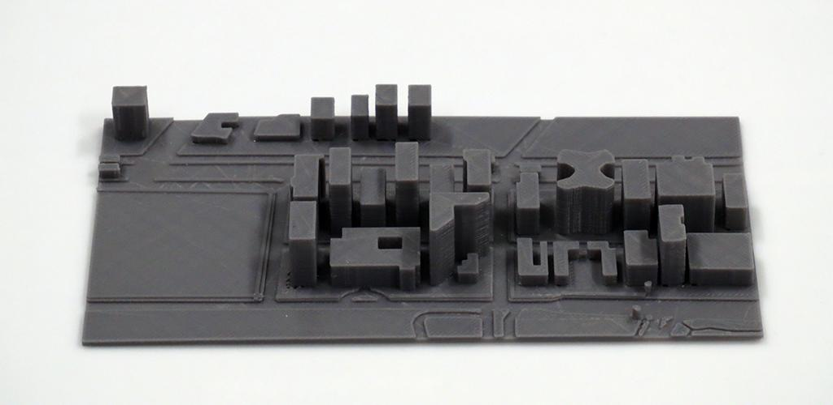
Mapping

Slide 10
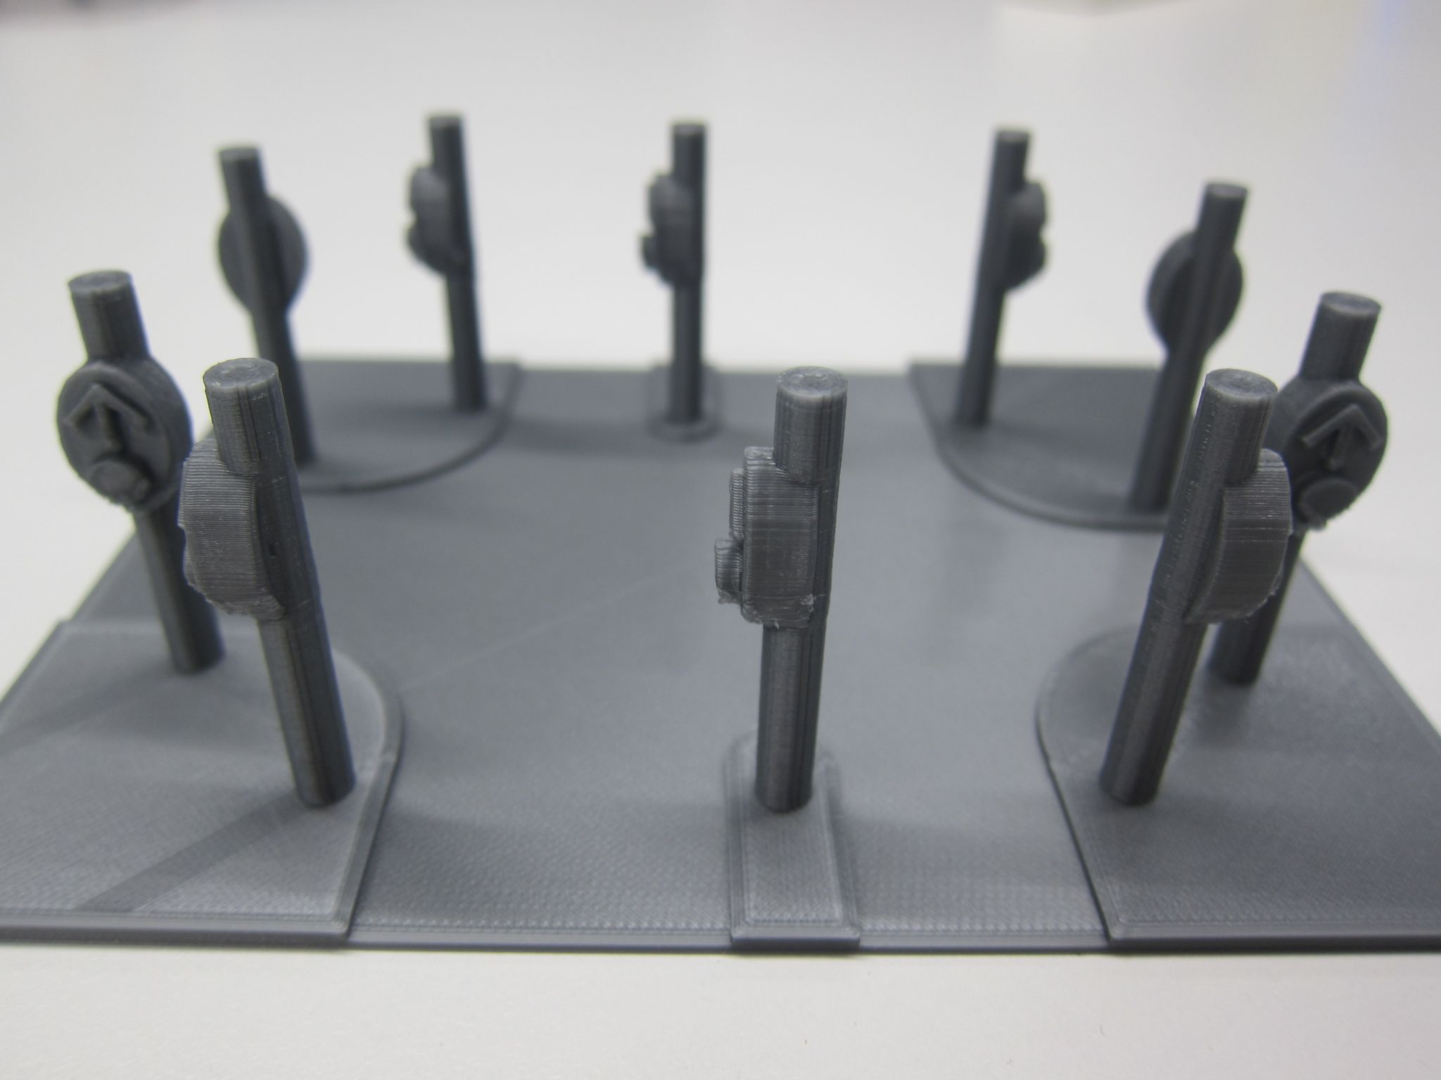
3D printed maps - Round Table 2019 workshop
Round Table 2019 workshop outcomes:
3D icons are helpful
3D icons do not need to be tall
Indented roads make sense

Slide 11
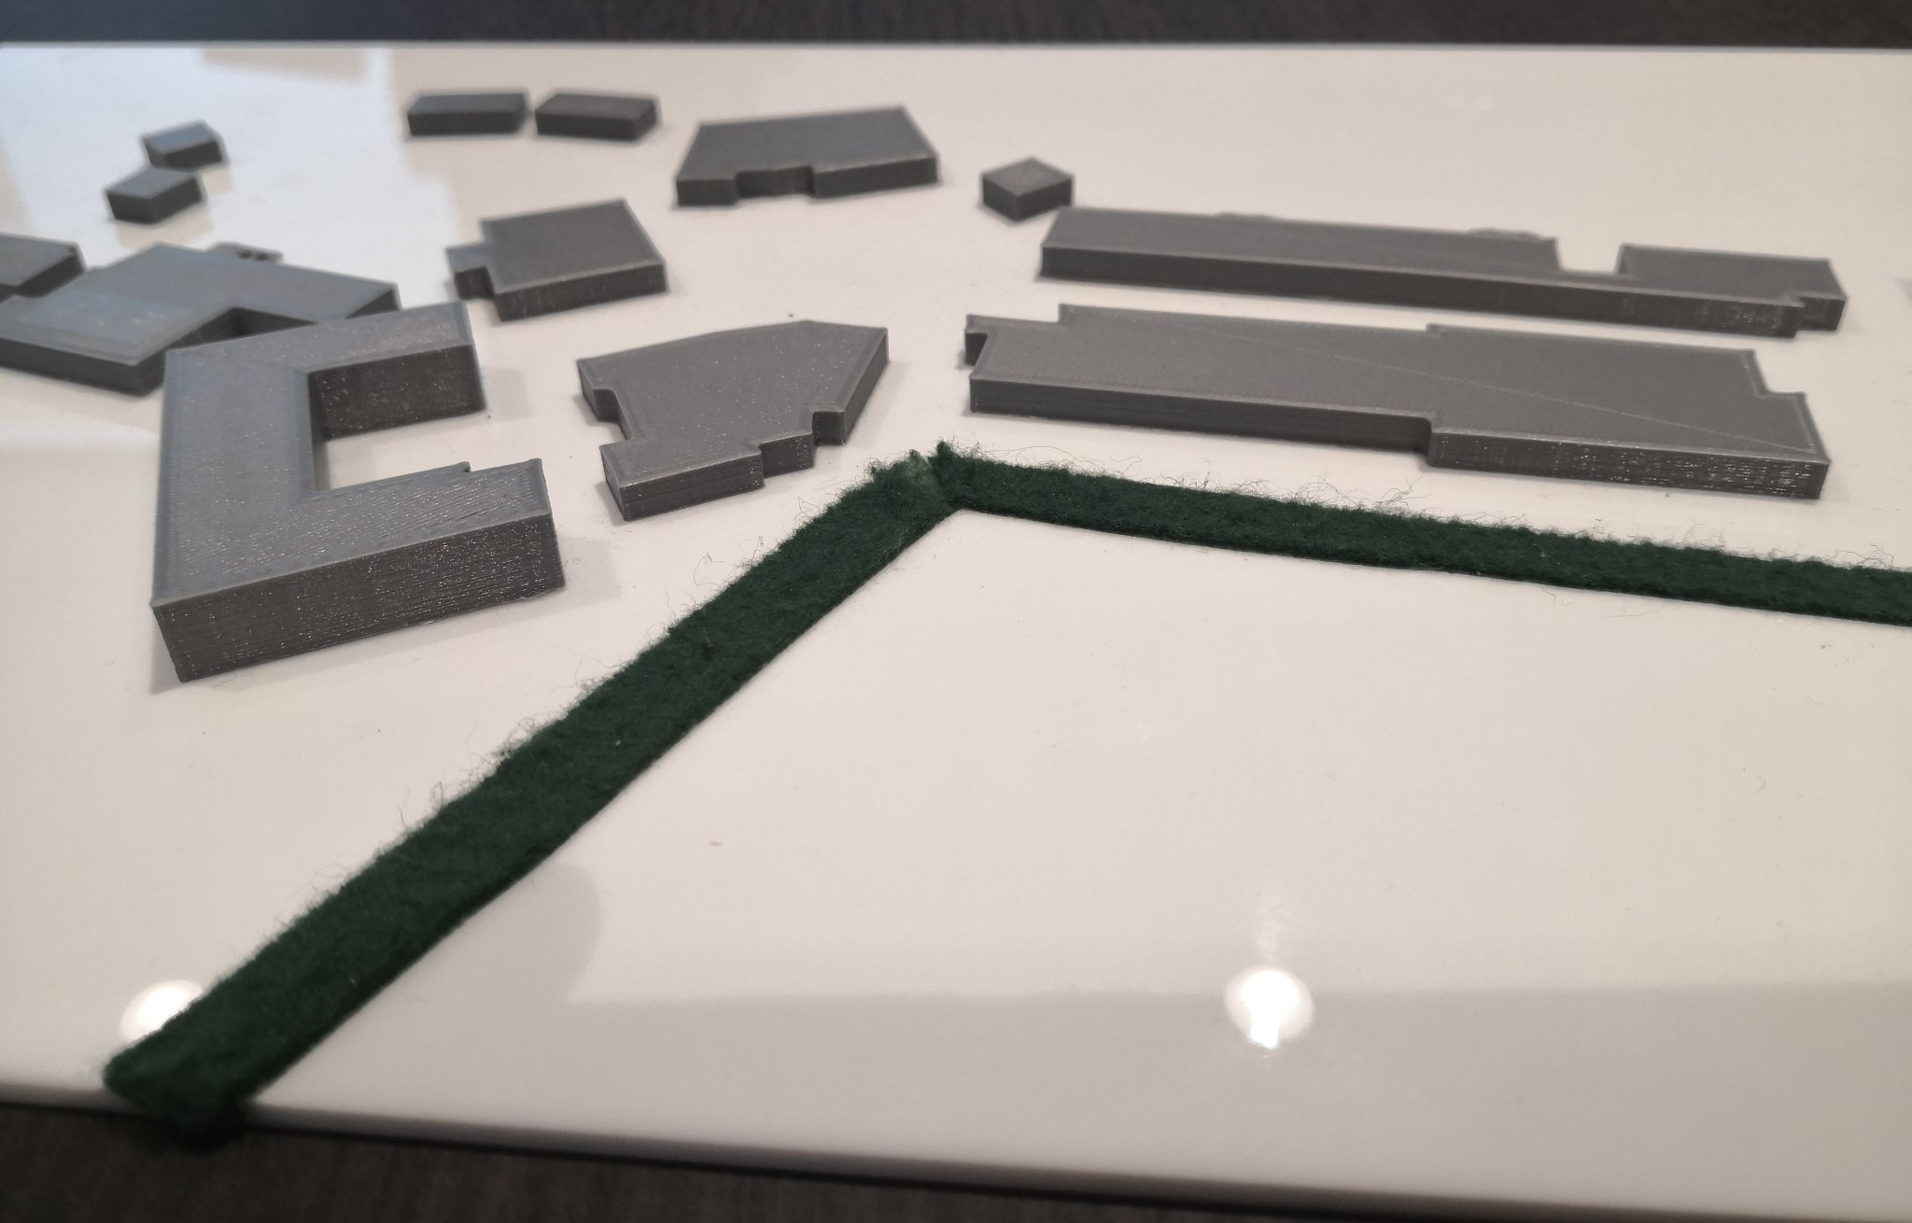
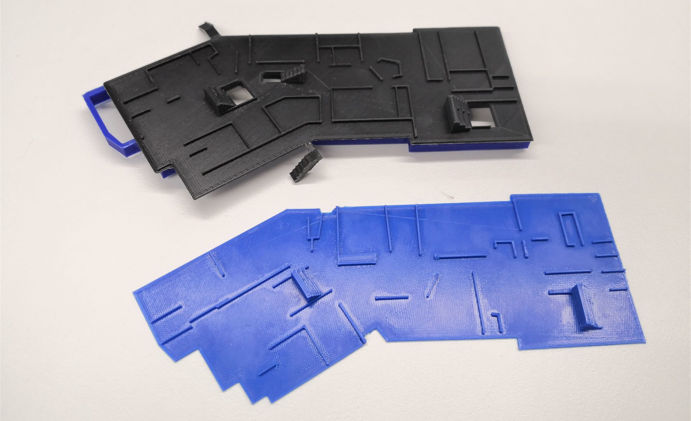
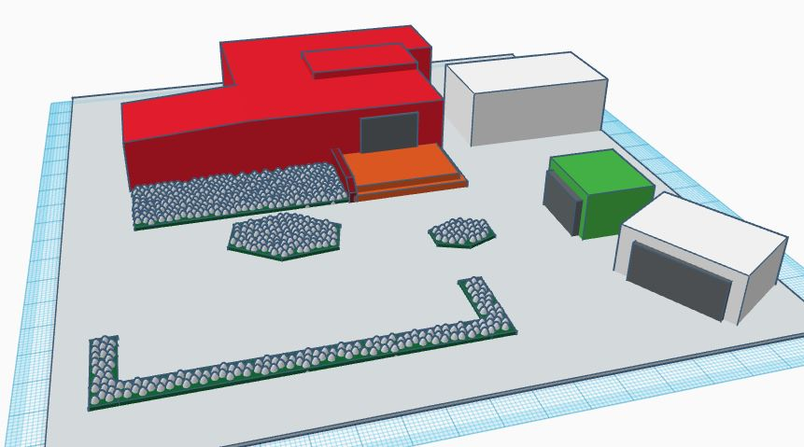
School Maps
Whole school layout
Year 7 area with doors, stairs and garden beds indicated
2-storey building with rooms and stairs

Slide 12
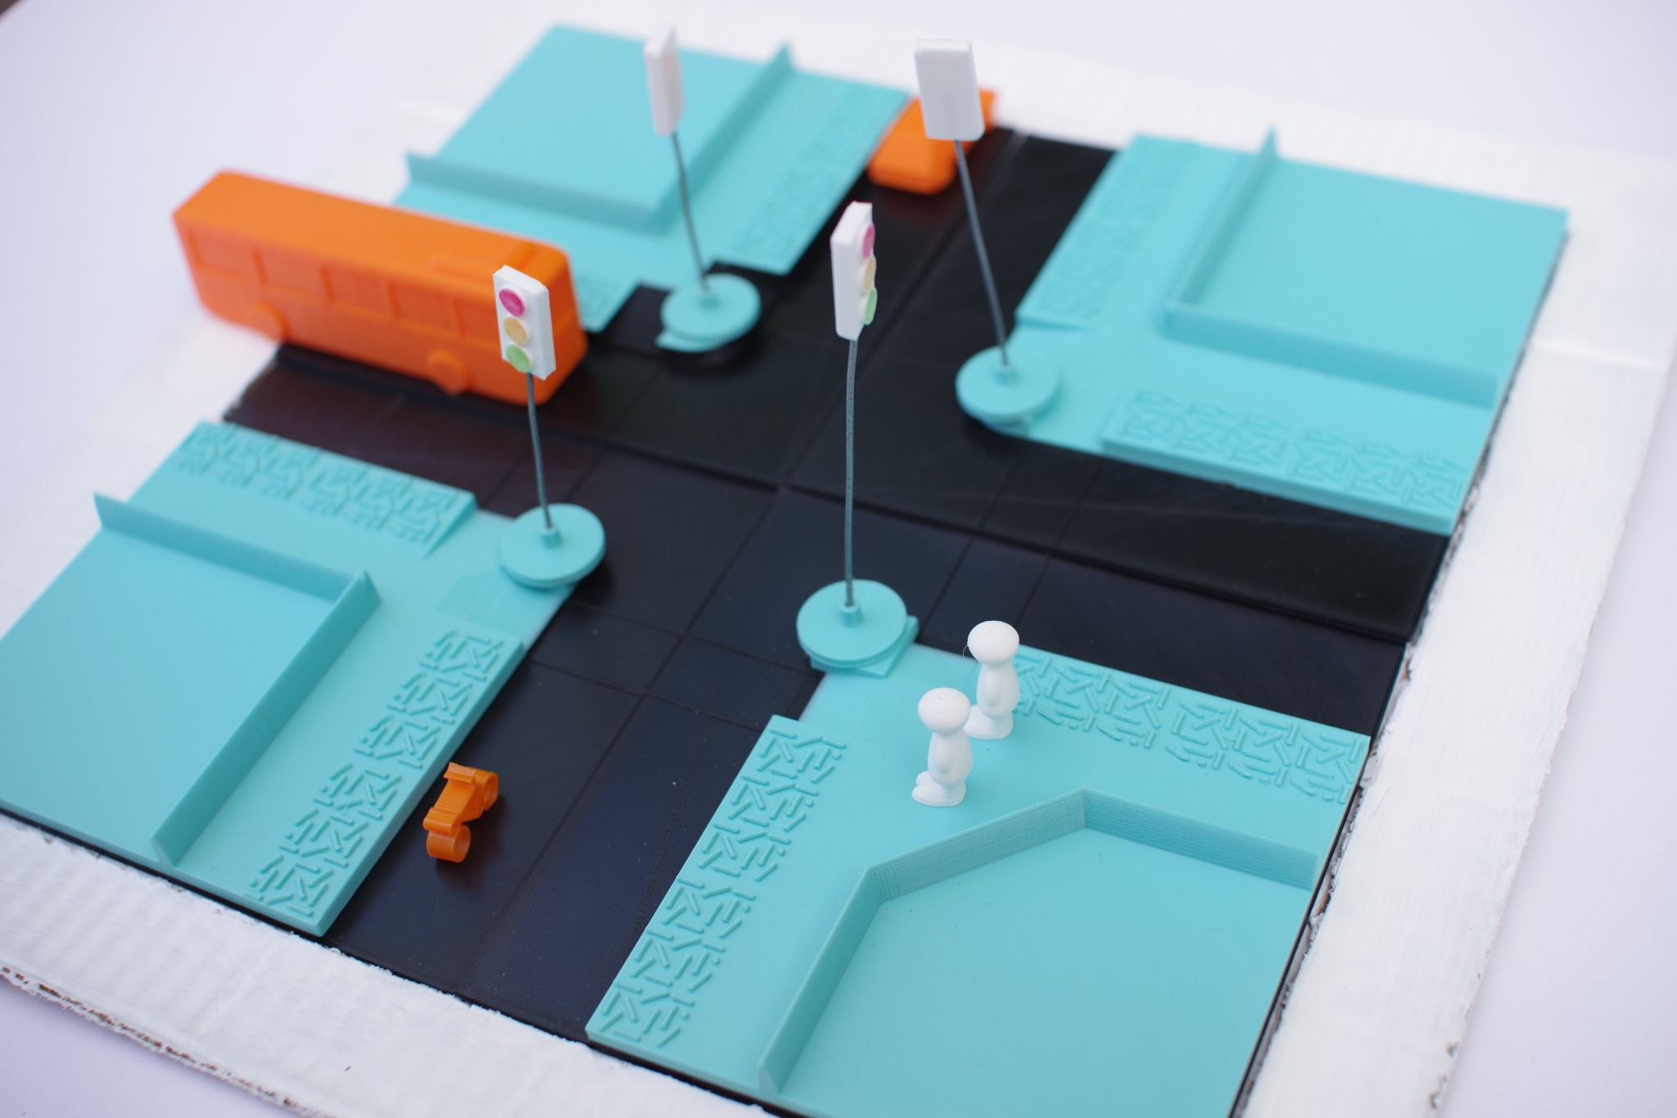
3D printed maps - street crossings
Based on consultation with O&M professionals.
3D prints are helpful because they are:
Portable (light and durable)
Customisable
Easy to understand by touch
Professional in appearance
Creation of 3D printed components that can be used to teach concepts for street crossings.

Slide 13
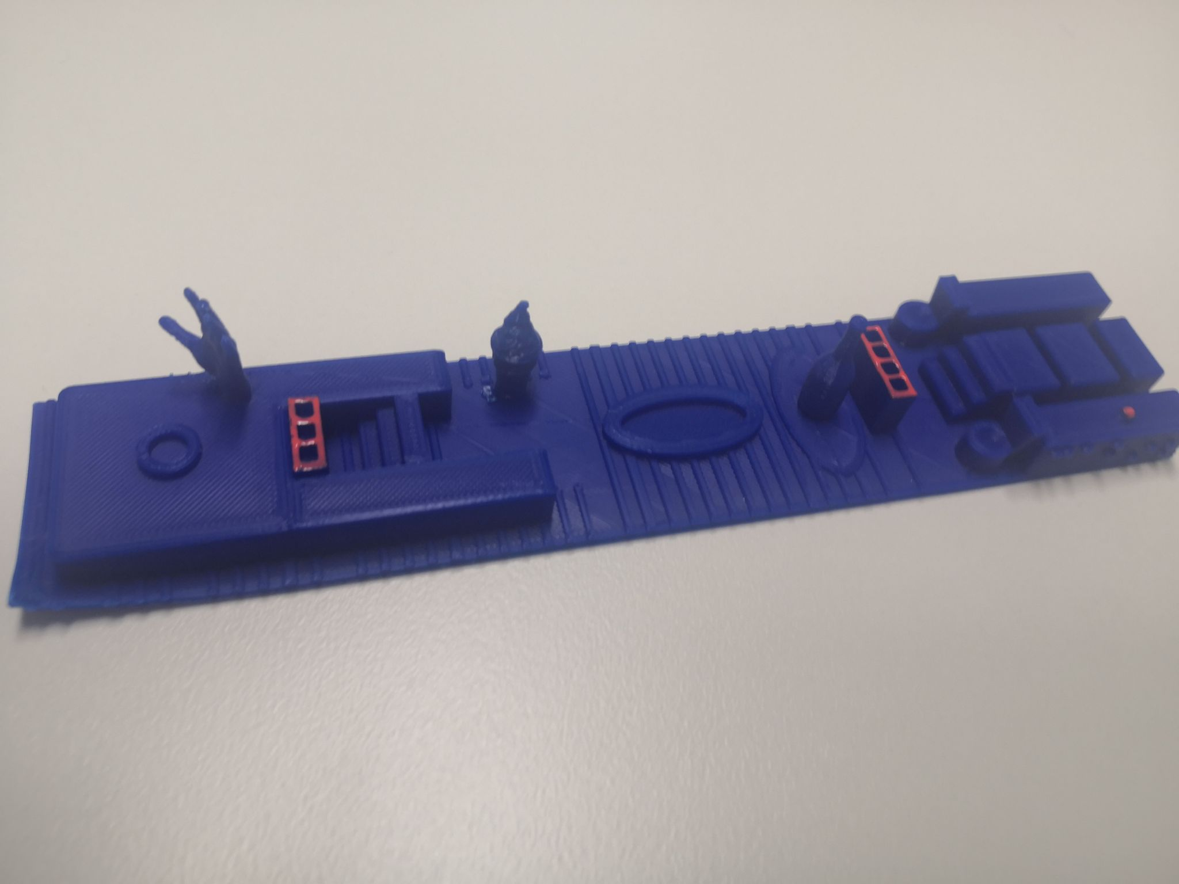
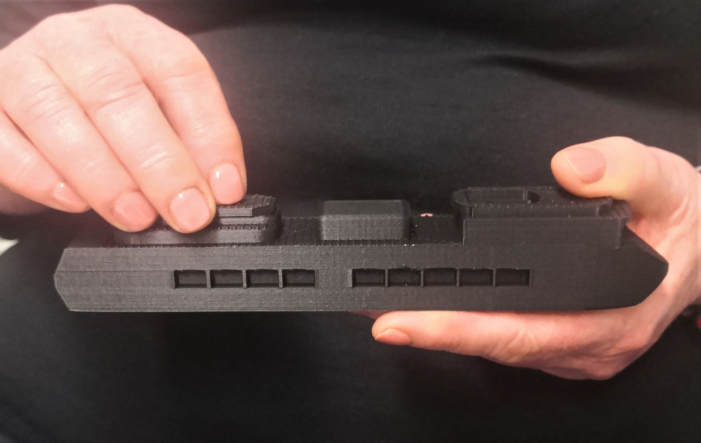
3D printed cruise ship
Floorplan with icons
Ship model illustrating relationship between upper levels
Stephens, Butler, Holloway, Goncu & Marriott (2020) Smooth Sailing? An Autoethnography of Recreational Travel by a Blind Person, ASSETS

Slide 14
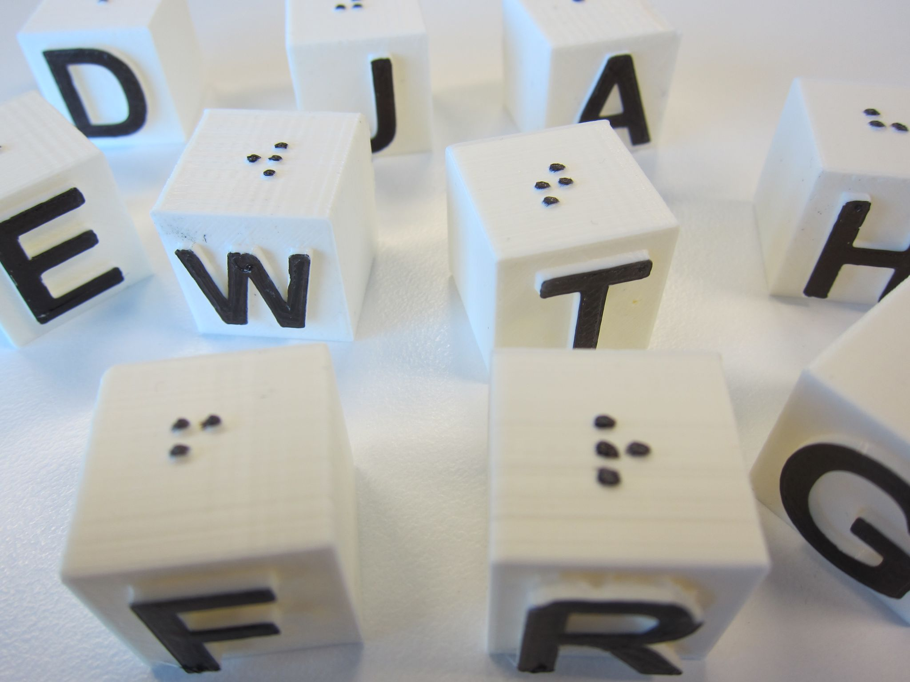
Building Capacity

Slide 15
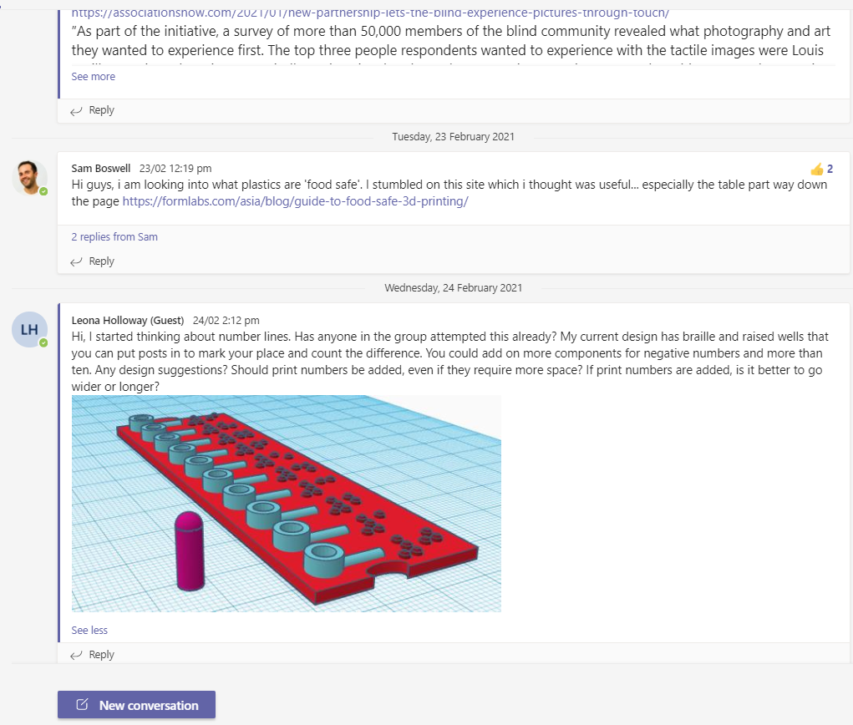
ANZAGG 3D printing group
Members:
Australia, New Zealand and international guests
Mainly in VI education sector.
At all stages in adoption of 3D printing
Activities:
Monthly zoom meeting
Sharing files and ideas via Teams
Assisting with guidelines

Slide 16
Guidelines
http://printdisability.org/about-us/accessible- graphics/3d-printing/
When to use 3D printing for touch readers
Where to find 3D printing designs
3D printing design software
3D printing by people who are blind or have low vision
Finishing – Preparing 3D prints for touch readers
Understanding 3D prints through touch

Slide 17
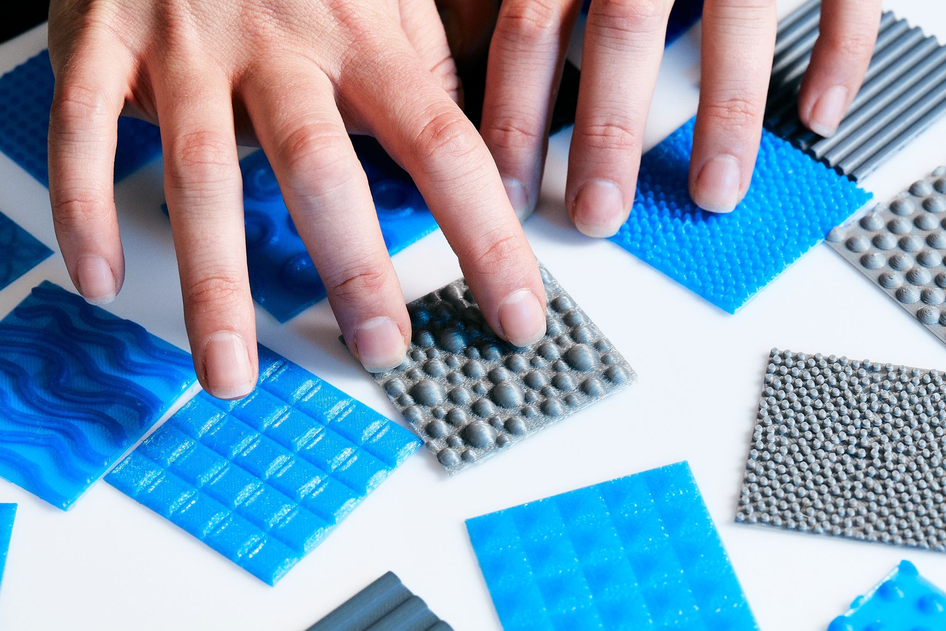
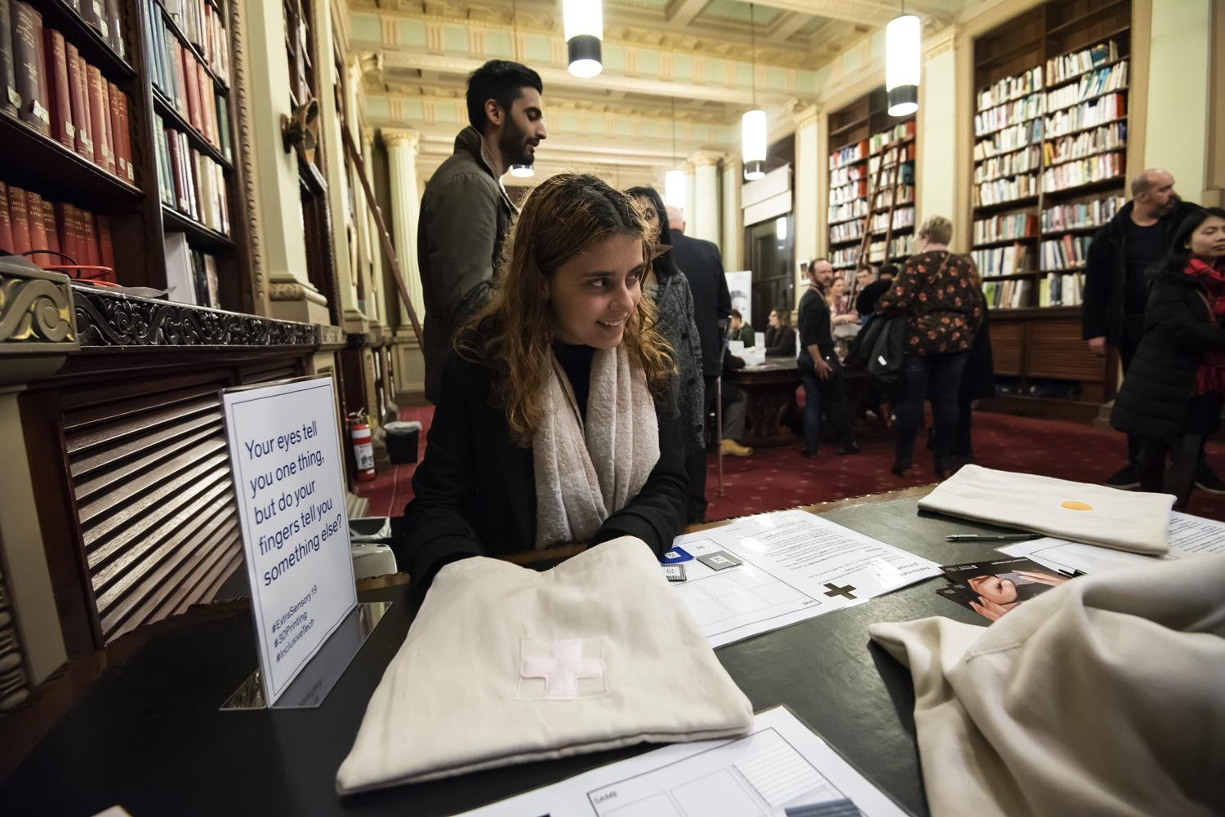
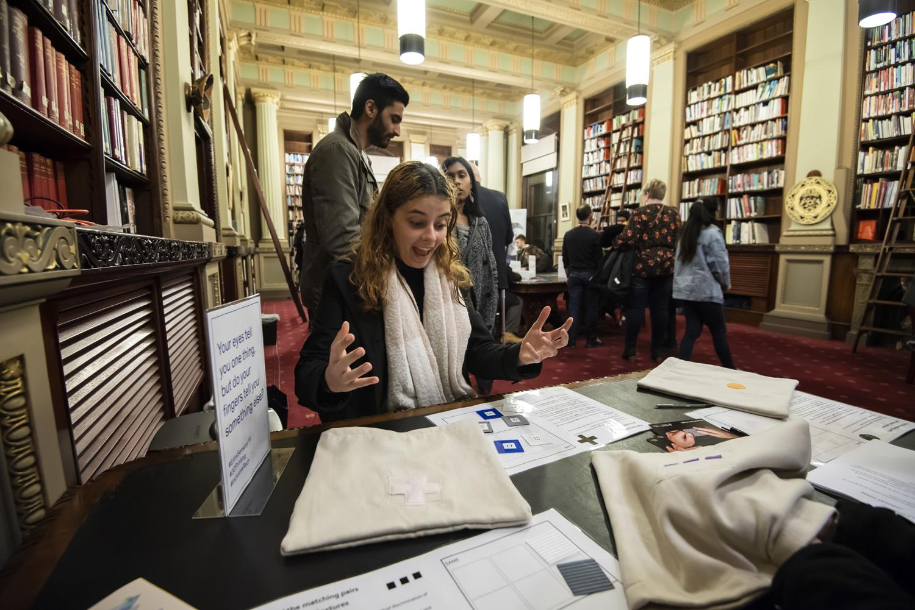
3D Printed Textures

Slide 18
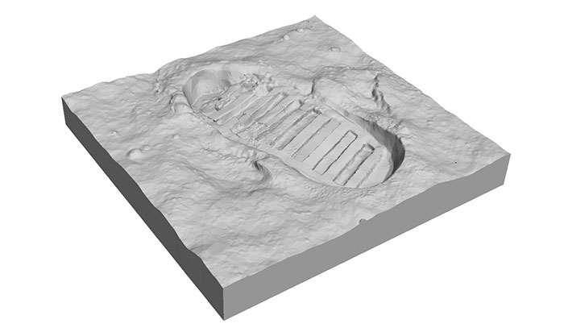
Next steps

Slide 19
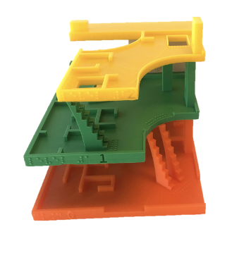
Multi-level 3D Printed Maps
What presentation of 3D printed floor plans is most useful in developing a mental model of multi-level buildings?
Flat
Tiered
Sliding
Rotating

Slide 20
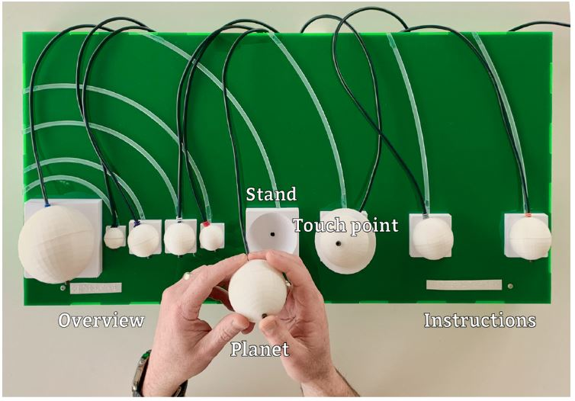
Interaction
Audio labelling
Reinders, S., Butler, M., & Marriott, K. (2020). "Hey Model!" – Natural User Interactions and Agency in Accessible Interactive 3D Models. CHI Conference on Human Factors in Computing Systems

Slide 21
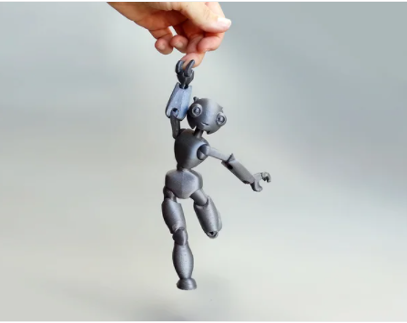
The future of 3D printing for accessible graphics
Already being adopted as a new format for accessible graphics
Standards coming soon
Lots of models available for touch readers
Vibrant ANZAGG 3D printing group

Slide 22
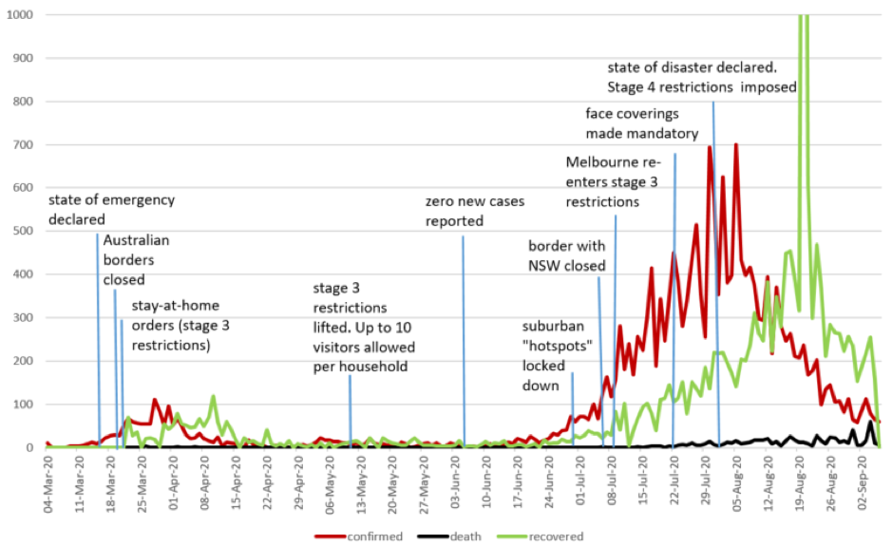
Sonification
Experimental Infosonics created and tested
Working towards future project:
SonoKids
Seeking partners

Slide 23
Questions?

Slide 24
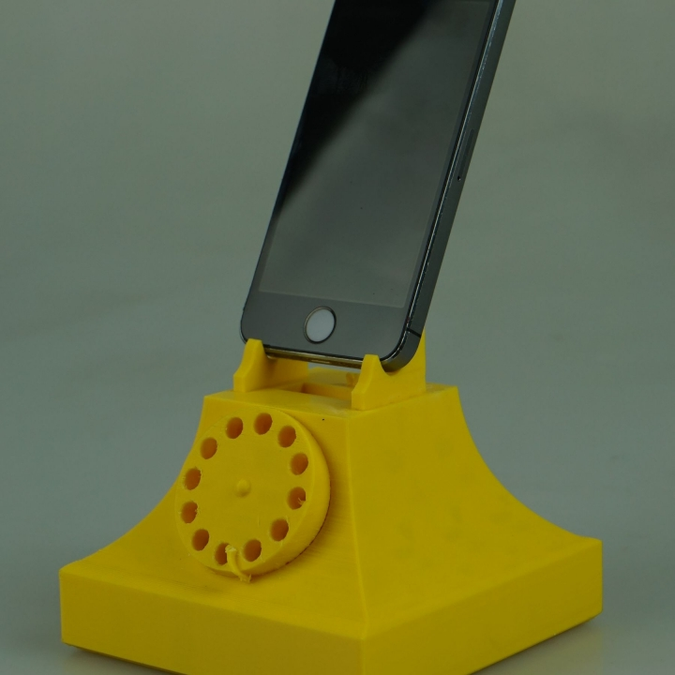
Contact Us
kim.marriott@monash.edu
leona.holloway@monash.edu
http://accessiblegraphics.org/research/3dprints/arc/

