Slide 1
3D Printing for Inclusive Classrooms
Braille and Large Print Services
Navkaran Virdi

Slide 2
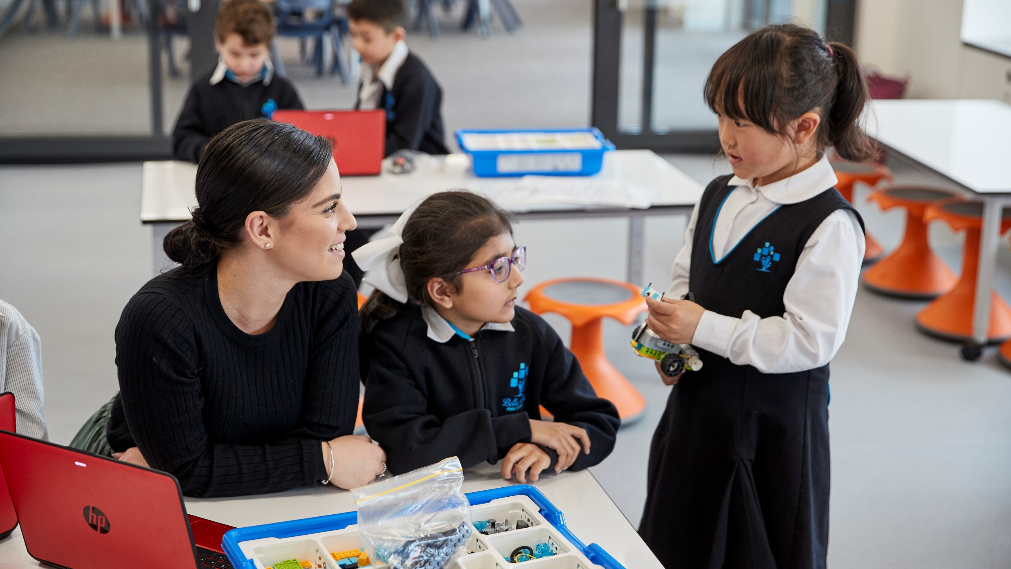
Overview

Slide 3
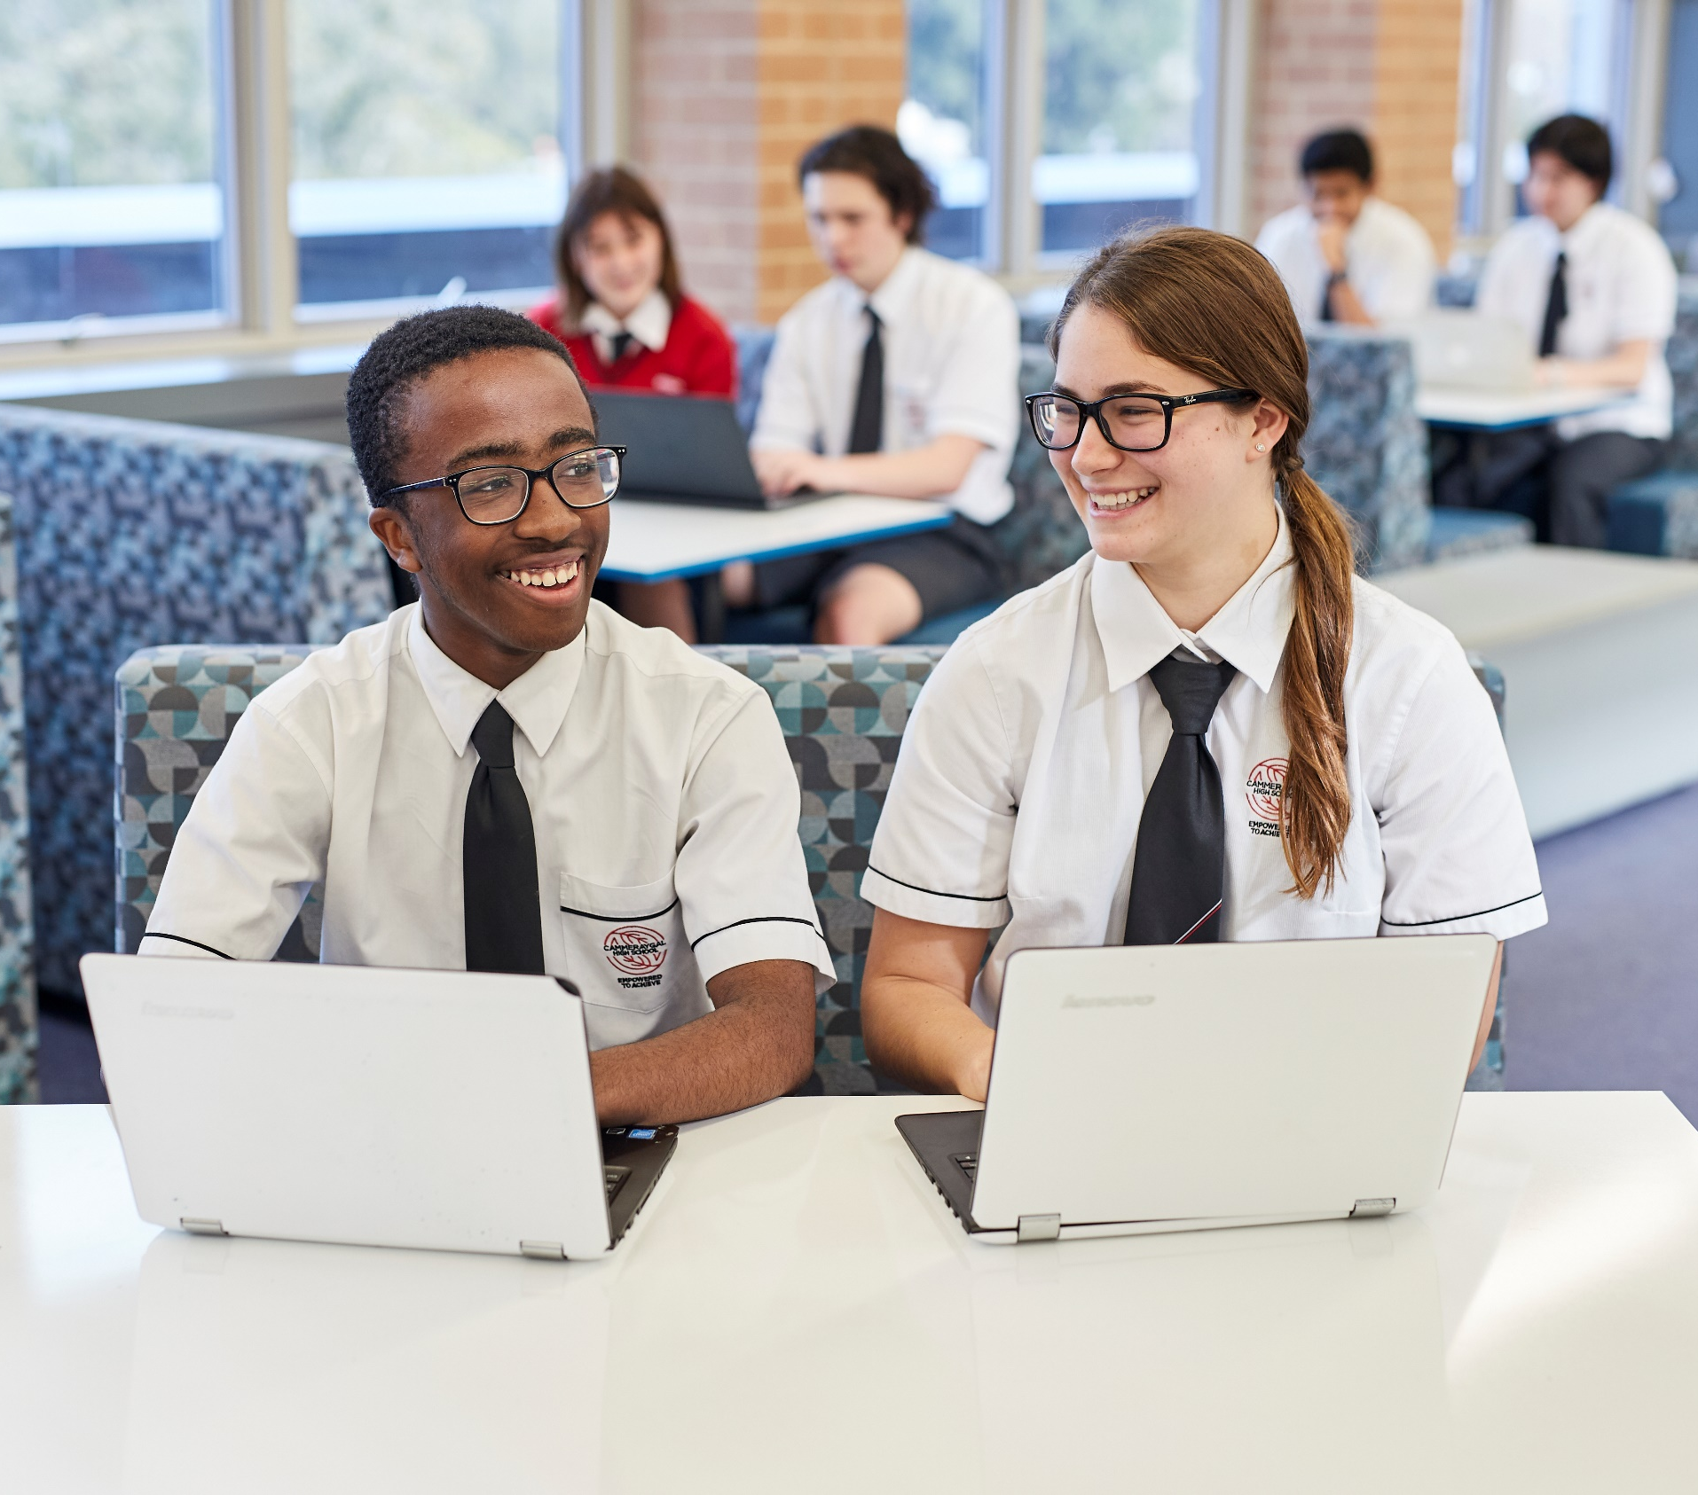
Contents
Why are 3D prints important?
What are we making?
Teacher feedback
How to use 3D prints with BVI students
How to order?
Contact

Slide 4
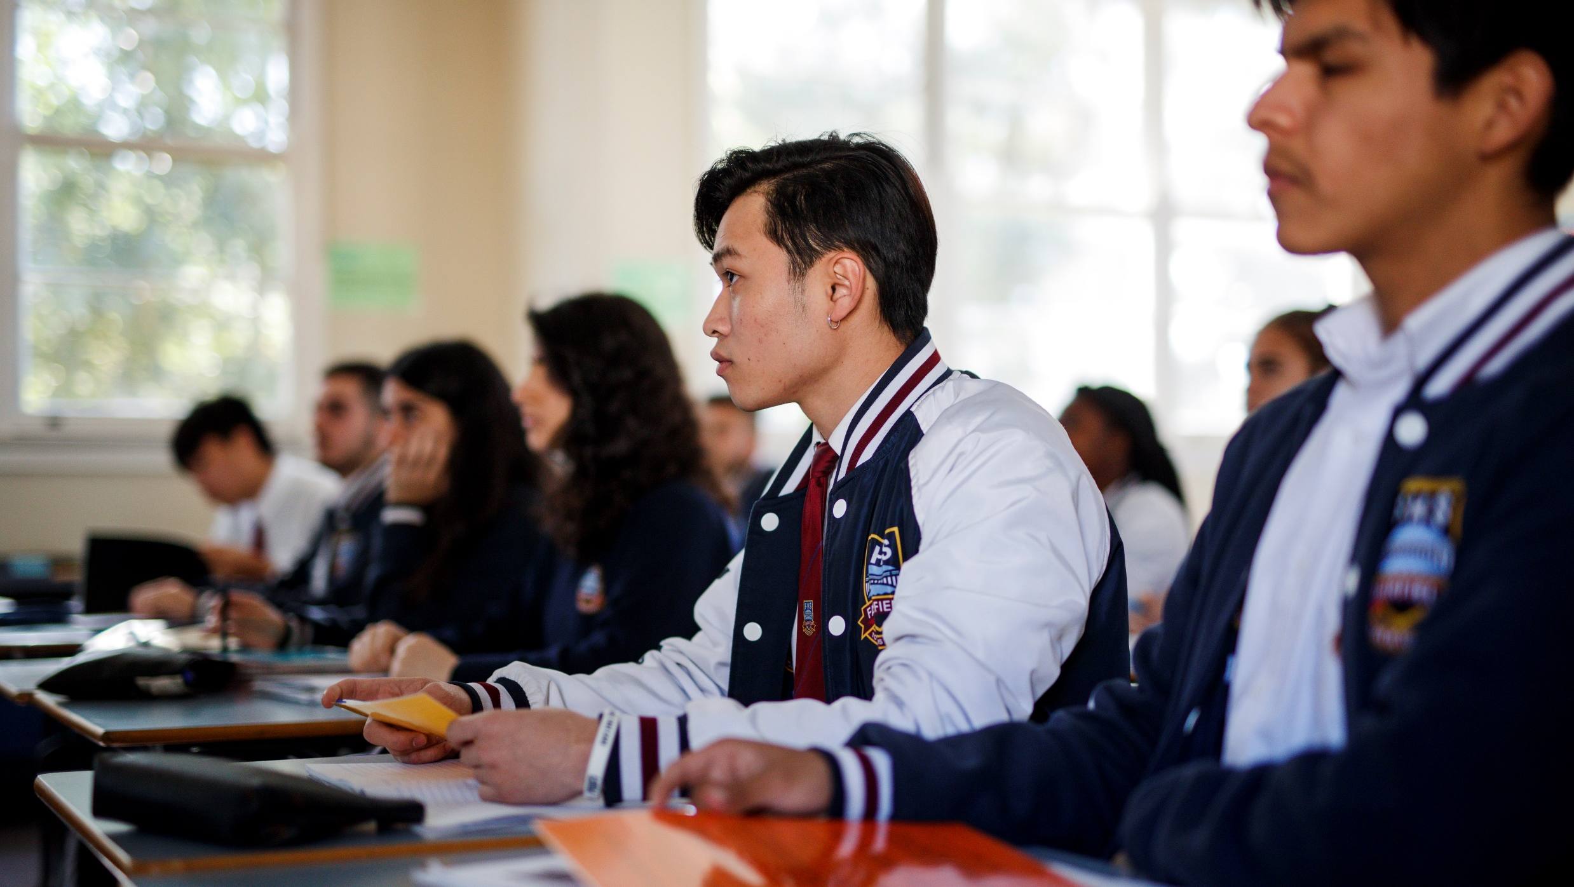
Why are 3D prints important?

Slide 5
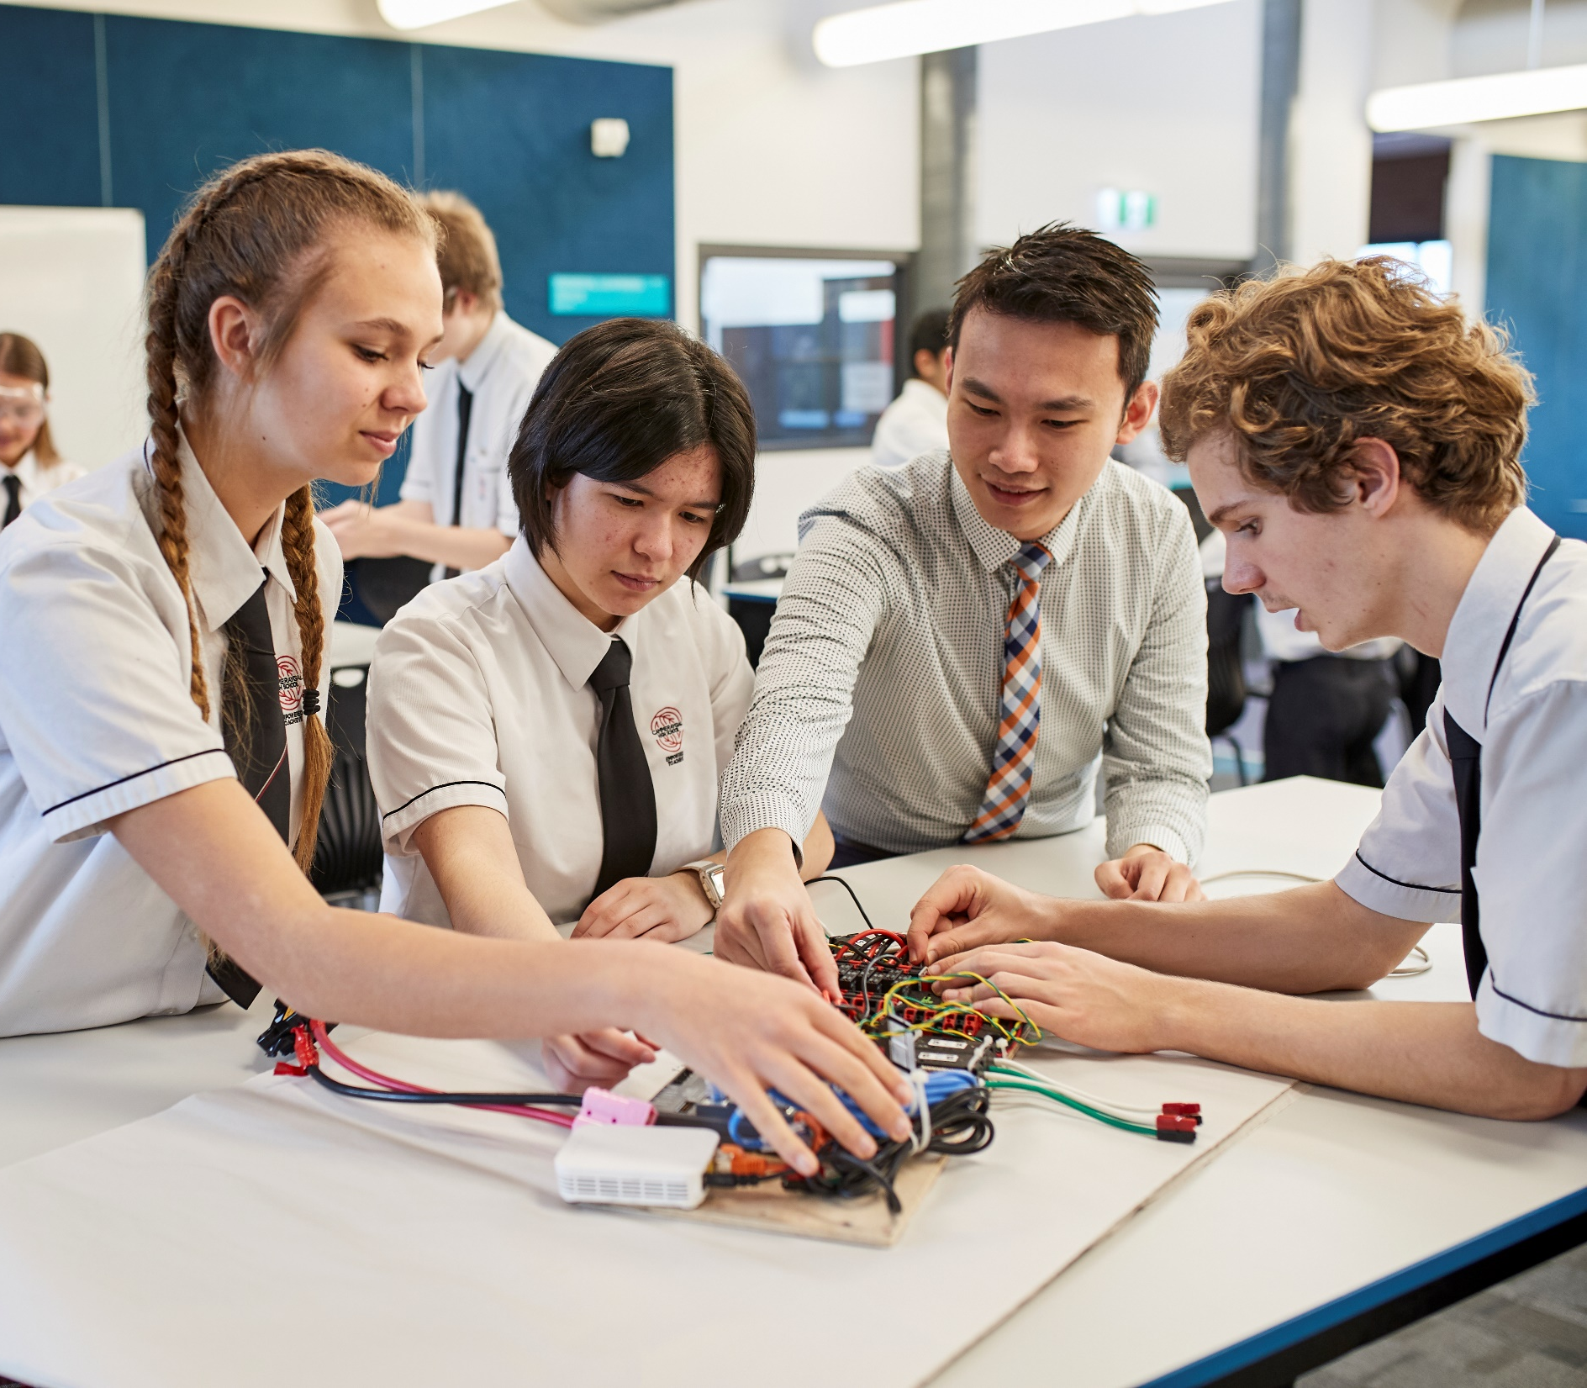
Visual cues
“80 to 85% of our perception, learning, cognition, and brain activity is stimulated and mediated through visual cues.”
Thomas Politzer
Neuro-Optometric Rehabilitation Association

Slide 6
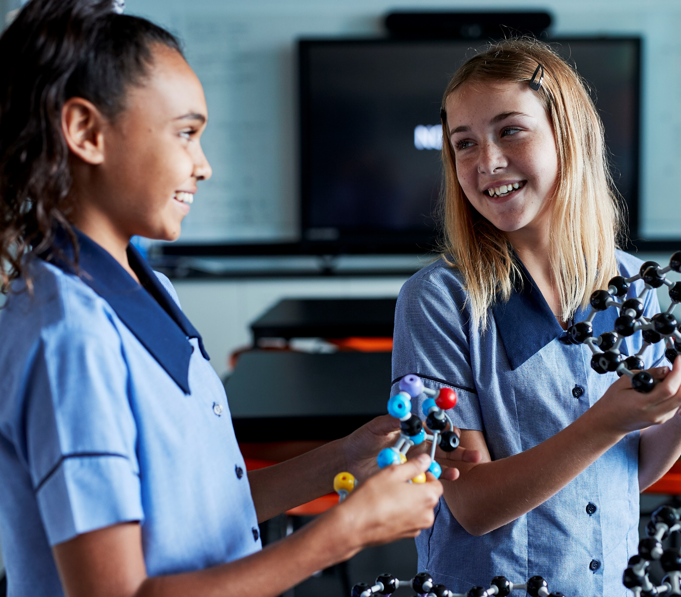
Cognitive load
“[BVI students] showed an improvement of memorisation and comprehension, as well as a decrease in perceived cognitive load when using multimodal resources.”
S. Erhel and E. Jamet
Improvement of Space and Text Memorization in Visually Impaired Students

Slide 7
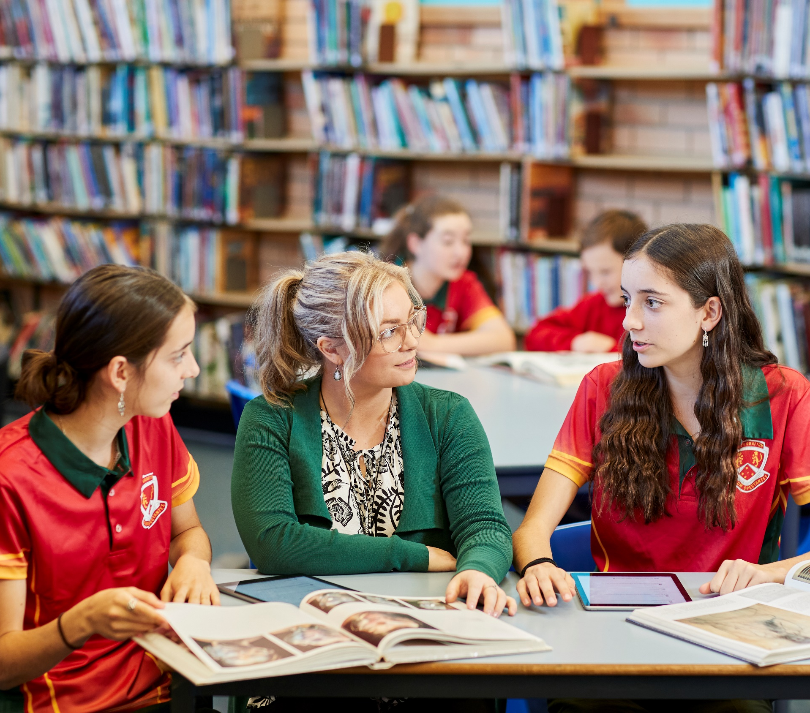
Three functions
“We initially conducted a formative study exploring the use of 3D printing at three locations serving populations of varying ability, including individuals with cognitive, motor, and visual impairments.
We found that 3D design and printing perform three functions in special education: (1) STEM engagement, (2) creation of educational aids for accessible curriculum content, and (3) making custom adaptive devices.”
E. Buehler et al
Investigating the Implications of 3D Printing in Special Education (2016)

Slide 8
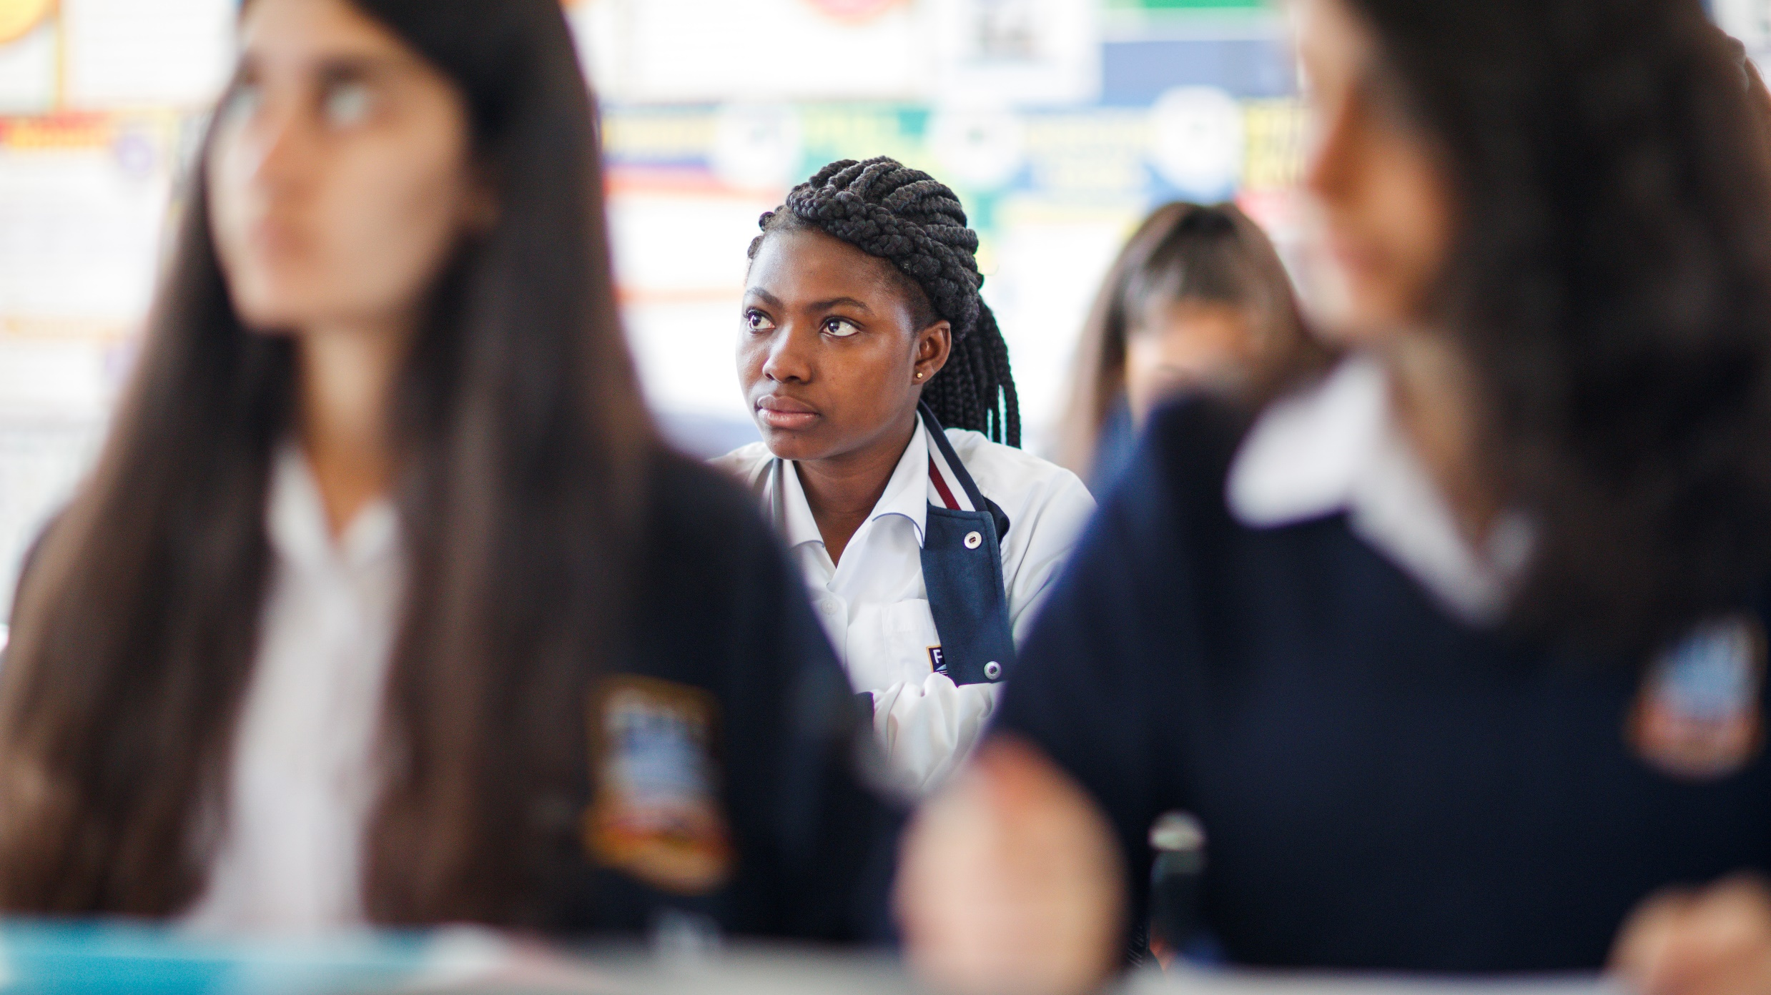
What can ISTVs borrow?

Slide 9
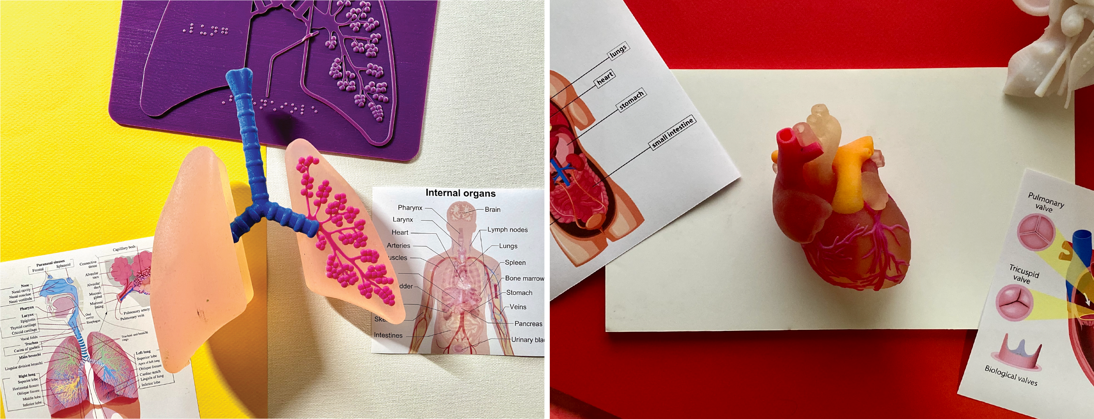
Anatomy 01

Slide 10
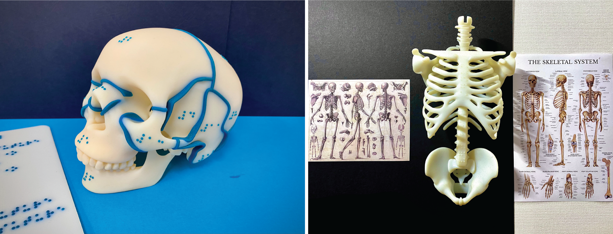
Anatomy 02

Slide 11
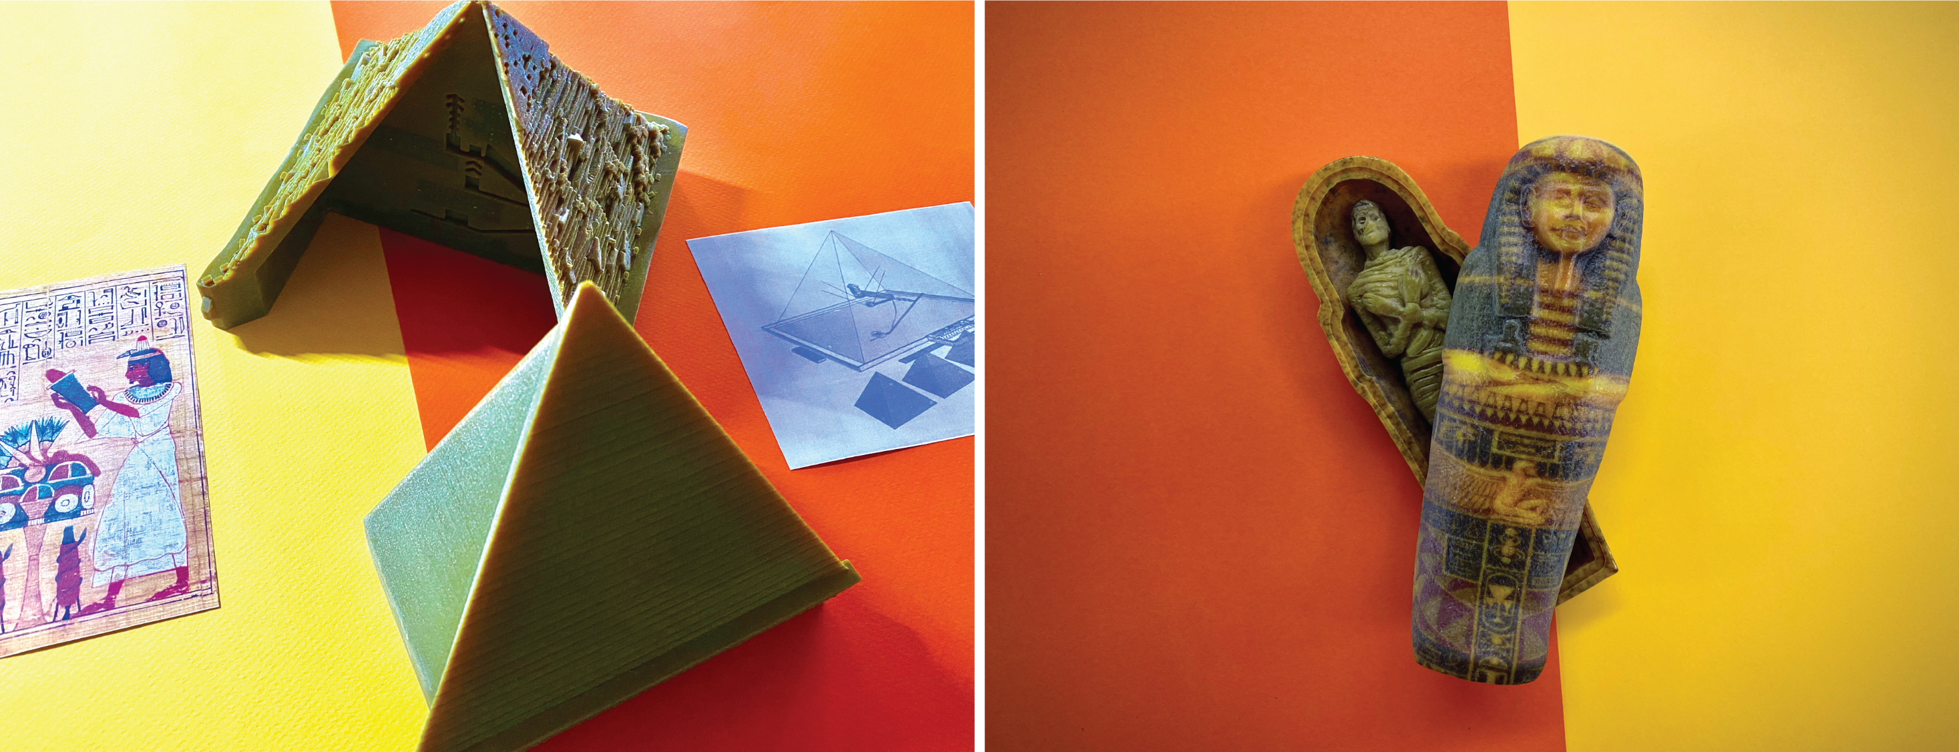
History 01

Slide 12
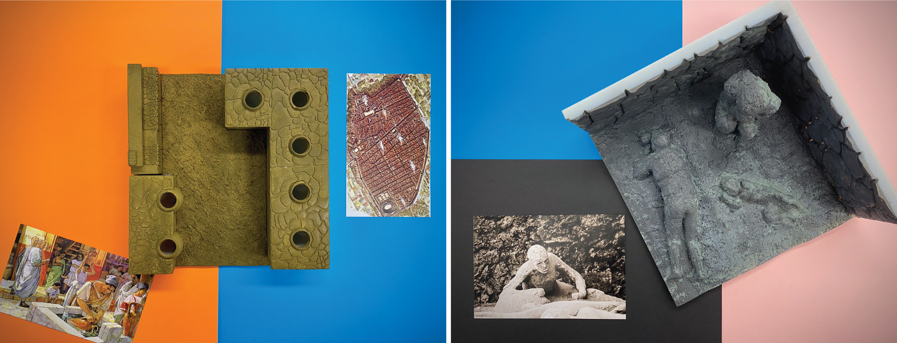
History 02

Slide 13
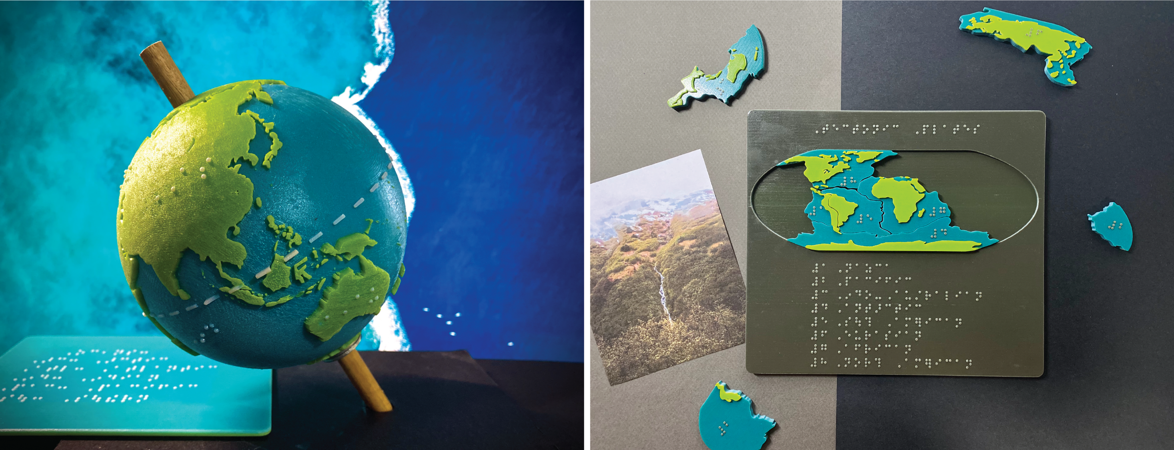
Geography 01

Slide 14
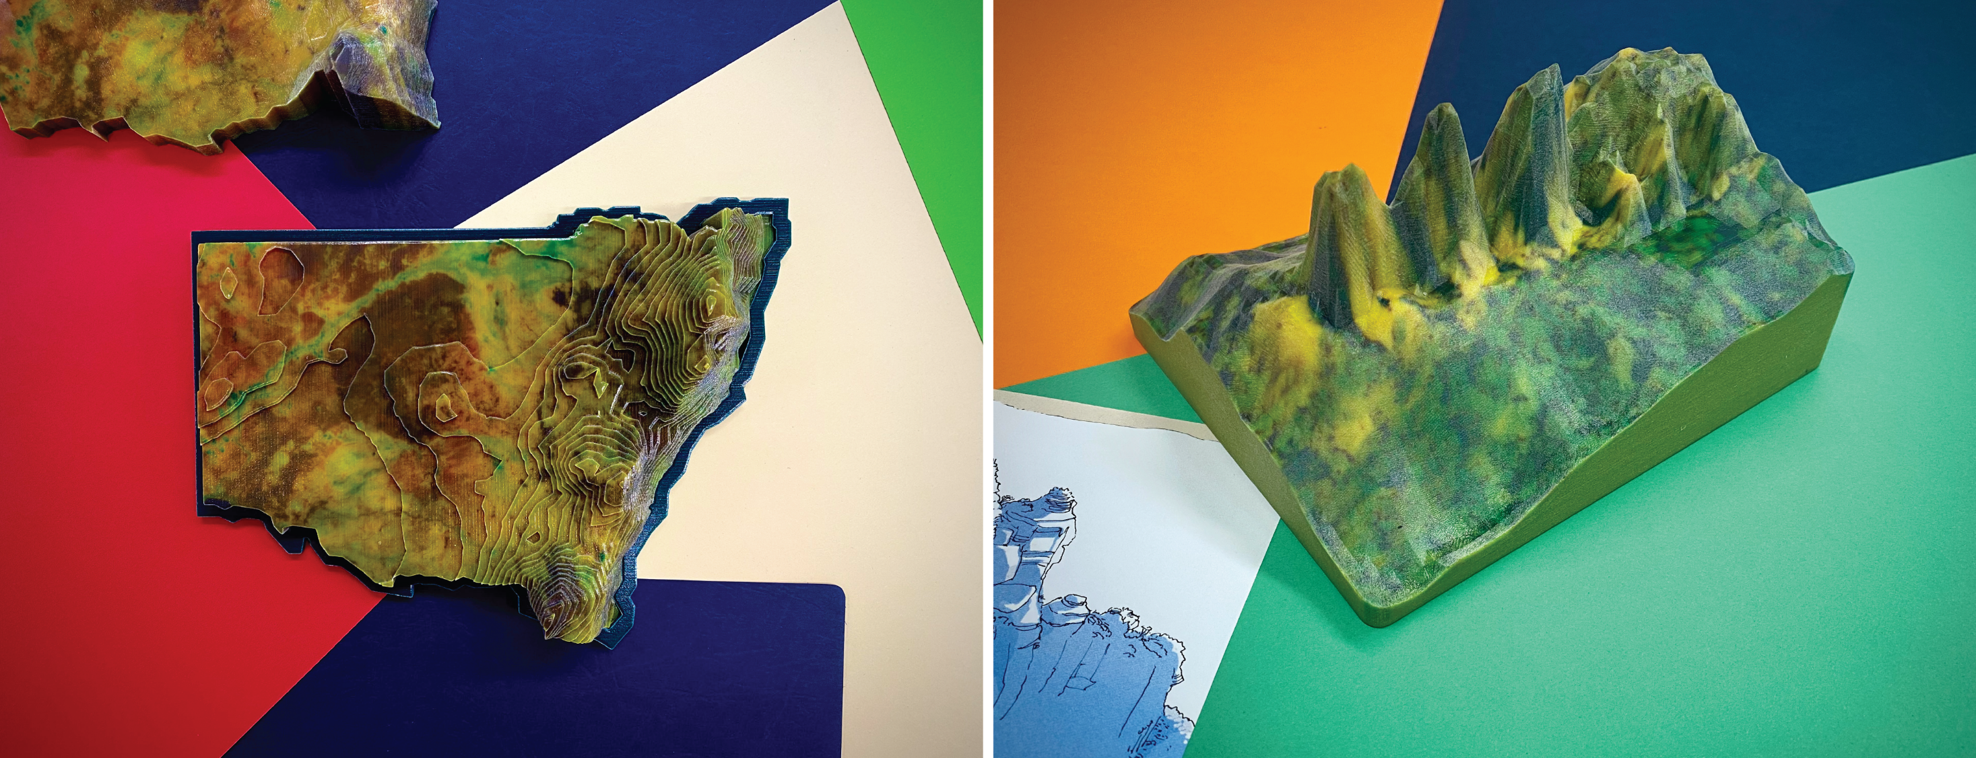
Geography 02

Slide 15
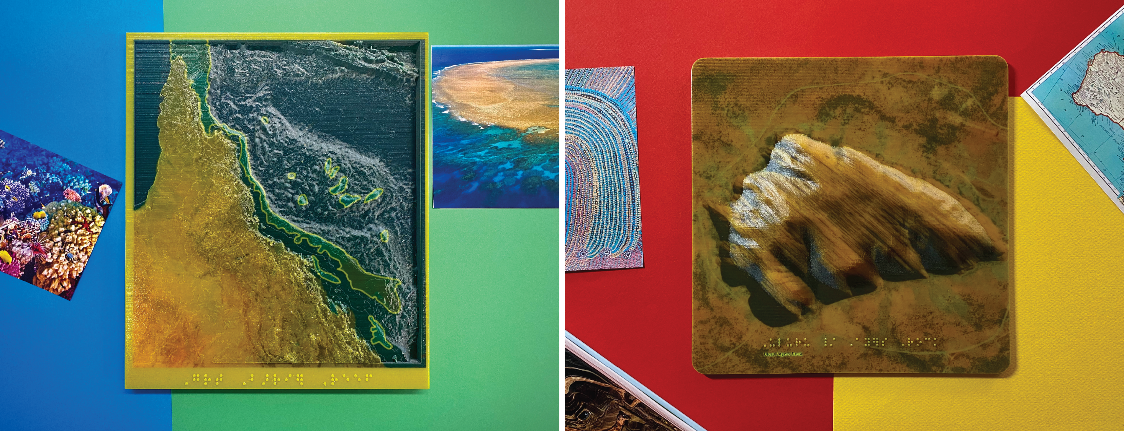
Geography 03

Slide 16
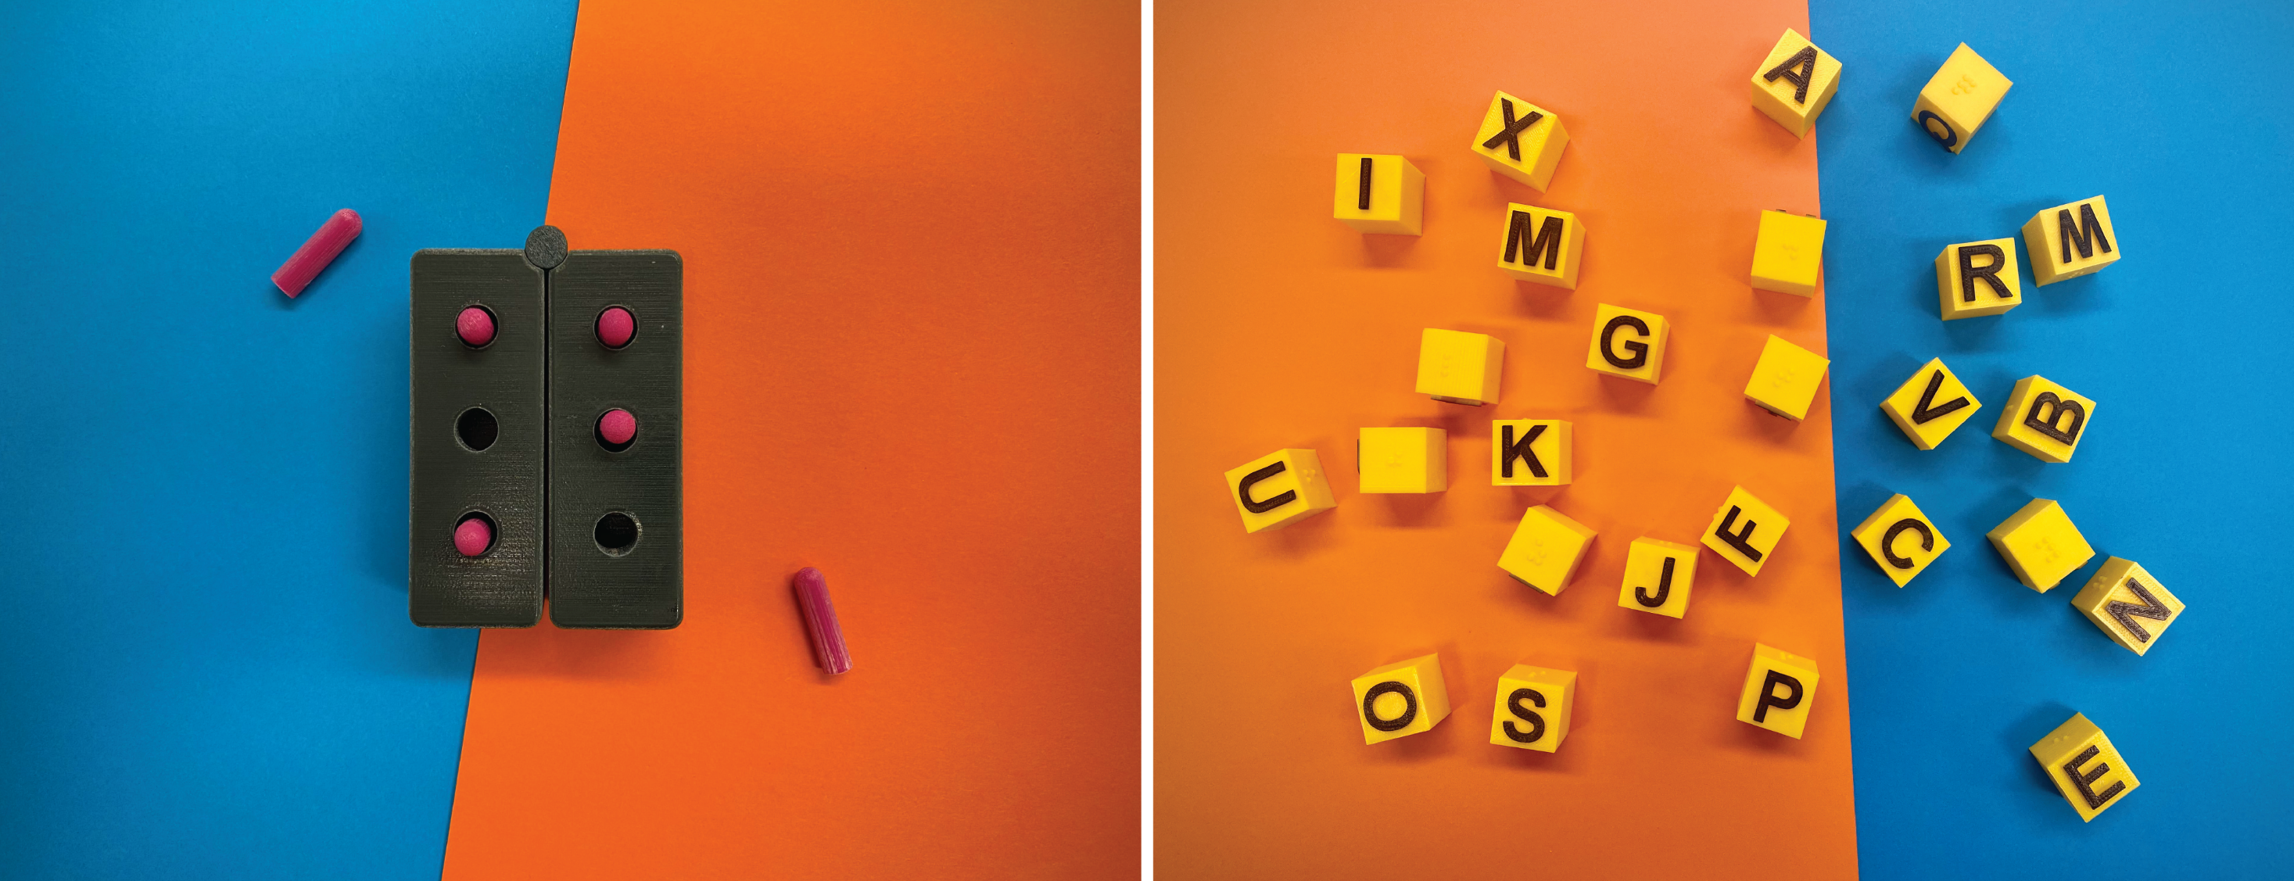
Teaching aids

Slide 17
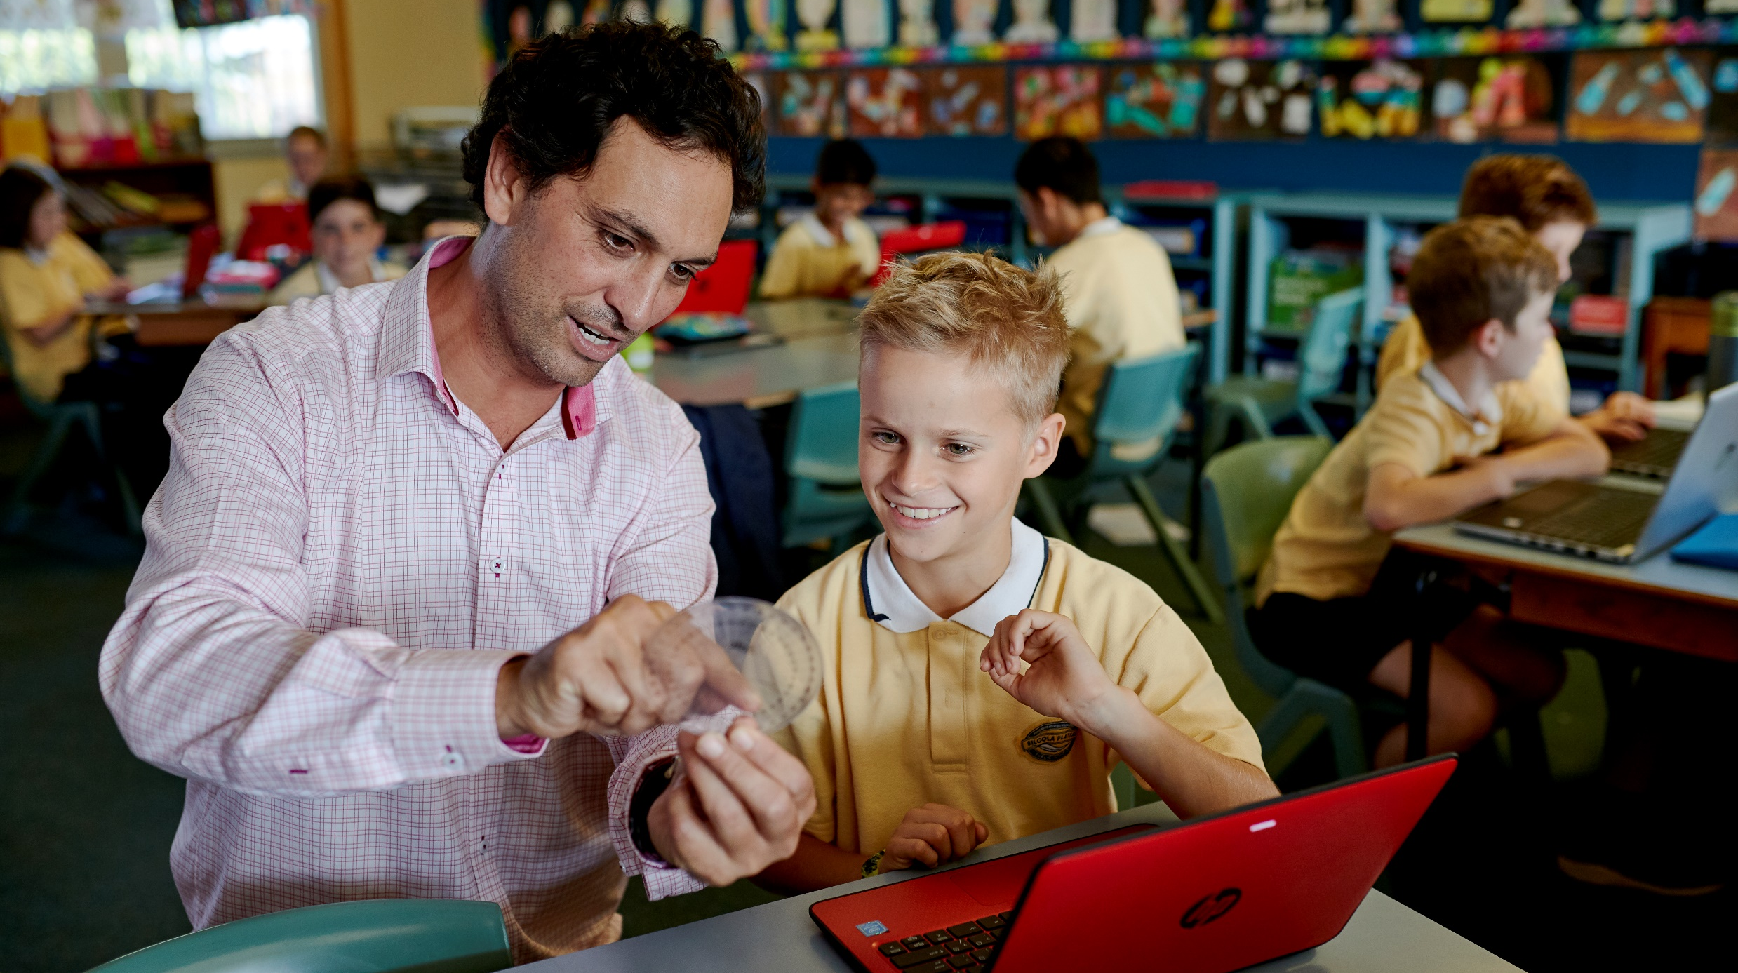
Teacher feedback

Slide 18
Feedback 01
My student didn’t want to return the globe!
The 3D prints made teaching anatomy so much easier.

Slide 19
Feedback 02
My student said he could make a clear picture in his mind.
The different textures and colours made learning really fun!

Slide 20
Feedback 03
My student loved that it could come apart and he could put it back together.
I’ve had students drop subjects in the past because the resources were difficult to use.

Slide 21
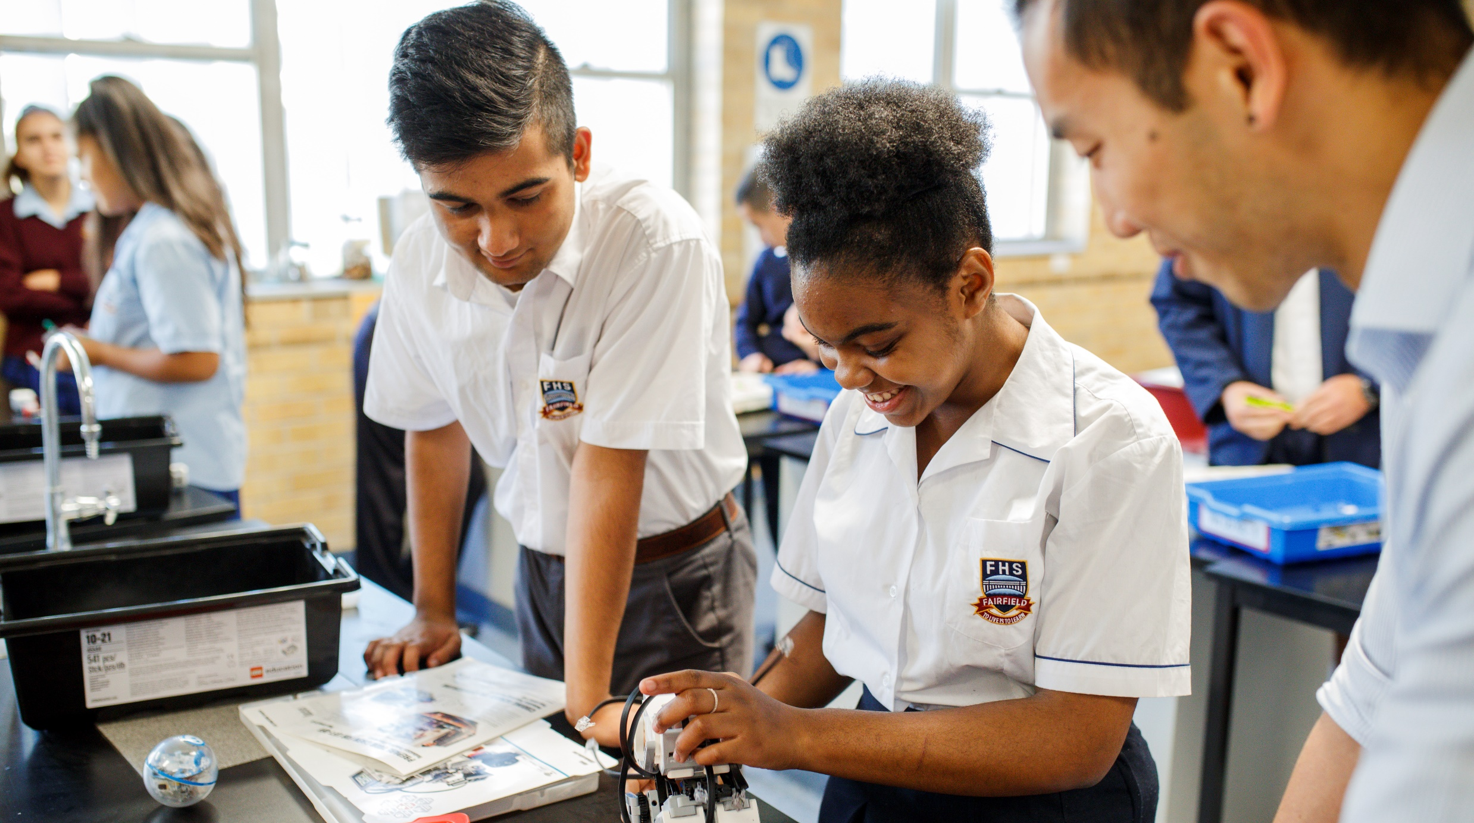
How to use 3D prints with BVI students

Slide 22
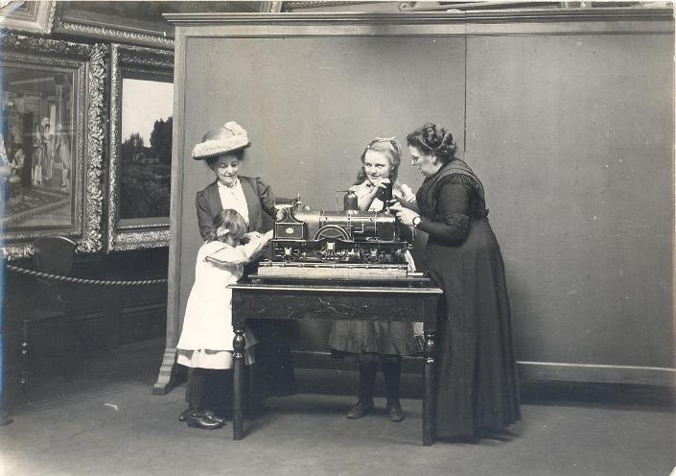
How to use 3D prints with BVI students 01
Don’t get your student to guess what the print is.
If your students needs a little more encouragement to tactually explore then a hand-under-hand or hand-over-hand method may be introduced. This is when you use your hands to guide your students’ hands.
Focus on the extremities of the print and exploring all the sections. Discuss the ends of the print, the edges, the sides, the surfaces, the corners and discuss this vocabulary, when investigating your prints.
Two blind students being shown a model locomotive.
Source: Tyne and Wear Archives and Museum

Slide 23
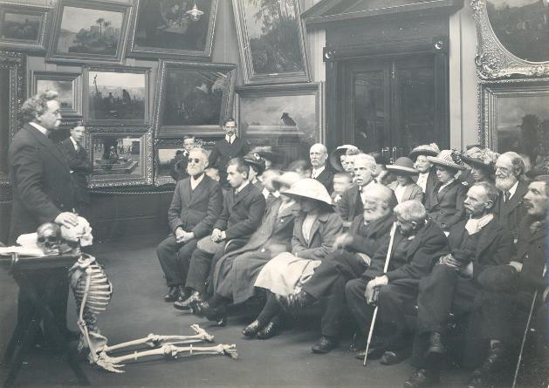
How to use 3D prints with BVI students 02
Focus on the size of the print. Discuss and show the student the three dimensional components of height, length, width or depth, of the print.
Use precise positional terminology during instruction.
Discuss the Braille labels that can be located on the print.
Encourage your student to move their hands over the entire print. Seek out the different textures embedded within the print and discuss their meaning.
Encourage the student to manipulate and move the print. Some prints contain many parts, while others have hidden internal sections.
Blind adults listening to a short lecture before
examining a human skeleton, 1913.
Source: Tyne and Wear Archives and Museum

Slide 24
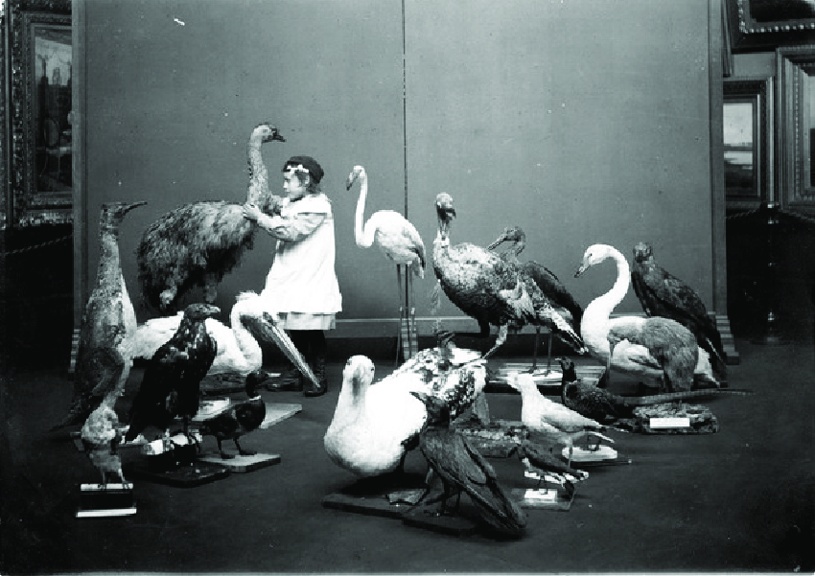
How to use 3D prints with BVI students 03
Continually take advantage of opportunities in the environment and in the classroom to look at how things that don’t seem alike really do have similarities. Also you might like to discuss with your student the differences between the print and real object.
Assist the student to connect the shape of the new print to prior knowledge of known shapes.
Give your student plenty of time to explore.
A blind girl examining mounted birds.
Source: Tyne and Wear Archives and Museum

Slide 25
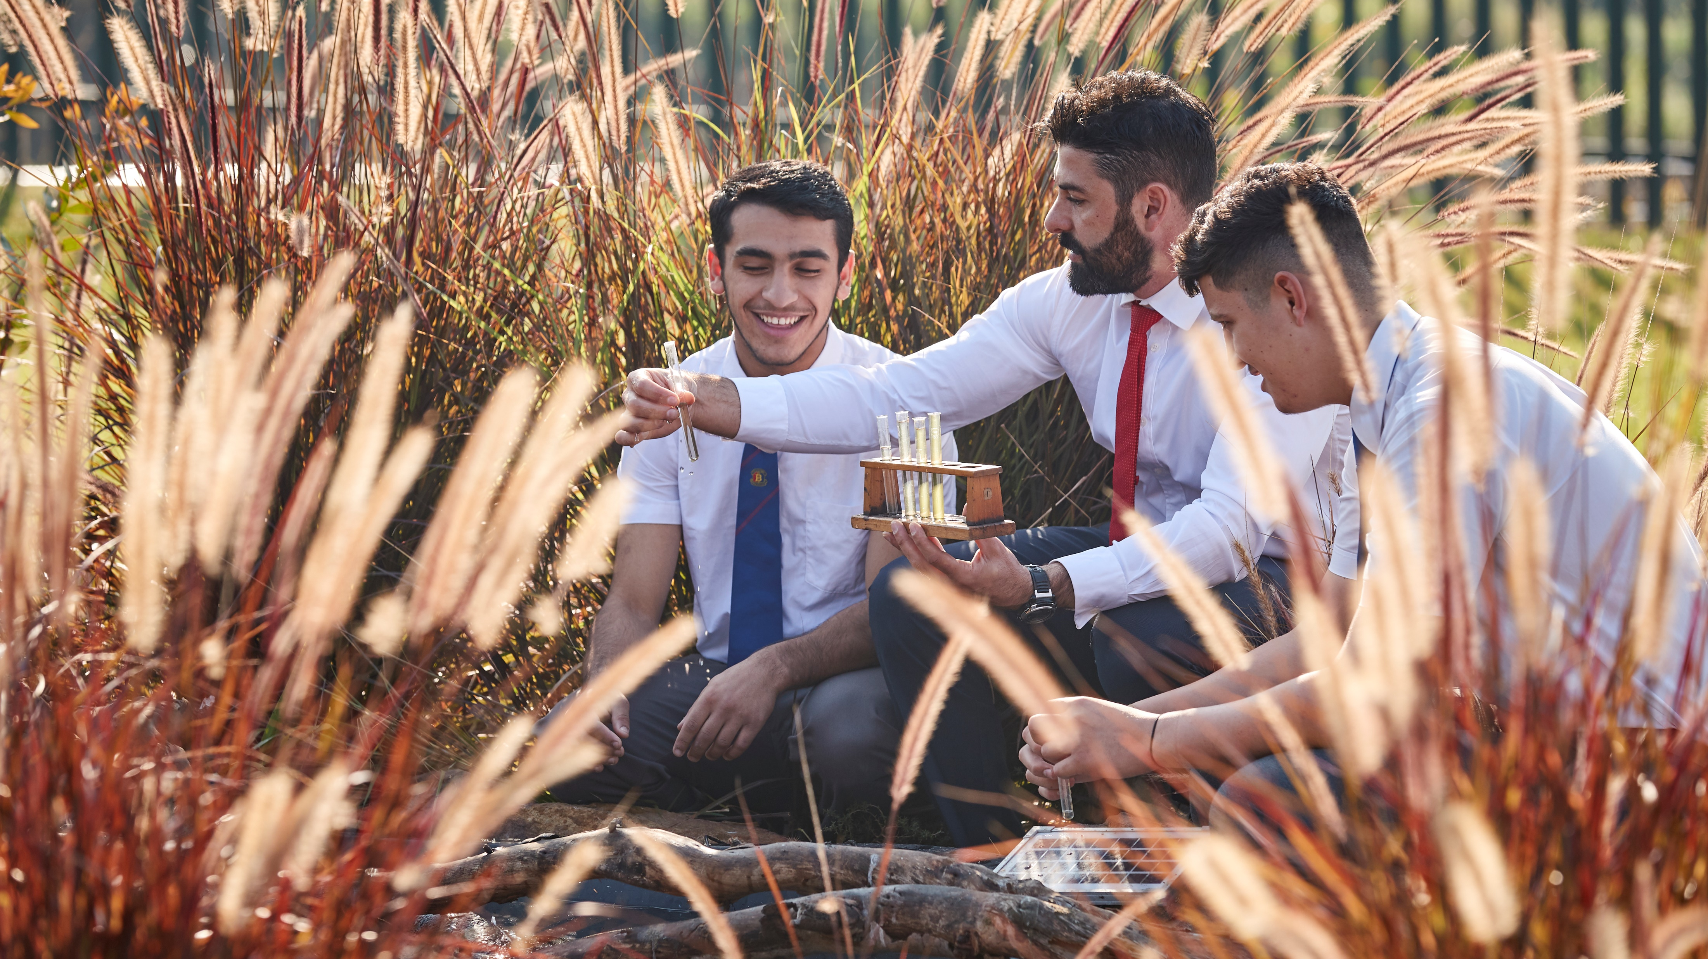
How to order?

Slide 26
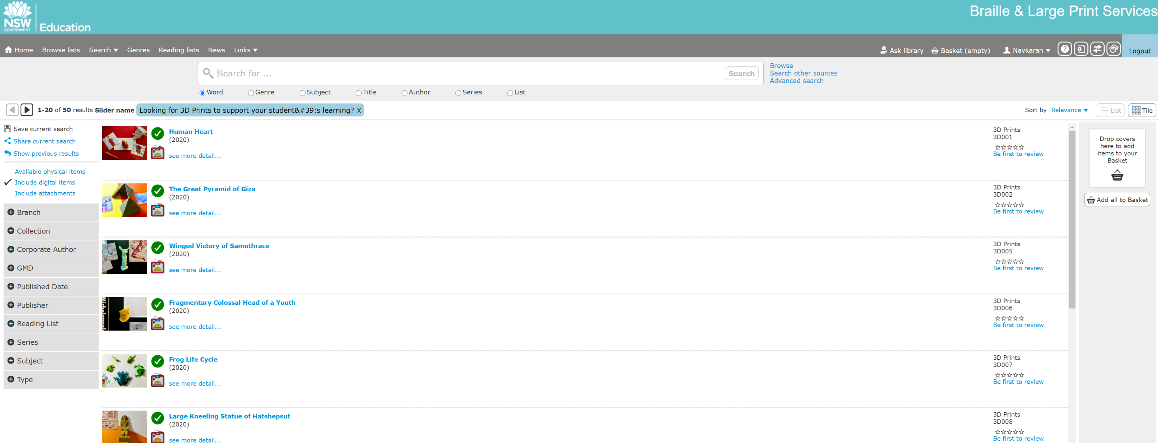
Oliver

Slide 27
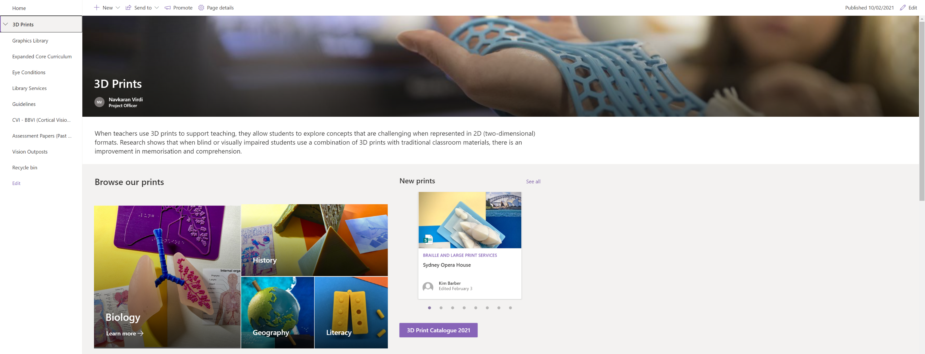
SharePoint

Slide 28
Contact

Slide 29
Contact
Navkaran Virdi (Nav)
NSW Department of Education
Braille and Large Print Services
navkaran.virdi@det.nsw.edu.au
(02) 8837 5003

