Slide 1
UV Printing:
the future of Tactile graphics
Peter Le
Email: peter.le@visionaustralia.org
Round Table 2021
Information Access – Innovation and Collaboration

Slide 2
Who am I?
Team Leader of Transcriptions at Vision Australia
Over 22 years working with print accessibility
Background in Biology and Organic Chemistry
Experienced in programming, graphic design and adaptive technology
Fluent in using and producing Braille, can read by touch and by sight
Has been apart of many RoundTable production workgroups
Plays the Panflute and Harp

Slide 3
Overview
What is UV Printing?
How It Works
The Electromagnetic Spectrum
What Can a UV Printer Print On?
The Benefits of a UV LED Printing Machine
Pros and Cons
Layering of images
Types of UV printers
VA Transcription testing and progress

Slide 4
What is UV Printing?
UV printing is a form of digital printing that uses ultra-violet lights to dry or cure ink as it is printed. As the printer distributes ink on the surface of a material (called a "substrate"), specially designed UV lights follow close behind, curing - or drying - the ink instantly. Originally developed for quickly drying gel nail polishes during manicures, ultraviolet light applications quickly expanded into industrial and commercial markets. Because the UV lights cure any printed ink immediately, the dots of wet ink do not get a chance to spread out once printed, resulting in much finer detail. In addition, UV cured inks are weather-resistant and offer increased resistance to fading. This curing process is more environmentally friendly as it produces few VOC’s, odor, and heat.
https://www.displays2go.com/Article/UV-Flatbed-Printing-53

Slide 5
How It Works
UV curing involves a photo-chemical reaction which converts a liquid or semi-liquid organic compound to a hard plastic-like polymer. The heart of this reaction is a special compound, known as a "photoinitiator", which absorbs light and then uses the absorbed light energy to initiate and propagate the curing reaction.
Other printing processes requires heat to vaporise water or solvents. UV curing involves a total conversion of liquid material to a solid state.
The UV curing process is very fast, usually completed in fractions of a second. This means reduced space requirements. Racking or secondary drying operations are eliminated with UV curing.
Any UV curing process requires a UV light source and a specially design formulation for the UV curing process. Both the light source and the UV curable material are normally designed for each specific application.

Slide 6
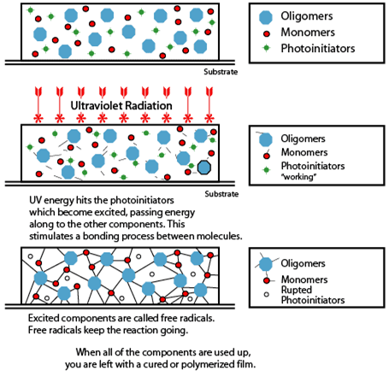
UV ink curing
http://www.bul.com.hk/bul/en/technologies/uv_curing

Slide 7
Another image of UV Curing
http://www.brancher.com/-Sechage,41-.html?lang=en

Slide 8
The Electromagnetic Spectrum
UV lamps emit in different UV ranges in order to have maximum drying efficiency.
UV-C (200-280 nm) activate the photoinitiators and assure surface drying.
UV-B (280-315 nm) maintain the polymerisation reaction.
UV-A (315-380 nm) assure in-depth drying.
http://www.brancher.com/-Sechage,41-.html?lang=en

Slide 9
What Can a UV Printer Print On?
Any non absorbent surface.
Plastics, glass, metal, wood, fabric, paper … the list is endless
The main issue is how long will it adhere to the material?
Primers can be used to improve how well the UV print can adhere to material
Gloss ink adheres best as the UV light can penetrate further into the ink

Slide 10
The Benefits of a UV LED Printing Machine
UV printing offers a new way of tactile production
Faster than 3D printing
Roland UV printer has flexible ink
It’s a clean and precise finish
Long lasting and durable
Full colour print
Can be printed on most objects and materials
Quality printing
UV printing is considered a green technology, safe for the environment and leaving an almost zero carbon footprint.
UV inks dry on contact, they never smudge.

Slide 11
Pros and Cons
Pro
Can print on most surfaces
Great for fabricating already made items
Mass production of small units
Can print white or over print mistakes
No guess work, will always print the same quality
Photo quality colour printing
Cons
    Slower than swell paper
    Not a standard office product
    Niche area – specific support
    Cost of Machine

Slide 12
Types of UV printers
Large Format UV Printers
Flat Bed UV Printer
UV 3D printer
UV Resin 3D printer
UV Printer Cutters

Slide 13
Layering of images
To make UV printing effecting, we use it like a 3D.
By printing multiple levels.
Gloss works best for building layers
All colours work, at varying heights.
Using multiple print heads
Print order matters

Slide 14
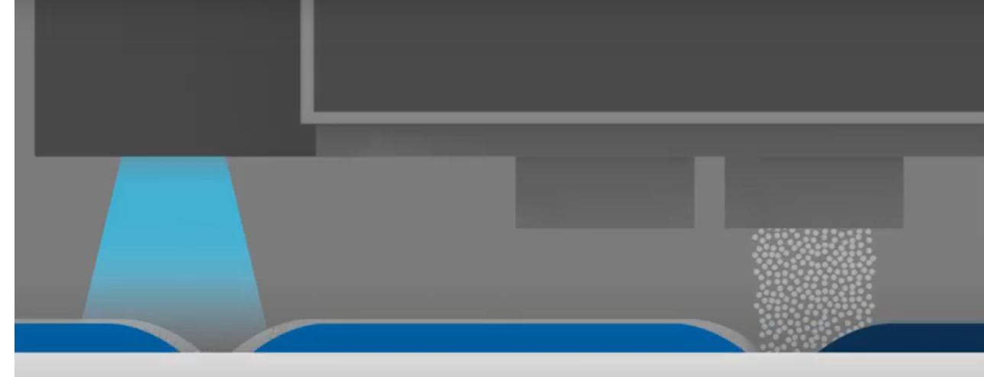
Layering of images – example
Source https://gjs.co/courses/e30/understanding-uv-printing

Slide 15
VA Transcription testing and progress
Where to start?
What materials to try first?
Colour test
Gloss test
Layered test
Lines and textures
Layering of images
Transparency

Slide 16
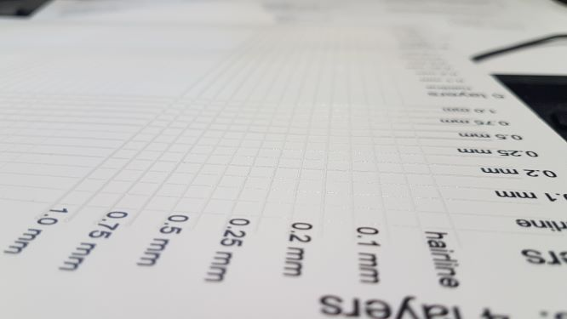
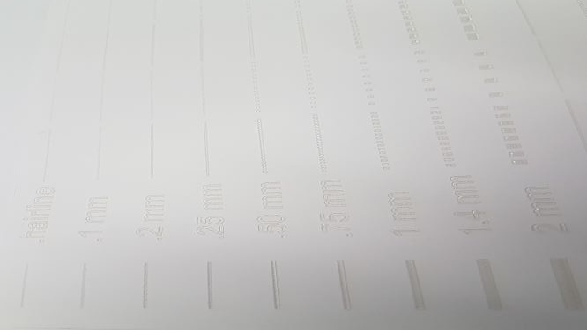
Lines, how do they work
Line thickness: Solid lines and line patterns

Slide 17
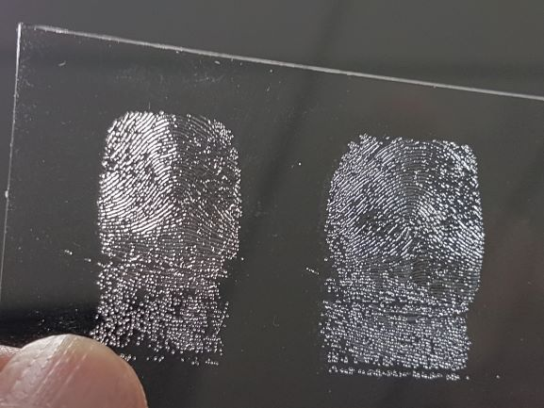
Finger prints – line quality

Slide 18
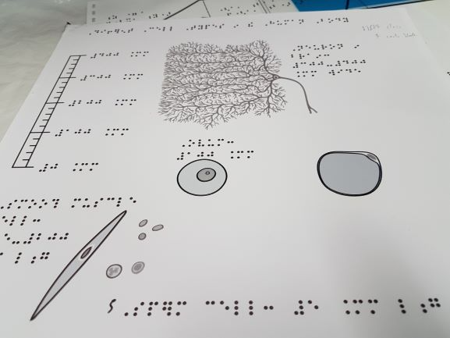
Swell paper cross over

Slide 19
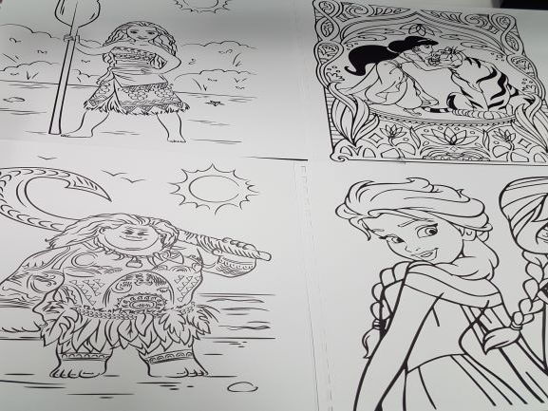
Tactile colouring pictures

Slide 20
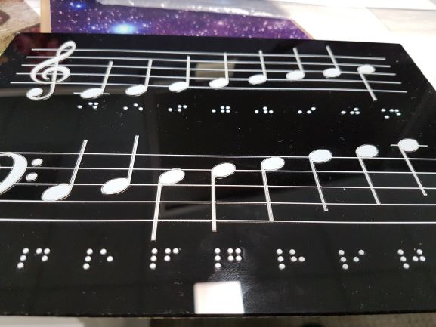
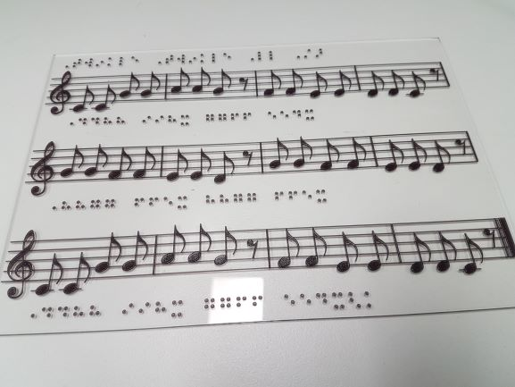
Braille Music – using different line thickness to build layers

Slide 21
Floor plan section – using 3 layers to create a multilevel map

Slide 22
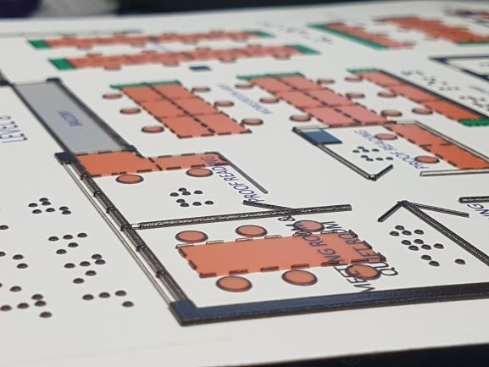
Floor Plan – final print

Slide 23
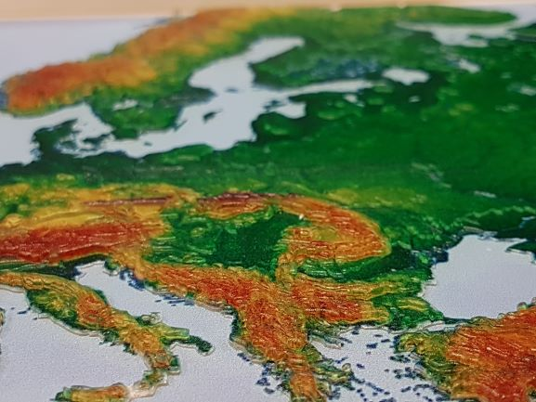
Europe typographical map –
7 layers

Slide 24
Australia – 3 level map

Slide 25
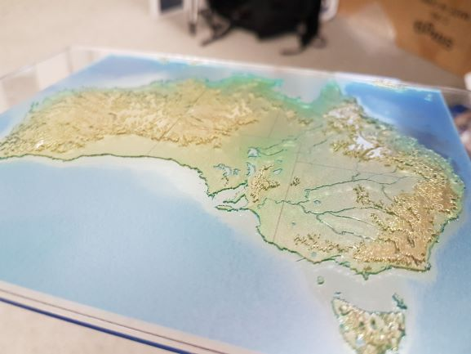
Australia printed map

Slide 26
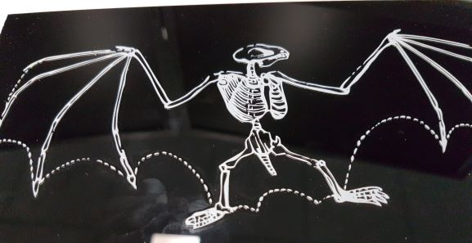
Bat skeleton – white gloss print

Slide 27
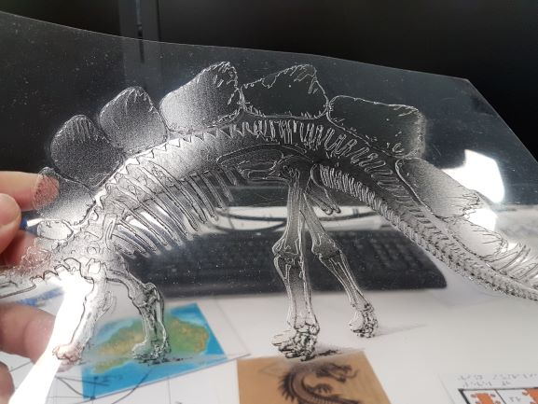
Stegosaurus

Slide 28
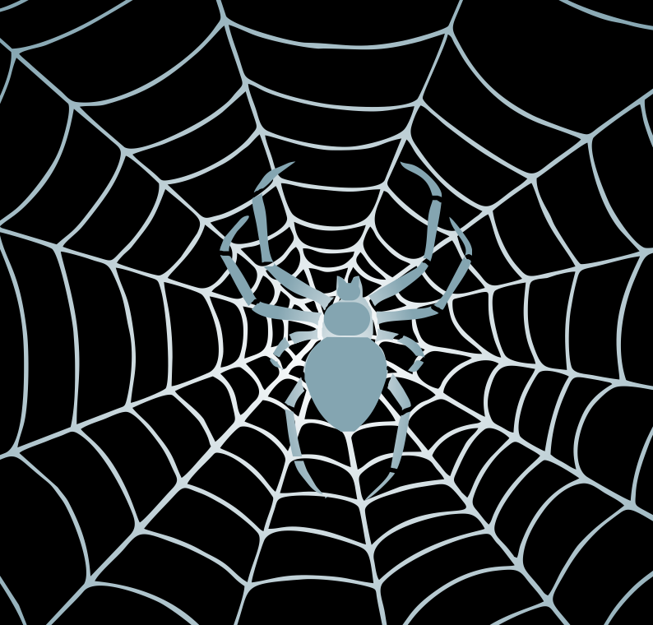
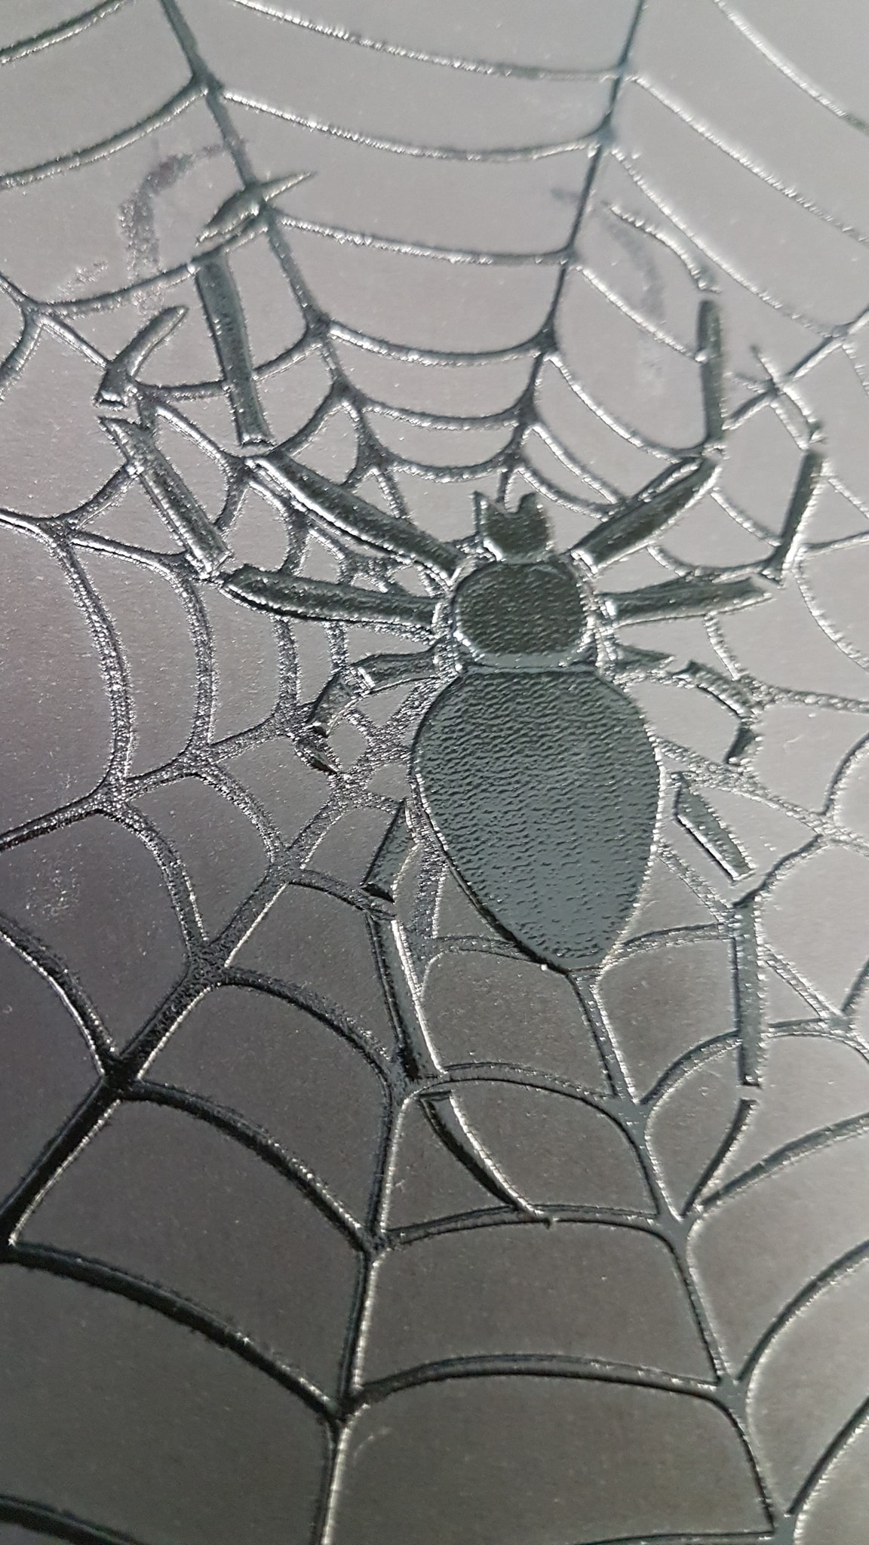
Spider – using transparency
How to have one print and still create a layered image

Slide 29
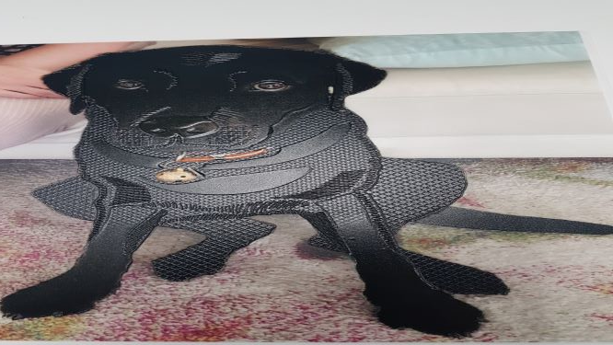
Ember – 4 layers

Slide 30
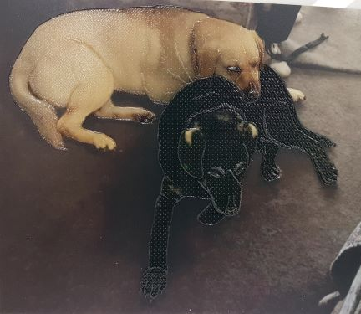
Vadrik and Rob – work of art

Slide 31
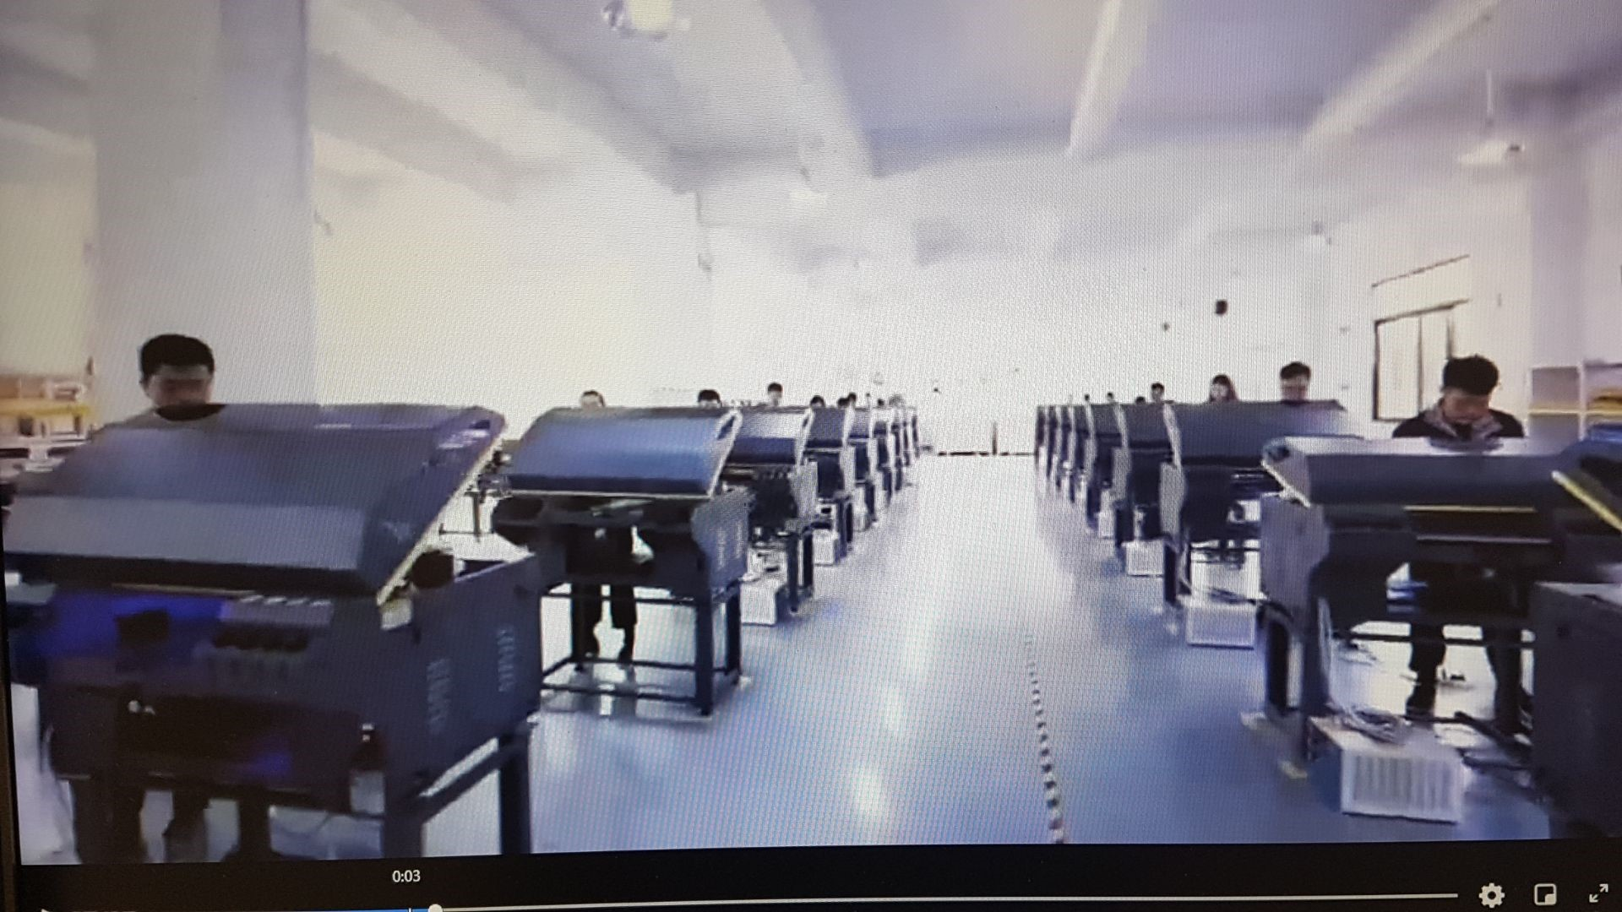
Dreams
Chinese Factory of UV printers

Slide 32
Thank you
Any questions?
Peter Le
Email: peter.le@visionaustralia.org
We offer free transcription to Clients of Vision Australia under our Personal Support service which is a free service that is funded by the Federal Government's Print Disability Grant. This service is for personal use.
For more information on accessible format conversions,
email: printaccess@visionaustralia.org
or call 1300 84 74 66
Notes:
Does anyone have any questions?

