Slide 1
BindiMaps: Wayfinding for Everyone, Everwhere
2021 Round Table Conference

Slide 2
Presenter:
Dr Anna Wright
CEO and Co-Founder of BindiMaps
E: anna@bindimaps.com
M: +61 412 006 427
Notes:
My name is Anna Wright and I am the CEO and cofounder of BindiMaps. Around 20 years ago I was diagnosed with a rare retinal disease that should leave me completely blind. With assistive technology I knew that I would still be able to work, but how was I going to get to work? Thf there were Braille signs around, how was I going to find them? That started my mission that lead to BindiMaps – a smart phone wayfinding app that helps anyone navigate anywhere, indoors or outdoors.

Slide 3
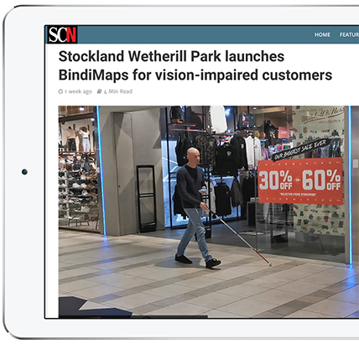
Accessibility & Inclusion
18%
of Australians are living with a disability
of Australians are living with a mental or behavioural disorder
22%
3%
of Australians have a vision impairment
Notes:
So the statistics on disability in Australia will be no surpise to any of us here today

Slide 4
So why BindiMaps?
BindiMaps provides safe, independent navigation and contextual information for both indoors and outdoors.
BindiMaps is a tool which is completely accessible to people of all abilities.
Notes:
So where does BindiMaps fit in? BindiMaps is a smart phone app that will let anyone navigate any environment safely and independently. We fisrt built the app for people living with low vision or blindness, and now have moved on to those needing wheelchair accessible routing, autism spectrum routing as well as routing for those who do not have a disability. Im sure that there are many people here at this conference who have had the frustration of trying to find the only gate that is wheel chair accessible in a large stadium, or trying to find a staff member to help you. Or trying to understand an exhibition where there is no Braille signage or audio guides.

Slide 5
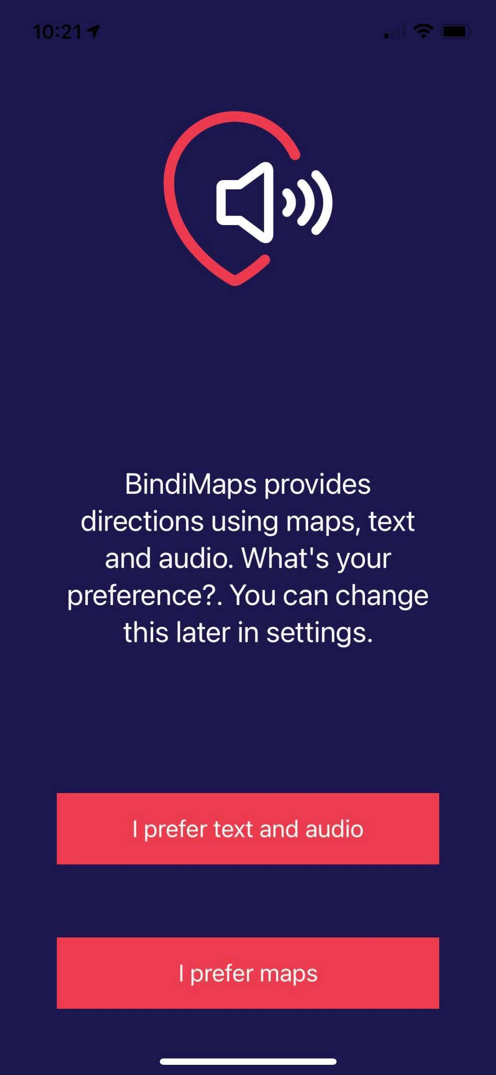
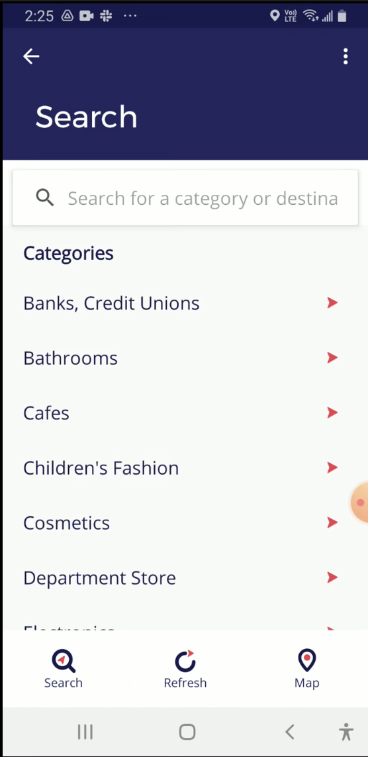
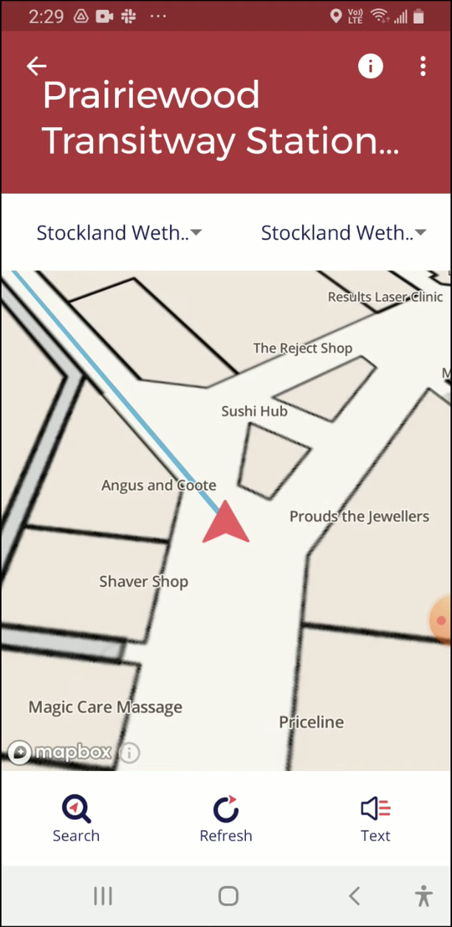
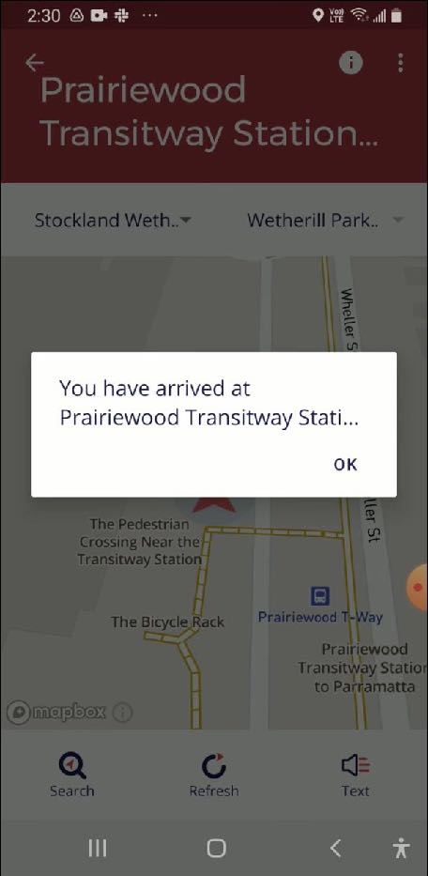
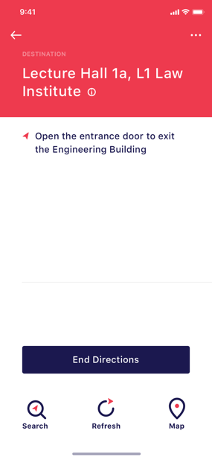
How BindiMaps works
Preference
Destination
Directions
Arrival
Pick whether you want to receive text and audio guidance, or visual guidance
User selects destination: Category or individual room
BindiMaps provides step-by-step directions
User arrives at destination
Notes:
BindiMaps works just like any other outdoor mapping app that you would be familiar with, except that it works in doors as well

Slide 6
Other Important Features
Hazard Alerts
We warn users about stairs, obstacles or other hazards
Drop a pin
Allows users to drop a pin and save favourite locations like stores, entrances and where they parked their car.
“About this location”
Gives users useful information about a particular destination
Emergency evacuations
In emergencies, BindiMaps guides users to the nearest emergency exit, then on to the designated emergency evacuation point
Share a location (BindiLinks)
Locations can be shared with other people or apps
Pick your preference
BindiMaps users are able to set their preference on whether they prefer auditory or visual guidance.
Notes:
.We have lots of other features, such as contextual information, especially important if you are blind, and are trying to enjoy an exhibition or other venue that has predominatly visual signage

Slide 7
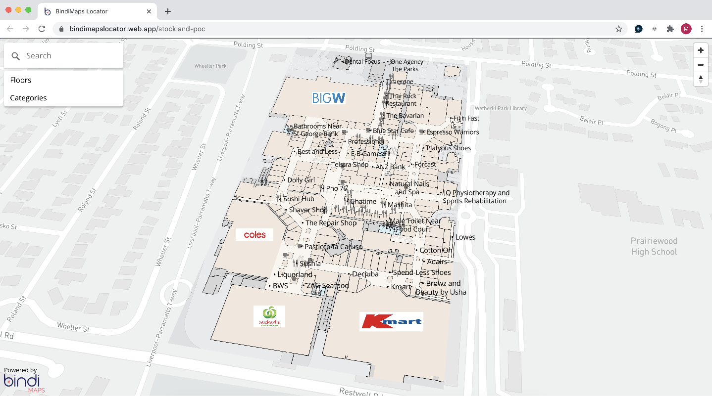
The BindiWeb
Notes:
As well as our app solution, we can also provide interactive maps as a simple link to a website – again, all completely accessible

Slide 8
The BindiLytics
Areas of high and low traffic flow
Destinations searched and reached
“Dwell times” and time spent in the building
Entrance and exit points
Searches (including dead searches)
Notes:
We collect highly annomonised data in the app, which is of great value to building owners – we creat heat maps of travel paths, as well as recording all search made in a venue

Slide 9
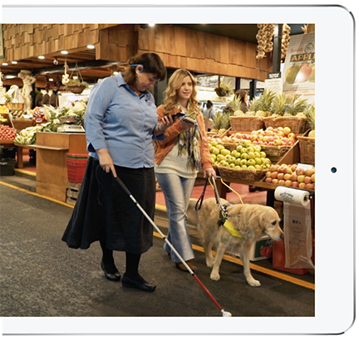
BindiMaps Benefits
Customer Experience
Customers are likely to spend
more if offered a positive experience
140%
1
(Deloitte)
Offering a high-quality customer experience can lower the cost of serving a customer by
2
33%
(Deloitte)
of customers who say they had a great experience will make another purchase from the company.
87%
3
(Qualtrics XM Institute)
(Qualtrics XM Institute)
Notes:
Installing BindiMaps in a venue will improve everyone’s customer experience, especially those customers with a disability. Bindi is short for Be independent, which is one thing that we all like to be, even when being a tourist – imagine knowing what the locals know in a strange place, and all through your smart phone

Slide 10
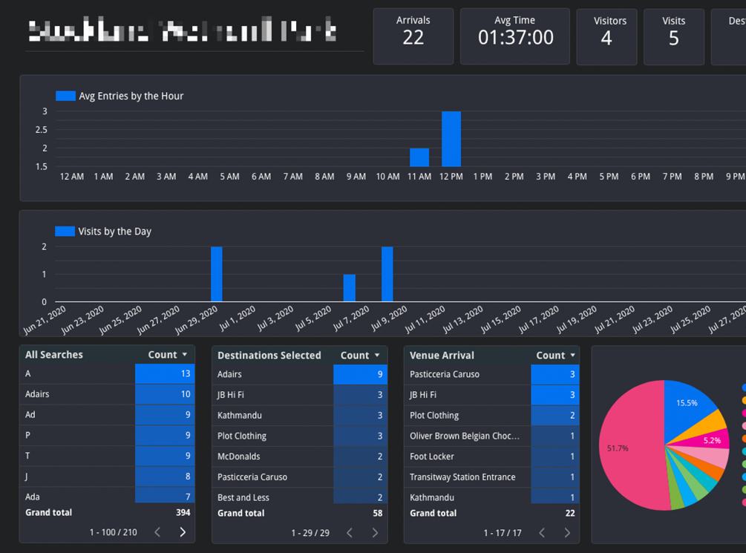
BindiMaps Benefits
Analytics Dashboard
1
Companies that use journey mapping tools reduce costs by
15-20%
(McKinsey & Co)
65%
of companies say improving their data analysis is very important to delivering a better customer experience
2
(Giorgina Gottlieb)
of marketers say they will be responsible for the end-to-end experience over the customer’s life
75%
3
(Deloitte)
(Giorgina Gottlieb)
(Deloitte)
Notes:
Data is always gold, and in the tourism setting as well. Data improves the offered customer experience, as well as reducing costs to the tourism organisation

Slide 11
ROI from BindiMaps
1
2
Accessible and Inclusive
Improved Customer Experience
3
Better Decision Making
Notes:
With BindiMaps, we can make your buildings accessible to everyone, improve your customers’ experience and provide a rich data base to you to make better decisions from

Slide 12
Our Clients
Notes:
Here are just a few of our clients – others in the tourism space include the National Library of Australia, and the Newcastle Museum

Slide 13
Making spaces accessible
Anna Wright
E: anna@bindimaps.com
M: +61 412 006 427
Notes:
We would love to hear from any tourism destination interested in opening up their spaces to accessible tourism. And we also welcome any feedback from users. So if you would like to discuss having your precinct or building bindimapped, or if you have feed back on the app, I would love to hear from you.

